Slide 1
Sexually Transmitted Infections
Surveillance 2023
Congenital Syphilis
Notes:
This slide set was prepared by the Division of STD Prevention, National Center for HIV, Viral Hepatitis, STD, and TB Prevention (NCHHSTP), Centers for Disease Control and Prevention (CDC). These slides display trends for STIs in the United States through 2023. Data presented include case notifications provided to CDC through the National Notifiable Diseases Surveillance System (NNDSS) and data collected through projects and programs that monitor STIs in various settings, including the STI Surveillance Network (SSuN).
For more information on data sources, data collection and reporting practices, and case definitions, please see the Technical Notes, available at https://www.cdc.gov/sti-statistics/annual/technical-notes.html.
All data points for figures presented in these slides are available at https://www.cdc.gov/sti-statistics/media/files/2024/11/2023-STI-Surveillance-Report-Data-Points.zip.
NOTE: This slide set is in the public domain. You may reproduce these slides without permission; however, citation as to source is appreciated.
Centers for Disease Control and Prevention. Sexually Transmitted Infections Surveillance 2023. Atlanta: U.S. Department of Health and Human Services; 2024.
You are also free to adapt and revise these slides; however, you must remove the CDC name and logo if changes are made.

Slide 2
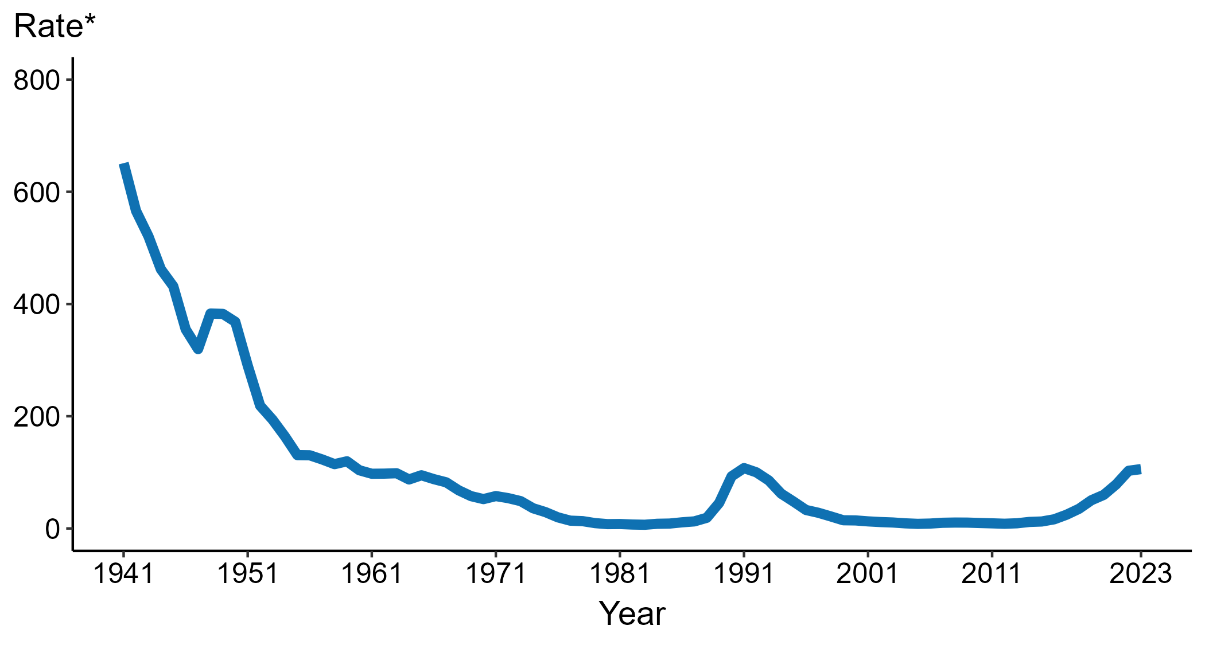
Congenital Syphilis — Rates of Reported Cases by Year of Birth, United States, 1941–2023
* Per 100,000 live births
Notes:
Data collection for congenital syphilis (CS) began in 1941, and CS was made a nationally notifiable condition in 1944. There was a significant change in the CS case definition in the 1990s and rates before versus after the case definition change should be interpreted with caution.
In 2023, there were a total of 3,882 cases of CS reported among states and the District of Columbia for a rate of 105.8 per 100,000 live births.
During 2022 to 2023, the rate of reported CS increased 2.9% (from 102.8 to 105.8 per 100,000 live births).
This report includes data from years that coincide with the COVID-19 pandemic, which introduced uncertainty and difficulty in interpreting STI surveillance data. See Impact of COVID-19 on STIs (https://www.cdc.gov/sti-statistics/about/impact-of-covid-19.html) for more information.
See Technical Notes (https://www.cdc.gov/sti-statistics/annual/technical-notes.html) for information on STI case reporting formats and practices, including collected and derived variables displayed in this report. Table A (https://www.cdc.gov/sti-statistics/data-vis/table-selected-percunknown.html) provides information on unknown, missing, or invalid values of select variables.
Data for all figures are available at https://www.cdc.gov/sti-statistics/media/files/2024/11/2023-STI-Surveillance-Report-Data-Points.zip. The file “CS - Rates by Year of Birth (US 1941-2023).xlsx” contains the data for the figure presented on this slide.

Slide 3
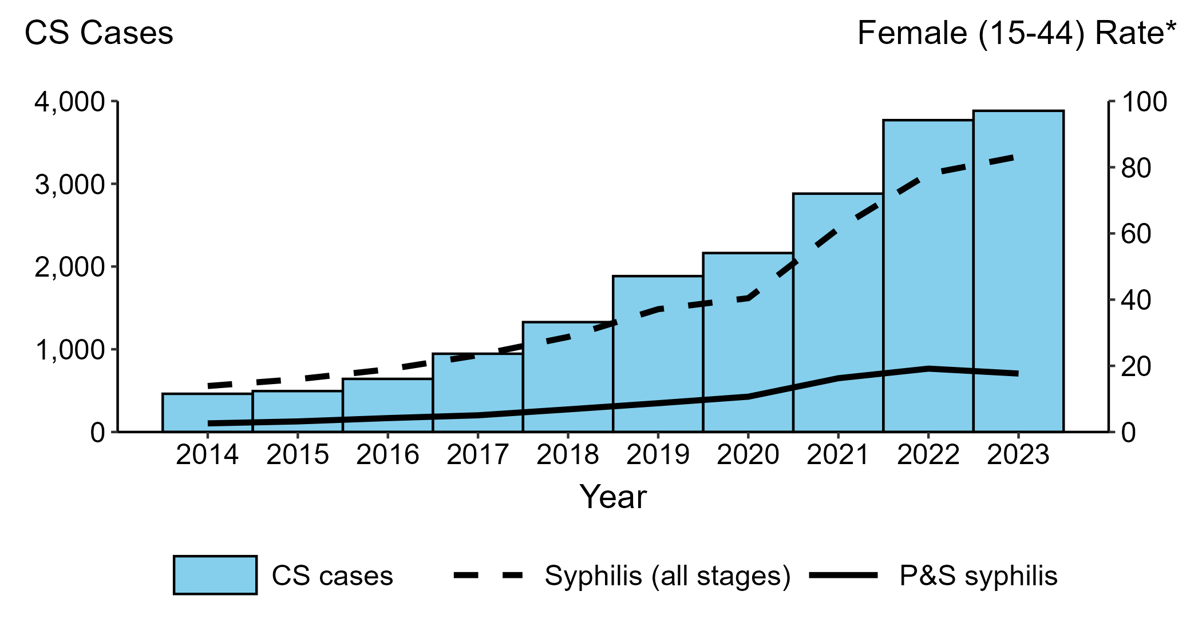
Congenital Syphilis — Reported Cases by Year of Birth and Rates of Reported Cases of Primary and Secondary Syphilis and Syphilis (All Stages) Among Women Aged 15–44 Years, United States, 2014–2023
* Per 100,000
ACRONYMS: CS = Congenital syphilis; P&S Syphilis = Primary and secondary syphilis
Notes:
In 2023, there were a total of 3,882 cases of congenital syphilis (CS) reported among states and the District of Columbia for a rate of 105.8 per 100,000 live births.
During 2022 to 2023, the number of cases of CS increased 3.0% (3,769 to 3,882 cases), concurrent with a 6.8% increase (78.0 to 83.3 per 100,000) in the rate of syphilis (all stages) among women aged 15 to 44 years and a 7.3% decrease (19.1 to 17.7 per 100,000) in the rate of primary and secondary (P&S) syphilis among women aged 15 to 44 years.
During 2014 to 2023, the number of cases of CS increased 740.3% (462 to 3,882 cases), concurrent with a 499.3% increase (13.9 to 83.3 per 100,000) in the rate of syphilis (all stages) among women aged 15 to 44 years and a 580.8% increase (2.6 to 17.7 per 100,000) in the rate of P&S syphilis among women aged 15 to 44 years.
This report includes data from years that coincide with the COVID-19 pandemic, which introduced uncertainty and difficulty in interpreting STI surveillance data. See Impact of COVID-19 on STIs (https://www.cdc.gov/sti-statistics/about/impact-of-covid-19.html) for more information.
See Technical Notes (https://www.cdc.gov/sti-statistics/annual/technical-notes.html) for information on STI case reporting formats and practices, including collected and derived variables displayed in this report. Table A (https://www.cdc.gov/sti-statistics/data-vis/table-selected-percunknown.html) provides information on unknown, missing, or invalid values of select variables.
Data for all figures are available at https://www.cdc.gov/sti-statistics/media/files/2024/11/2023-STI-Surveillance-Report-Data-Points.zip. The file “CS - Cases by Year of Birth and Syphilis Rates Women 15-44 (US 2014-2023).xlsx” contains the data for the figure presented on this slide.

Slide 4
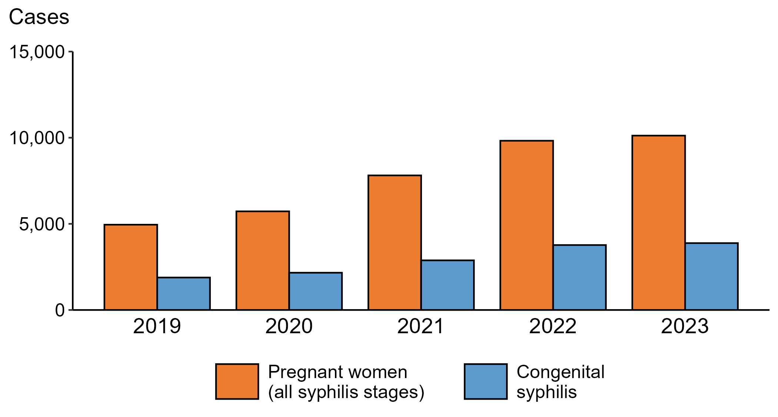
Syphilis — Reported Cases of Syphilis (All Stages) among Pregnant Women and Reported Cases of Congenital Syphilis by Year of Birth, United States, 2019–2023
Notes:
In 2023, there were a total of 3,882 cases of congenital syphilis (CS) reported among states and the District of Columbia for a rate of 105.8 per 100,000 live births.
During 2022 to 2023, the number of women reported with syphilis (all stages) who were pregnant increased 3.0% (from 9,823 to 10,121). During the same time period, the number of reported cases of CS increased 3.0% (from 3,769 to 3,882).
During 2019 to 2023, the number of women reported with syphilis (all stages) who were pregnant increased 104.4% (from 4,951 to 10,121). During the same time period, the number of reported cases of CS increased 106.1% (from 1,884 to 3,882).
This report includes data from years that coincide with the COVID-19 pandemic, which introduced uncertainty and difficulty in interpreting STI surveillance data. See Impact of COVID-19 on STIs (https://www.cdc.gov/sti-statistics/about/impact-of-covid-19.html) for more information.
See Technical Notes (https://www.cdc.gov/sti-statistics/annual/technical-notes.html) for information on STI case reporting formats and practices, including collected and derived variables displayed in this report. Table A (https://www.cdc.gov/sti-statistics/data-vis/table-selected-percunknown.html) provides information on unknown, missing, or invalid values of select variables.
Data for all figures are available at https://www.cdc.gov/sti-statistics/media/files/2024/11/2023-STI-Surveillance-Report-Data-Points.zip. The file “CS and Syphilis - Cases Pregnant Women and CS Cases by Year of Birth (US 2019-2023).xlsx” contains the data for the figure presented on this slide.

Slide 5
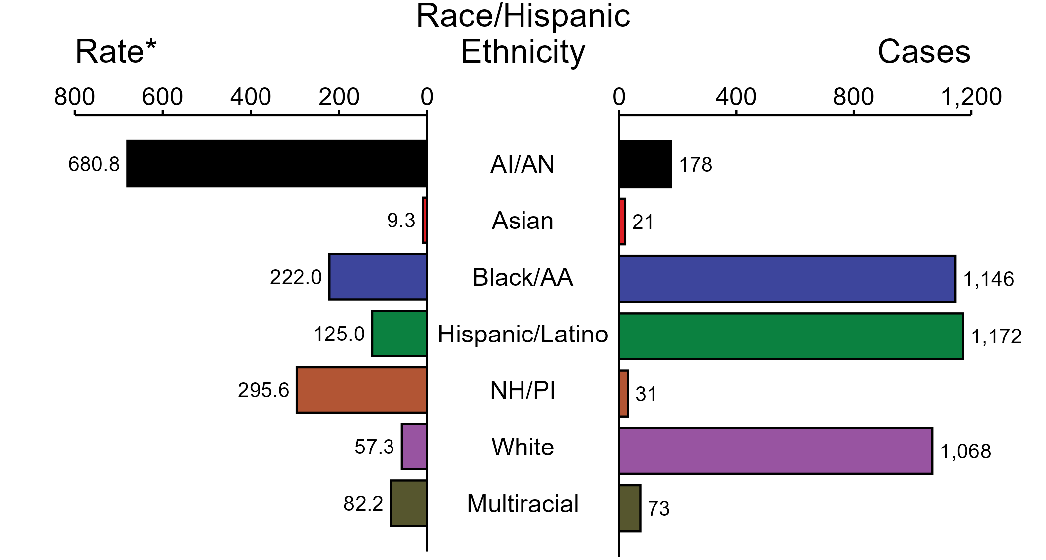
Congenital Syphilis — Case Counts and Rates of Reported Cases by Race/Hispanic Ethnicity of Birth Parent, United States, 2023
* Per 100,000 live births
ACRONYMS: AI/AN = American Indian or Alaska Native; Black/AA = Black or African American; NH/PI = Native Hawaiian or other Pacific Islander
NOTE: In 2023, a total of 193 congenital syphilis (CS) cases (5.0%) had missing, unknown, or other race and were not reported to be of Hispanic ethnicity. These cases are not shown in this figure. Including these cases, there were a total of 3,882 cases of CS reported among states and the District of Columbia for a rate of 105.8 per 100,000 live births.
Notes:
In 2023, there were a total of 3,882 cases of congenital syphilis (CS) reported among states and the District of Columbia for a rate of 105.8 per 100,000 live births.
In 2023, rates of CS were highest among birth parents who were non-Hispanic American Indian or Alaska Native (680.8 per 100,000 live births), followed by birth parents who were non-Hispanic Native Hawaiian or other Pacific Islander (295.6 per 100,000 live births) and birth parents who were non-Hispanic Black or African American (222.0 per 100,000 live births). The greatest number of reported CS cases was among birth parents who were Hispanic or Latino and of any race(s) (1,172 cases), followed by birth parents who were non-Hispanic Black or African American (1,146 cases) and birth parents who were non-Hispanic White (1,068 cases).
This report includes data from years that coincide with the COVID-19 pandemic, which introduced uncertainty and difficulty in interpreting STI surveillance data. See Impact of COVID-19 on STIs (https://www.cdc.gov/sti-statistics/about/impact-of-covid-19.html) for more information.
See Technical Notes (https://www.cdc.gov/sti-statistics/annual/technical-notes.html) for information on STI case reporting formats and practices, including collected and derived variables displayed in this report. Table A (https://www.cdc.gov/sti-statistics/data-vis/table-selected-percunknown.html) provides information on unknown, missing, or invalid values of select variables.
Data for all figures are available at https://www.cdc.gov/sti-statistics/media/files/2024/11/2023-STI-Surveillance-Report-Data-Points.zip. The file “CS - Counts and Rates by Race Hispanic Ethnicity of Birth Parent (US 2023).xlsx” contains the data for the figure presented on this slide.

Slide 6
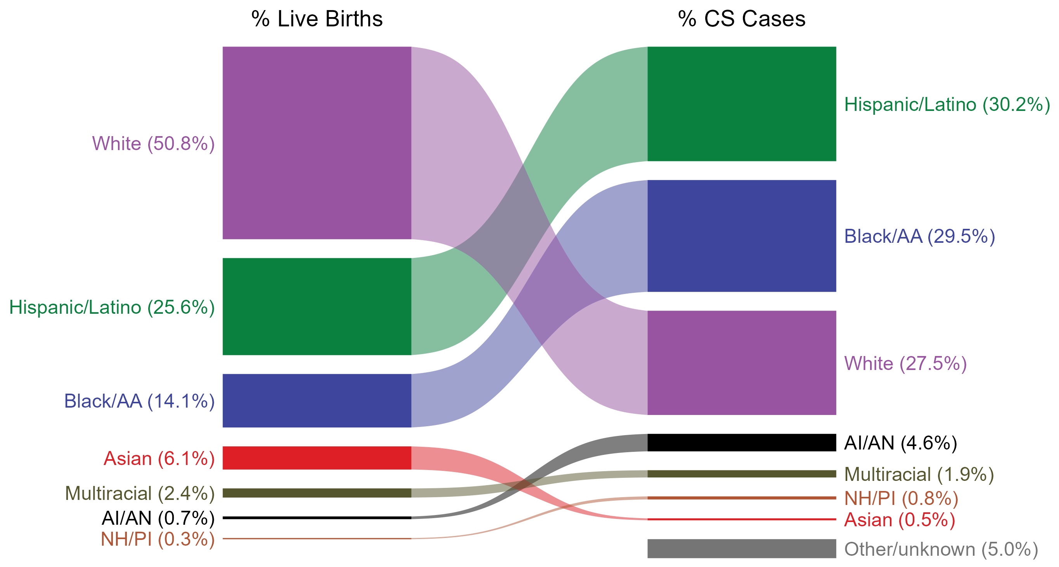
Congenital Syphilis — Total Live Births and Reported Cases by Race/Hispanic Ethnicity of Birth Parent, United States, 2023
NOTE: In 2023, a total of 193 congenital syphilis cases (5.0%) had missing, unknown, or other race and were not reported to be of Hispanic ethnicity. These cases are included in the “other/unknown” category.
ACRONYMS: AI/AN = American Indian or Alaska Native; Black/AA = Black or African American; NH/PI = Native Hawaiian or other Pacific Islander
Notes:
In 2023, there were a total of 3,882 cases of congenital syphilis (CS) reported among states and the District of Columbia for a rate of 105.8 per 100,000 live births.
The percentages of CS cases by race/Hispanic ethnicity of birth parent were disproportionate to the percentages among live births in the United States in 2023. The greatest absolute disparity was observed among non-Hispanic Black or African American birth parents, who represented 29.5% of reported CS cases (n = 1,146; 29.5% of CS cases with reported race or Hispanic ethnicity of birth parent) despite being 14.1% of the live births, or 15.4% more cases than would be expected based on their proportion of live births. The greatest relative disparity was among non-Hispanic American Indian or Alaska Native birth parents, who represented 4.6% of reported CS cases (n = 178; 4.6% of CS cases with reported race or Hispanic ethnicity of birth parent) despite being 0.7% of live births, or a burden 6.6 times what would be expected based on their proportion of live births. Additionally, Hispanic or Latino birth parents of any race(s) and non-Hispanic Native Hawaiian or other Pacific Islander birth parents were also overrepresented among CS cases relative to their proportion of live births.
This report includes data from years that coincide with the COVID-19 pandemic, which introduced uncertainty and difficulty in interpreting STI surveillance data. See Impact of COVID-19 on STIs (https://www.cdc.gov/sti-statistics/about/impact-of-covid-19.html) for more information.
See Technical Notes (https://www.cdc.gov/sti-statistics/annual/technical-notes.html) for information on STI case reporting formats and practices, including collected and derived variables displayed in this report. Table A (https://www.cdc.gov/sti-statistics/data-vis/table-selected-percunknown.html) provides information on unknown, missing, or invalid values of select variables.
Data for all figures are available at https://www.cdc.gov/sti-statistics/media/files/2024/11/2023-STI-Surveillance-Report-Data-Points.zip. The file “CS - Live Births and Cases by Race Hispanic Ethnicity of Birth Parent (US 2023).xlsx” contains the data for the figure presented on this slide.

Slide 7
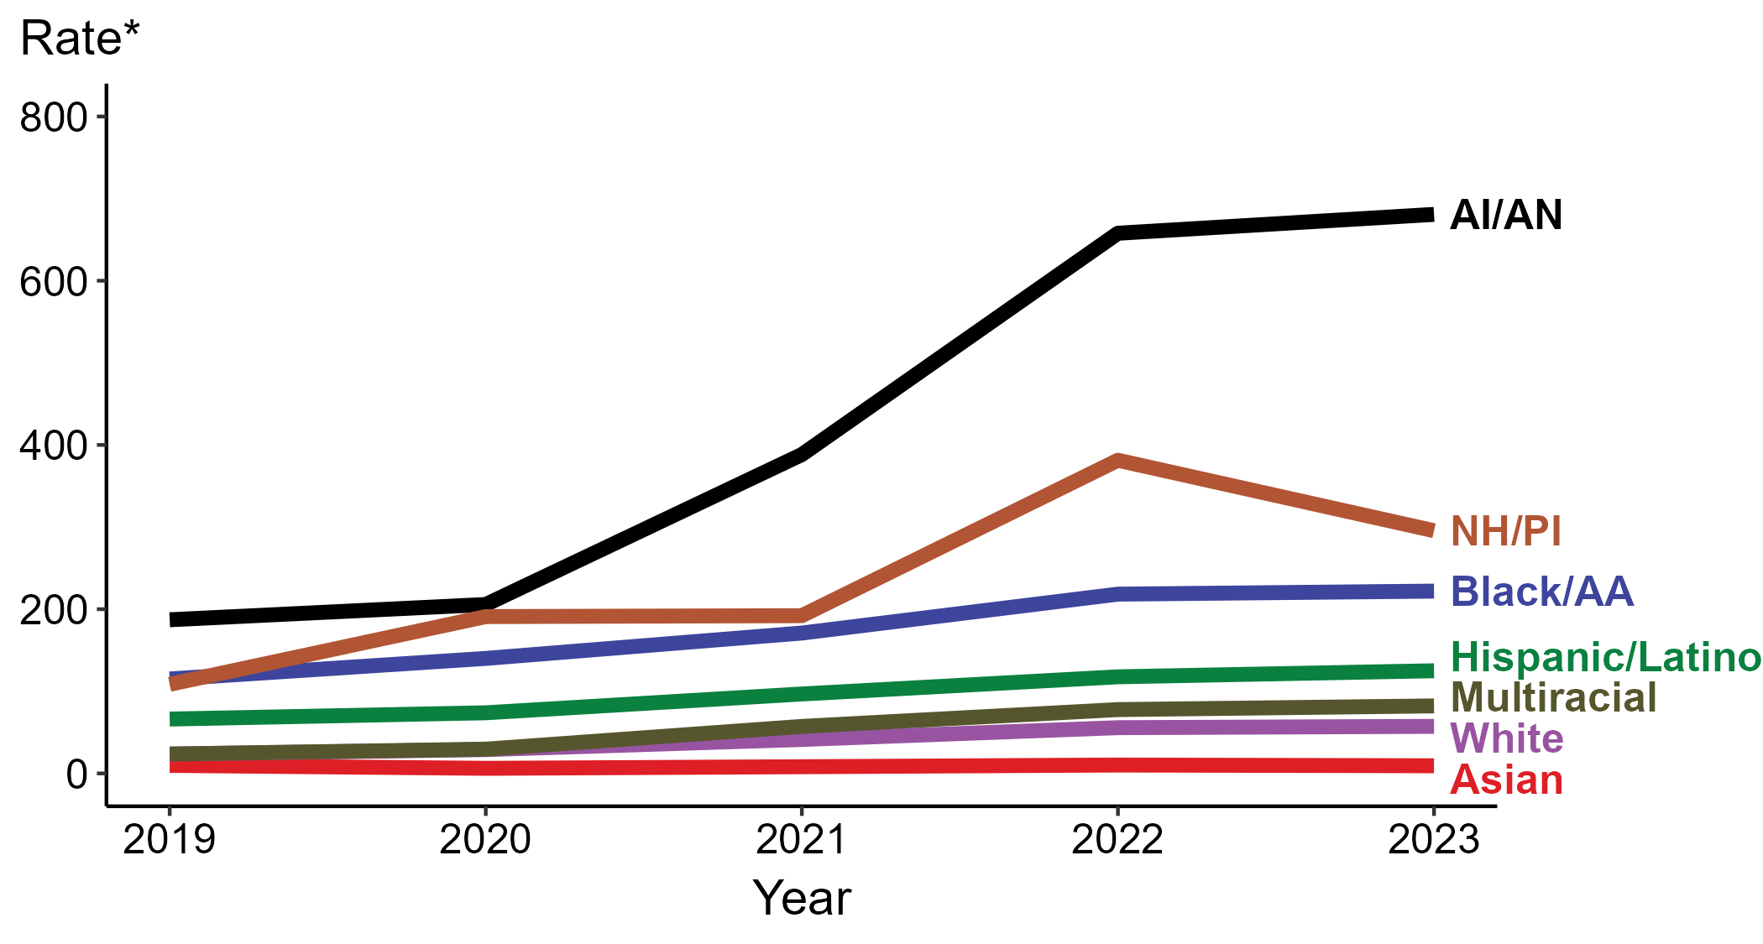
Congenital Syphilis — Rates of Reported Cases by Race/Hispanic Ethnicity of Birth Parent and Year of Birth, United States, 2019–2023
* Per 100,000 live births
ACRONYMS: AI/AN = American Indian or Alaska Native; Black/AA = Black or African American; NH/PI = Native Hawaiian or other Pacific Islander
NOTE: During 2019 to 2023, the percentage of all congenital syphilis cases with missing, unknown, or other race and not reported to be of Hispanic ethnicity was 5.2%, from a low of 5.0% (n = 193) in 2023 and 2019 to a high of 5.5% (n = 119) in 2020. These cases are not shown in this figure.
Notes:
In 2023, there were a total of 3,882 cases of congenital syphilis (CS) reported among states and the District of Columbia for a rate of 105.8 per 100,000 live births.
In 2023, the highest rate of reported cases of CS per 100,000 live births was among birth parents who were non-Hispanic American Indian or Alaska Native (680.8), followed by birth parents who were non-Hispanic Native Hawaiian or other Pacific Islander (295.6).
During 2022 to 2023, the greatest increase in rate of reported cases of CS per 100,000 live births was among birth parents who were Hispanic or Latino and of any race(s) (117.7 to 125.0; 6.2% increase). Birth parents who were non-Hispanic American Indian or Alaska Native had the greatest five-year increase in rate of CS (187.1 to 680.8; 263.9% increase from 2019).
During 2022 to 2023, the greatest decrease in rate of reported cases of CS per 100,000 live births was among birth parents who were non-Hispanic Native Hawaiian or other Pacific Islander (381.4 to 295.6; 22.5% decrease). Birth parents who were non-Hispanic Asian had the only five-year decrease in rate of CS (9.8 to 9.3; 5.1% decrease from 2019).
This report includes data from years that coincide with the COVID-19 pandemic, which introduced uncertainty and difficulty in interpreting STI surveillance data. See Impact of COVID-19 on STIs (https://www.cdc.gov/sti-statistics/about/impact-of-covid-19.html) for more information.
See Technical Notes (https://www.cdc.gov/sti-statistics/annual/technical-notes.html) for information on STI case reporting formats and practices, including collected and derived variables displayed in this report. Table A (https://www.cdc.gov/sti-statistics/data-vis/table-selected-percunknown.html) provides information on unknown, missing, or invalid values of select variables.
Data for all figures are available at https://www.cdc.gov/sti-statistics/media/files/2024/11/2023-STI-Surveillance-Report-Data-Points.zip. The file “CS - Rates by Race Hispanic Ethnicity of Birth Parent (US 2019-2023).xlsx” contains the data for the figure presented on this slide.

Slide 8
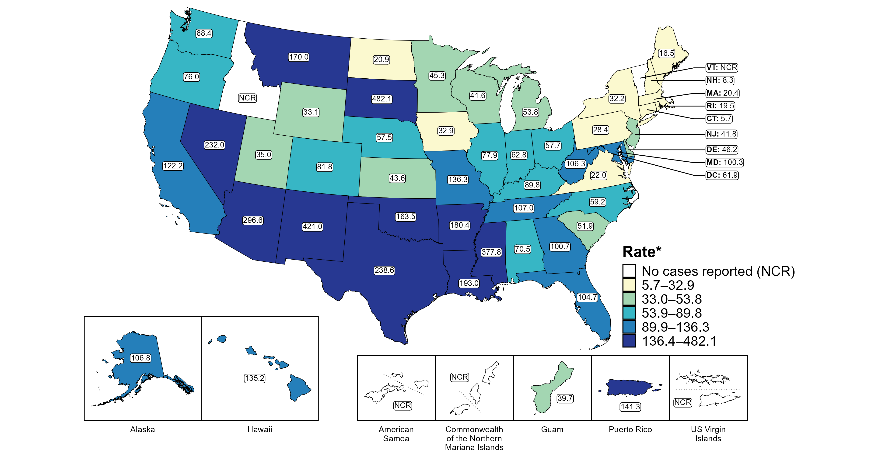
Congenital Syphilis — Rates of Reported Cases by Jurisdiction, United States and Territories, 2023
* Per 100,000 live births
Notes:
In 2023, there were a total of 3,882 cases of congenital syphilis (CS) reported among states and the District of Columbia (DC) for a rate of 105.8 per 100,000 live births. Rates of reported CS among states reporting any cases ranged from 5.7 cases per 100,000 live births in Connecticut to 482.1 cases per 100,000 live births in South Dakota. No cases of CS were reported in Idaho and Vermont. The rate of reported CS in DC was 61.9 per 100,000 live births.
Including data from US territories, there were a total of 3,910 cases of CS reported for a rate of 105.9 per 100,000 live births in 2023. Among US territories reporting any cases, rates of reported CS ranged from 39.7 cases per 100,000 live births in Guam to 141.3 cases per 100,000 live births in Puerto Rico. No cases of CS were reported in American Samoa, the Commonwealth of the Northern Mariana Islands, or the US Virgin Islands.
Tennessee transitioned STI surveillance information systems in September of 2023 which may have impacted the overall case counts. Caution should be applied in interpretation of these data.
This report includes data from years that coincide with the COVID-19 pandemic, which introduced uncertainty and difficulty in interpreting STI surveillance data. See Impact of COVID-19 on STIs (https://www.cdc.gov/sti-statistics/about/impact-of-covid-19.html) for more information.
See Technical Notes (https://www.cdc.gov/sti-statistics/annual/technical-notes.html) for information on syphilis case reporting and on interpreting reported rates in US territories. Table A (https://www.cdc.gov/sti-statistics/data-vis/table-selected-percunknown.html) provides information on unknown, missing, or invalid values of select variables.
Data for all figures are available at https://www.cdc.gov/sti-statistics/media/files/2024/11/2023-STI-Surveillance-Report-Data-Points.zip. The file “CS - Rates by Jurisdiction (US and Terr 2023).xlsx” contains the data for the figure presented on this slide.

Slide 9
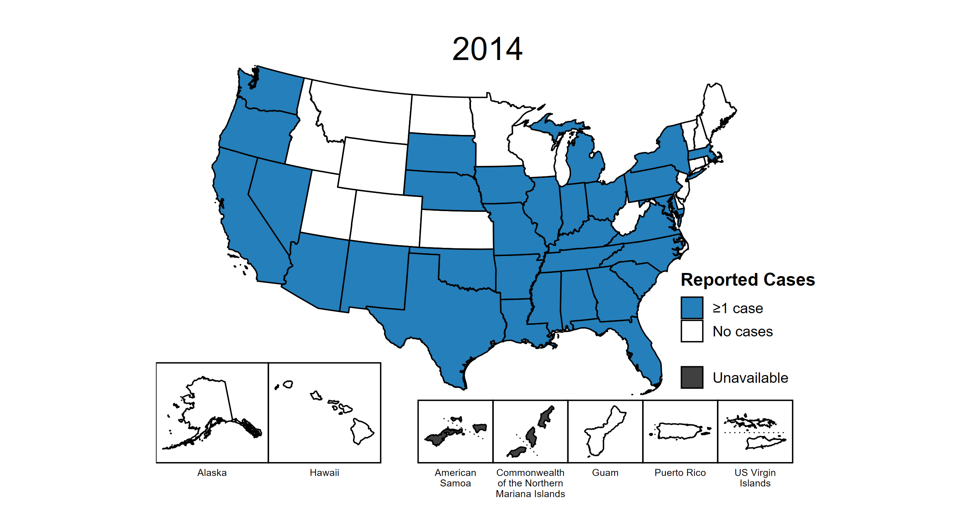
Congenital Syphilis — Reported Cases by Year of Birth and Jurisdiction, United States and Territories, 2014–2023
Notes:
This slide contains an animated figure that will play when the slide is in presentation mode. A static version of the figure that displays maps from the first and last years of the range is available as a separate slide.
In 2023, there were a total of 3,882 cases of congenital syphilis (CS) reported among states and the District of Columbia (DC) for a rate of 105.8 per 100,000 live births. Including data from US territories, there were a total of 3,910 cases of CS reported for a rate of 105.9 per 100,000 live births.
In 2014, 31 states and no US territories (57.4% of areas with available data) reported one or more cases of CS. This increased to 48 states, DC, and two US territories (91.1% of areas with available data) in 2023.
American Samoa and the Commonwealth of the Northern Mariana Islands began providing data on CS cases to CDC in 2018; data are not available for those areas prior to that year. In addition, data on reported CS cases in 2018 are not available for the US Virgin Islands. Due to a network security incident in December 2021, the Maryland Department of Health could not finalize their 2021 STI case notification data. Data for 2021 from Maryland have been suppressed for this figure; however, they are included in national and regional case counts and rates displayed in other figures. Tennessee transitioned STI surveillance information systems in September of 2023 which may have impacted the overall case counts. Caution should be applied in interpretation of these data.
This report includes data from years that coincide with the COVID-19 pandemic, which introduced uncertainty and difficulty in interpreting STI surveillance data. See Impact of COVID-19 on STIs (https://www.cdc.gov/sti-statistics/about/impact-of-covid-19.html) for more information.
See Technical Notes (https://www.cdc.gov/sti-statistics/annual/technical-notes.html) for information on STI case reporting formats and practices, including collected and derived variables displayed in this report. Table A (https://www.cdc.gov/sti-statistics/data-vis/table-selected-percunknown.html) provides information on unknown, missing, or invalid values of select variables.
Data for all figures are available at https://www.cdc.gov/sti-statistics/media/files/2024/11/2023-STI-Surveillance-Report-Data-Points.zip. The file “CS - Cases by Year of Birth and Jurisdiction (US and Terr, 2014-2023).xlsx” contains the data for the figure presented on this slide.

Slide 10
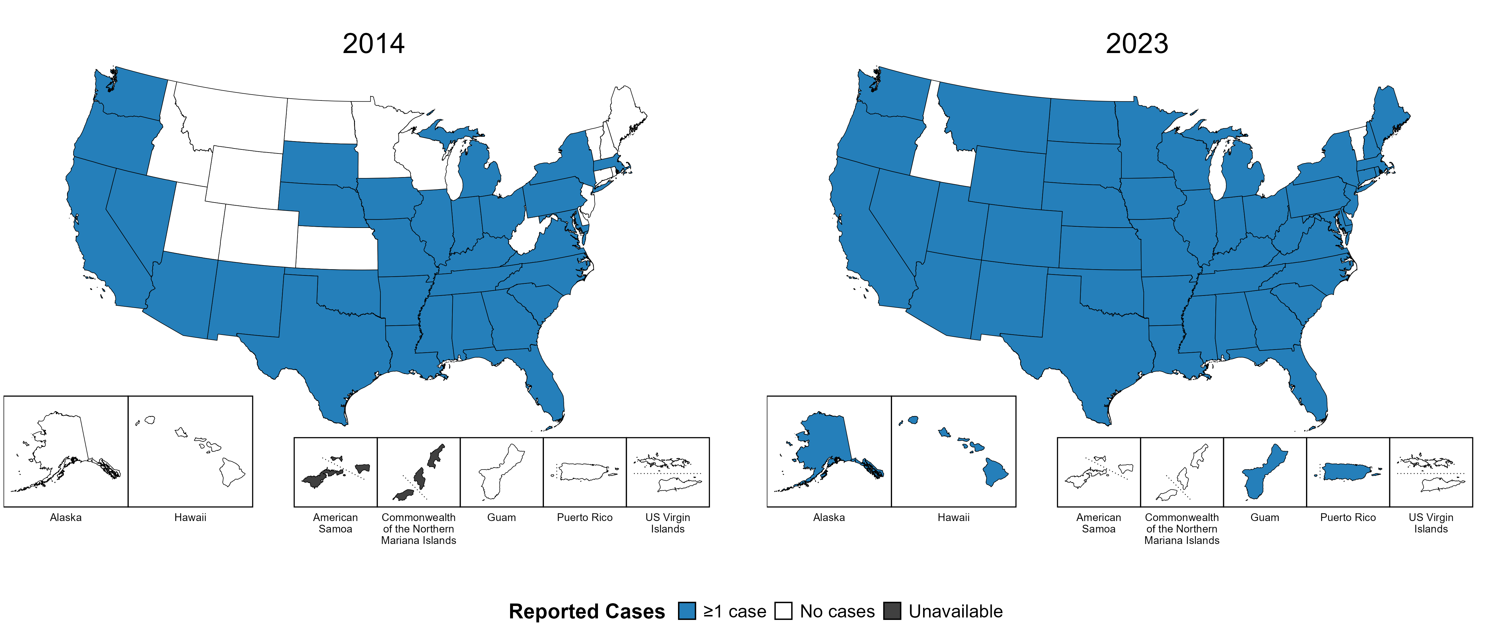
Congenital Syphilis — Reported Cases by Year of Birth and Jurisdiction, United States and Territories, 2014 and 2023
Notes:
In 2023, there were a total of 3,882 cases of congenital syphilis (CS) reported among states and the District of Columbia (DC) for a rate of 105.8 per 100,000 live births. Including data from US territories, there were a total of 3,910 cases of CS reported for a rate of 105.9 per 100,000 live births.
In 2014, 31 states and no US territories (57.4% of areas with available data) reported one or more cases of CS. This increased to 48 states, DC, and two US territories (91.1% of areas with available data) in 2023.
American Samoa and the Commonwealth of the Northern Mariana Islands began providing data on CS cases to CDC in 2018; data are not available for those areas prior to that year. Tennessee transitioned STI surveillance information systems in September of 2023 which may have impacted the overall case counts. Caution should be applied in interpretation of these data.
This report includes data from years that coincide with the COVID-19 pandemic, which introduced uncertainty and difficulty in interpreting STI surveillance data. See Impact of COVID-19 on STIs (https://www.cdc.gov/sti-statistics/about/impact-of-covid-19.html) for more information.
See Technical Notes (https://www.cdc.gov/sti-statistics/annual/technical-notes.html) for information on STI case reporting formats and practices, including collected and derived variables displayed in this report. Table A (https://www.cdc.gov/sti-statistics/data-vis/table-selected-percunknown.html) provides information on unknown, missing, or invalid values of select variables.
Data for all figures are available at https://www.cdc.gov/sti-statistics/media/files/2024/11/2023-STI-Surveillance-Report-Data-Points.zip. The file “CS - Cases by Year of Birth and Jurisdiction (US and Terr, 2014 and 2023).xlsx” contains the data for the figure presented on this slide.

Slide 11
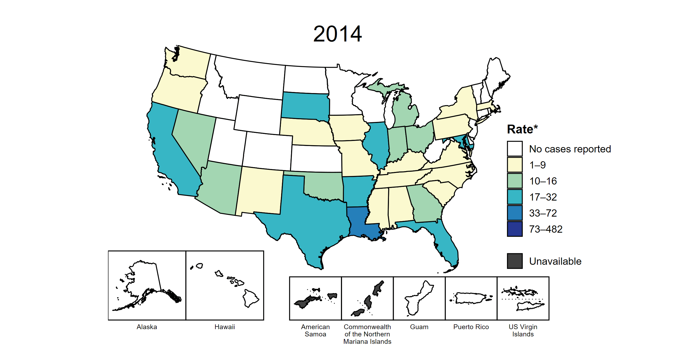
Congenital Syphilis — Rates of Reported Cases by Year of Birth and Jurisdiction, United States and Territories, 2014–2023
* Per 100,000 live births
Notes:
This slide contains an animated figure that will play when the slide is in presentation mode. A static version of the figure that displays maps from the first and last years of the range is available as a separate slide.
In 2023, there were a total of 3,882 cases of congenital syphilis (CS) reported among states and the District of Columbia (DC) for a rate of 105.8 per 100,000 live births. Including data from US territories, there were a total of 3,910 cases of CS reported for a rate of 105.9 per 100,000 live births.
In 2014, one state (1.9% of areas with available data) had a rate of reported CS greater than or equal to 33 cases per 100,000 live births. This increased to 39 states, DC, and two US territories (75.0% of areas with available data) in 2023. During 2022 to 2023, rates of reported CS among live births increased in 30 states and two territories.
American Samoa and the Commonwealth of the Northern Mariana Islands began providing data on CS cases to CDC in 2018; data are not available for those areas prior to that year. In addition, data on reported CS cases in 2018 are not available for the US Virgin Islands. Due to a network security incident in December 2021, the Maryland Department of Health could not finalize their 2021 STI case notification data. Data for 2021 from Maryland have been suppressed for this figure; however, they are included in national and regional case counts and rates displayed in other figures. Tennessee transitioned STI surveillance information systems in September of 2023 which may have impacted the overall case counts. Caution should be applied in interpretation of these data.
This report includes data from years that coincide with the COVID-19 pandemic, which introduced uncertainty and difficulty in interpreting STI surveillance data. See Impact of COVID-19 on STIs (https://www.cdc.gov/sti-statistics/about/impact-of-covid-19.html) for more information.
See Technical Notes (https://www.cdc.gov/sti-statistics/annual/technical-notes.html) for information on STI case reporting formats and practices, including collected and derived variables displayed in this report. Table A (https://www.cdc.gov/sti-statistics/data-vis/table-selected-percunknown.html) provides information on unknown, missing, or invalid values of select variables.
Data for all figures are available at https://www.cdc.gov/sti-statistics/media/files/2024/11/2023-STI-Surveillance-Report-Data-Points.zip. The file “CS - Rates by Year of Birth and Jurisdiction (US and Terr, 2014-2023).xlsx” contains the data for the figure presented on this slide.

Slide 12
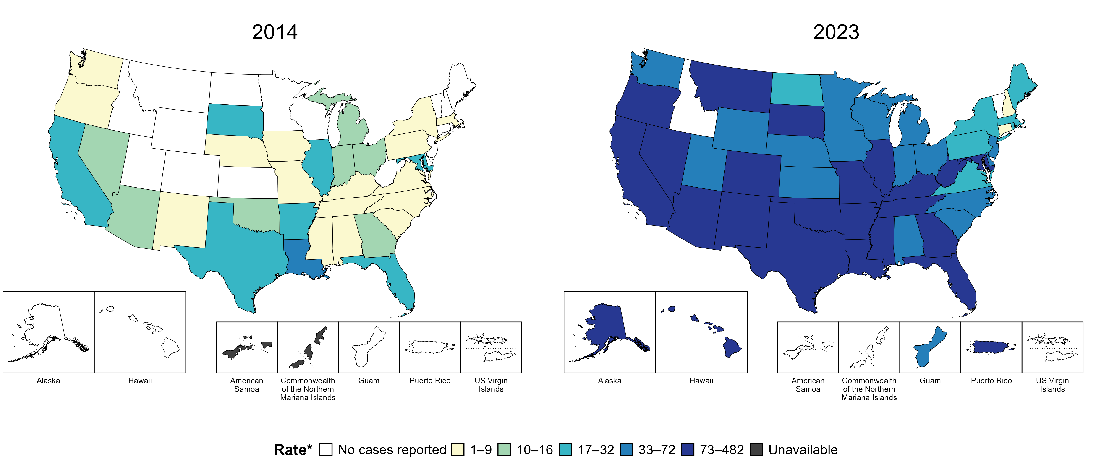
Congenital Syphilis — Rates of Reported Cases by Year of Birth and Jurisdiction, United States and Territories, 2014 and 2023
* Per 100,000 live births
Notes:
In 2023, there were a total of 3,882 cases of congenital syphilis (CS) reported among states and the District of Columbia (DC) for a rate of 105.8 per 100,000 live births. Including data from US territories, there were a total of 3,910 cases of CS reported for a rate of 105.9 per 100,000 live births.
In 2014, one state (1.9% of areas with available data) had a rate of reported CS greater than or equal to 33 cases per 100,000 live births. This increased to 39 states, DC, and two US territories (75.0% of areas with available data) in 2023.
American Samoa and the Commonwealth of the Northern Mariana Islands began providing data on CS cases to CDC in 2018; data are not available for those areas prior to that year. Tennessee transitioned STI surveillance information systems in September of 2023 which may have impacted the overall case counts. Caution should be applied in interpretation of these data.
This report includes data from years that coincide with the COVID-19 pandemic, which introduced uncertainty and difficulty in interpreting STI surveillance data. See Impact of COVID-19 on STIs (https://www.cdc.gov/sti-statistics/about/impact-of-covid-19.html) for more information.
See Technical Notes (https://www.cdc.gov/sti-statistics/annual/technical-notes.html) for information on STI case reporting formats and practices, including collected and derived variables displayed in this report. Table A (https://www.cdc.gov/sti-statistics/data-vis/table-selected-percunknown.html) provides information on unknown, missing, or invalid values of select variables.
Data for all figures are available at https://www.cdc.gov/sti-statistics/media/files/2024/11/2023-STI-Surveillance-Report-Data-Points.zip. The file “CS - Rates by Year of Birth and Jurisdiction (US and Terr 2014 and 2023).xlsx” contains the data for the figure presented on this slide.

Slide 13
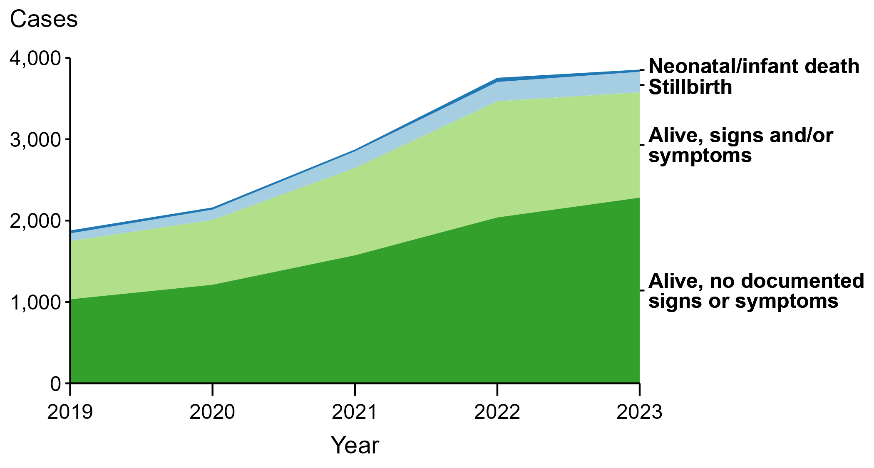
Congenital Syphilis — Reported Cases by Vital Status and Clinical Signs and Symptoms* of Infection and Year, United States, 2019–2023
* Neonates/infants with signs and/or symptoms of congenital syphilis (CS) have documentation of at least one of the following: long bone changes consistent with CS, snuffles, condylomata lata, syphilitic skin rash, pseudoparalysis, hepatosplenomegaly, edema, jaundice due to syphilitic hepatitis, reactive CSF-VDRL, elevated CSF WBC or protein values, or evidence of direct detection of T. pallidum.
NOTE: Of the 14,579 congenital syphilis cases reported during 2019 to 2023, 53 (0.4%) did not have sufficient information to be categorized.
Notes:
In 2023, there were a total of 3,882 cases of congenital syphilis (CS) reported among states and the District of Columbia for a rate of 105.8 per 100,000 live births.
In 2023, 27 cases (0.7%) were neonatal/infant deaths, 252 cases (6.5%) were stillbirths, 1,295 cases (33.4%) were born alive with CS-related signs or symptoms, 2,282 cases (58.8%) were born alive with no documented CS-related signs or symptoms, and 26 cases (0.7%) were missing information on vital status.
In 2023, there were 279 CS-related deaths (252 stillbirths and 27 neonatal/infant deaths), a decrease of 3.1% from 2022 (288 to 279) and an increase of 113.0% from 2019 (131 to 279).
The number of infants reported with CS who were born alive with CS-related signs and symptoms decreased 9.3% from 2022 to 2023 (1,428 to 1,295) and increased 81.1% from 2019 to 2023 (715 to 1,295).
This report includes data from years that coincide with the COVID-19 pandemic, which introduced uncertainty and difficulty in interpreting STI surveillance data. See Impact of COVID-19 on STIs (https://www.cdc.gov/sti-statistics/about/impact-of-covid-19.html) for more information.
See Technical Notes (https://www.cdc.gov/sti-statistics/annual/technical-notes.html) for information on STI case reporting formats and practices, including collected and derived variables displayed in this report. Table A (https://www.cdc.gov/sti-statistics/data-vis/table-selected-percunknown.html) provides information on unknown, missing, or invalid values of select variables.
Data for all figures are available at https://www.cdc.gov/sti-statistics/media/files/2024/11/2023-STI-Surveillance-Report-Data-Points.zip. The file “CS - Cases by Vital Status and Clinical Signs and Symptoms (US 2019-2023).xlsx” contains the data for the figure presented on this slide.

Slide 14
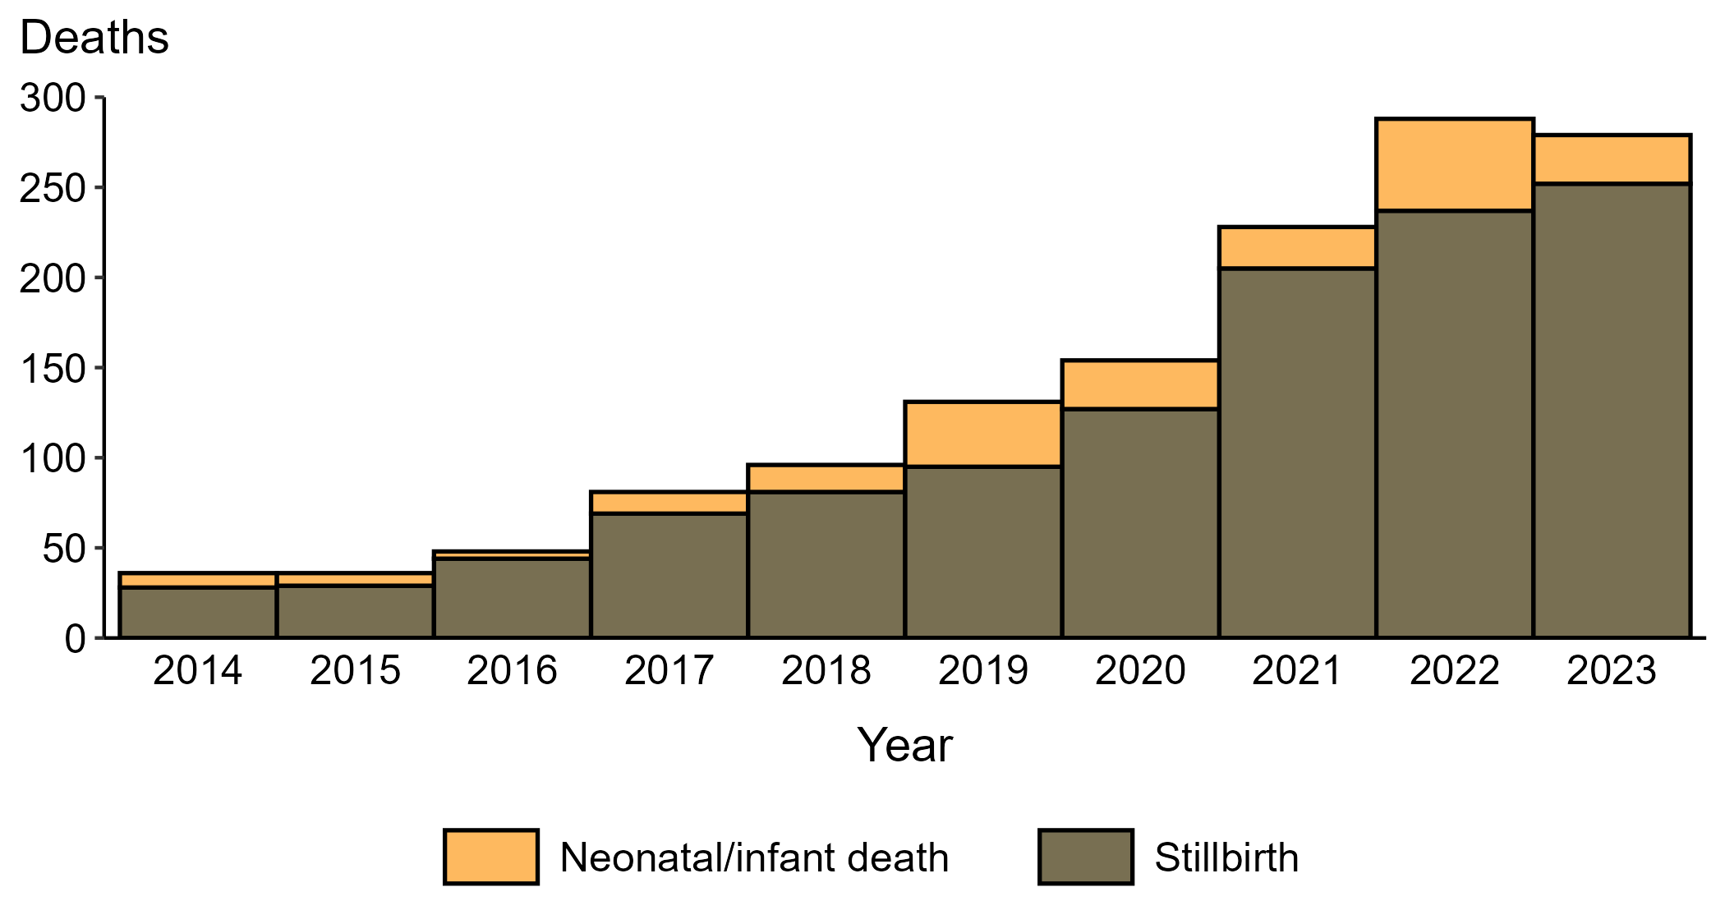
Congenital Syphilis — Reported Stillbirths and Neonatal/Infant Deaths by Year, United States, 2014–2023
Notes:
In 2023, there were a total of 3,882 cases of congenital syphilis (CS) reported among states and the District of Columbia for a rate of 105.8 per 100,000 live births.
In 2023, 252 CS-related stillbirths were reported, an increase of 6.3% since 2022 and an increase of 800.0% since 2014.
In 2023, 27 CS-related neonatal/infant deaths were reported, a decrease of 47.1% since 2022 and an increase of 237.5% since 2014.
This report includes data from years that coincide with the COVID-19 pandemic, which introduced uncertainty and difficulty in interpreting STI surveillance data. See Impact of COVID-19 on STIs (https://www.cdc.gov/sti-statistics/about/impact-of-covid-19.html) for more information.
See Technical Notes (https://www.cdc.gov/sti-statistics/annual/technical-notes.html) for information on STI case reporting formats and practices, including collected and derived variables displayed in this report. Table A (https://www.cdc.gov/sti-statistics/data-vis/table-selected-percunknown.html) provides information on unknown, missing, or invalid values of select variables.
Data for all figures are available at https://www.cdc.gov/sti-statistics/media/files/2024/11/2023-STI-Surveillance-Report-Data-Points.zip. The file “CS - Reported Stillbirths and Neonatal/Infant Deaths (US 2014-2023).xlsx” contains the data for the figure presented on this slide.

Slide 15
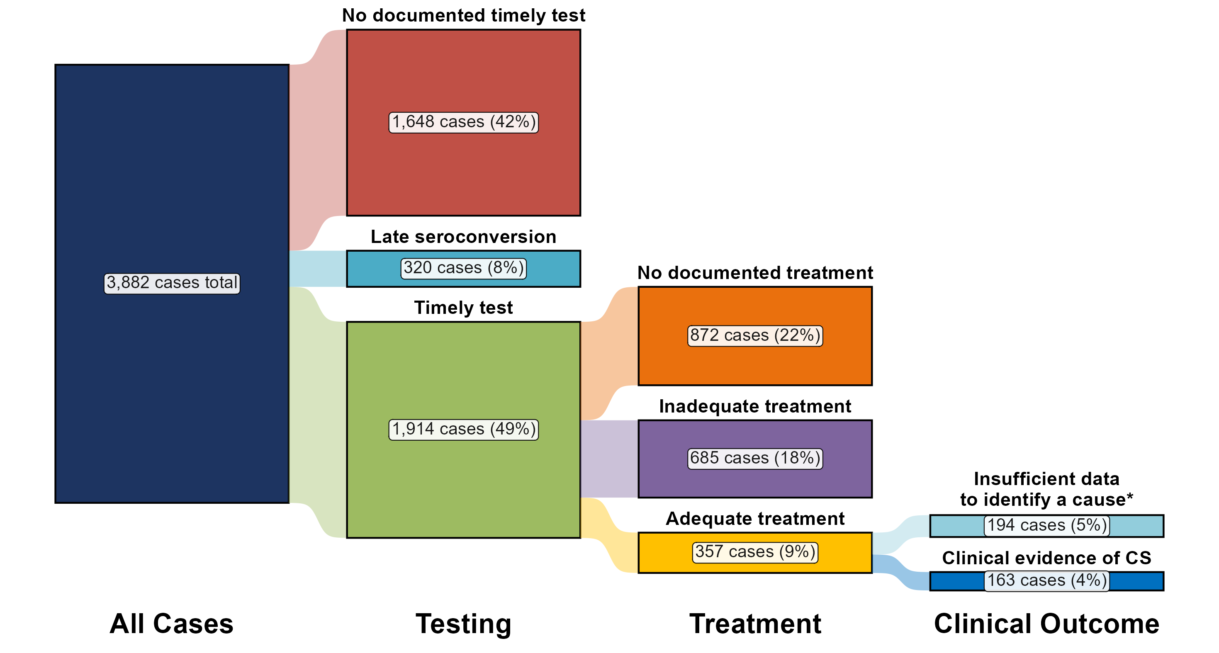
Congenital Syphilis — Distribution of Receipt of Testing and Treatment by Pregnant Persons with a Congenital Syphilis Outcome, United States, 2023
* Cases with insufficient data to assign a likely missed opportunity were due to missing or incomplete data in case notification data at CDC. More complete data on these cases may be available at the jurisdictional level, allowing for ascertainment of the likely missed opportunity.
NOTE: Percentages represent the number of congenital syphilis (CS) cases among the 3,882 total CS cases reported among states and the District of Columbia in 2023.
Notes:
In 2023, there were a total of 3,882 cases of congenital syphilis (CS) reported among states and the District of Columbia for a rate of 105.8 per 100,000 live births.
In 2023, the most common missed prevention opportunity among birth parents of infants with CS was no documented timely test (n = 1,648; 42.5%), followed by no treatment or non-documented treatment (n = 872; 22.5%).
These “missed opportunities” for prevention of CS correspond to critical elements in the cascade of care for syphilis in pregnancy, including timely screening and adequate and timely treatment. Barriers at each step are multifactorial and are frequently related to structural and systematic issues such as housing status and healthcare access, along with syndemics such as substance use disorder. These issues are often beyond the capacity of individual providers to address, and require focused, multi-stakeholder policy interventions.
This report includes data from years that coincide with the COVID-19 pandemic, which introduced uncertainty and difficulty in interpreting STI surveillance data. See Impact of COVID-19 on STIs (https://www.cdc.gov/sti-statistics/about/impact-of-covid-19.html) for more information.
See Technical Notes (https://www.cdc.gov/sti-statistics/annual/technical-notes.html) for information on STI case reporting formats and practices, including collected and derived variables displayed in this report. Table A (https://www.cdc.gov/sti-statistics/data-vis/table-selected-percunknown.html) provides information on unknown, missing, or invalid values of select variables.
Data for all figures are available at https://www.cdc.gov/sti-statistics/media/files/2024/11/2023-STI-Surveillance-Report-Data-Points.zip. The file “CS - Receipt of Testing and Treatment by Pregnant Person with CS Outcome (US 2023).xlsx” contains the data for the figure presented on this slide.

Slide 16
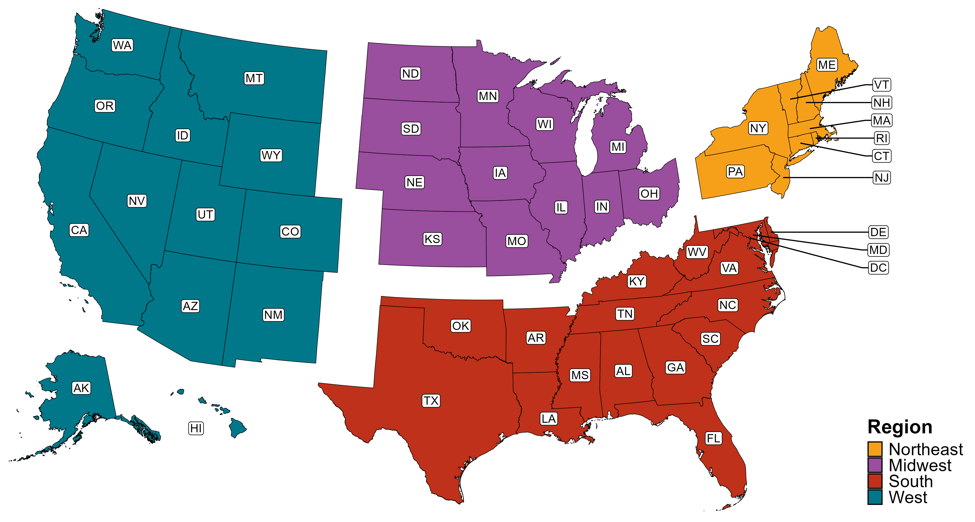
Reference Map of US Census Regions

