Slide 1




An Introduction to Public Health Law
Developed by the
Public Health Law Program
Center for State, Tribal, Local, and Territorial Support
Centers for Disease Control and Prevention
Notes:
This program was developed by the Center for Disease Control and Prevention Public Health Law Program
Mission
To advance the public’s health through law
Strategic goals
Support state, tribal, local, and territorial public health agencies’ use of law to achieve public health priorities
Support CDC programs’ development of capacity to use law to achieve CDC’s priorities
Explore innovative uses of law, identify and disseminate public health law best practices, and improve understanding of law as a public health tool
More information is available at http://www2a.cdc.gov/phlp/.
Note, PHLP does not offer legal advice but instead provides training, develops tools, and offers technical assistance to state and local public health legal counsel and to CDC on state public health legal issues. PHLP is separate from the Office of the General Counsel. OGC represents CDC in all legal matters.
Presentation Agenda:

Slide 2
Disclaimer
The contents of this presentation have not been formally disseminated by the Centers for Disease Control and Prevention and should not be construed to represent any agency determination or policy. These materials are for instructional use only and are not intended as a substitute for professional legal or other advice. While every effort has been made to verify the accuracy of these materials, legal authorities and requirements may vary from jurisdiction to jurisdiction. Always seek the advice of an attorney or other qualified professional with any questions you may have regarding a legal matter.

Slide 3
Agenda
Introductions
Icebreaker
Introduction to Public Health Law: Public Health Law 101
Quarantine Exercise: Super Duck Flu!

Slide 4
Introductions
Notes:
Introduce all instructors.

Slide 5

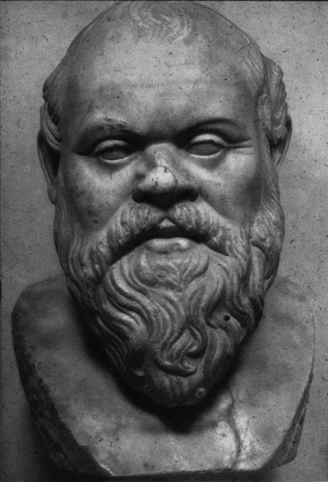
Public Health Law 101
Notes:
Public Health Law 101 : This presentation will introduce you to a teaching method used in law school classes, the Socratic Method.
True Socratic Method would require open-ended questions to facilitate the debate with the professor essentially playing Devil’s Advocate. Students are in the “hot seat,” called on without notice. The goal is to help law students begin to think on their feet and be able to debate the merits of a position. Here the questions are not open-ended and are calling for specific answer, but the professor should consider calling on students at random for the “hot seat.” A more traditional debate follows this presentation.

Slide 6
Key Definition: Public Health
Public health: “Fulfilling society’s interest in assuring conditions in which people can be healthy.”

Slide 7
Key Definition: Law
Law has many definitions
  Rules that are subject to the enforcement power of a government entity
  The structures, norms, and rules that a society uses to resolve disputes, govern itself, and order the relations between members of the society
  “The enterprise of subjecting human conduct to the governance of rules”*
What does law mean to you?

Slide 8
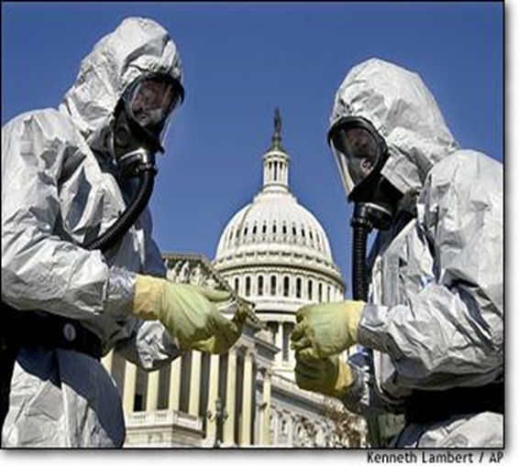
So, What Are Public Health Laws?
At the federal and state levels, public health laws establish public health infrastructure, authorize public health activities, and appropriate funds for these activities.
Notes:
What are public health laws?
Any laws or regulations that have important consequences for the health of defined populations
Not limited to laws related to “the official health department”
One definition:
“The legal powers and duties of the state to assure the conditions for people to be healthy, and the limitations on the power of the state to constrain the autonomy, privacy, liberty, proprietary, or other legally protected interests of individuals for the protection or promotion of community health.”*
*Adapted from: Gostin LO. Public Health Law: Power, Duty, Restraint. Berkeley: Univ. of California Press, 2000, p. 4.
Instructor: This slide permits discussion of concept of whether there is a distinct body of “public health law,” or whether the law of public health comprises many different sources of law and legal authorities to be covered in this unit and in subsequent units.
Students might be challenged on this concept throughout the course as they become increasingly acquainted with law in public health practice.
Important value of this definition: emphasizes tension inherent in need to balance government’s powers and duties in assuring public health with express limitations on government’s power and government’s need to prudently exercise its powers.

Slide 9
Public Health Laws
Examples of how public health laws work
  Change the physical environment
    Fluoridation of water; zoning of certain areas as residential v. industrial
  Penalize risky behavior
    Tickets for not wearing seatbelts; fines for polluting
  Alter the informational environment
    Violence or drug prevention programs in schools; food labeling; regulation of advertising of cigarettes or alcohol

Slide 10

Who Can Make Public Health Law?
Federal government authorities
  Commerce Clause
  Taxing/Spending Clause
State government authorities
  Police power
  Delegation to local governments
Socratic question:
What amendment reserves
powers to the states?
Notes:
The Constitution is the underlying authority for all public health activity at the federal and state level; however different portions of the Constitution serve as the basis for this authority.
Federal authority rests on the Art. I , Sec. 8 “Necessary and Proper” clause – specifically the Commerce Clause and the power to Tax/Spend.
Commerce Clause: Gives Congress power to regulate commerce “with foreign nations, among the several states and with the Indian Tribes”
Taxing/Spending: Gives Congress the power to raise revenues, fund programs and projects, and provide incentives/disincentives for certain activities/behaviors
State authority rests in the police power reserved under the 10th Amendment.
Police Power: Authorizes states to encourage and limit private interests and rights to promote and protect public health and social good (states may delegate to locals)
Answer: 10th Amendment

Slide 11
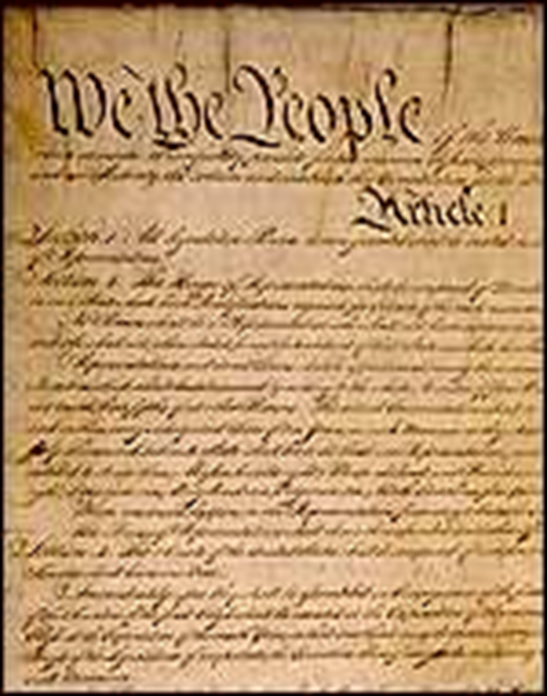

Key Source of Law: US Constitution
The Constitution establishes
  Two levels of government
    Federal (enumerated powers)
    State (reserved powers)
  Three branches of the federal government
    Separation of powers
    Checks/balances
Socratic question:
What are the three branches of the federal government?
Notes:
Most high school students will have already learned about the basics of government structure under the Constitution. These slides are designed to provide a very general overview and reminder.
The Constitution establishes
Two levels of government
Federal (enumerated/specified powers)
State (reserved/residual powers)
Three branches of the federal government
Separation of powers
Checks/balances
Answer: Legislative, Judicial, and Executive

Slide 12
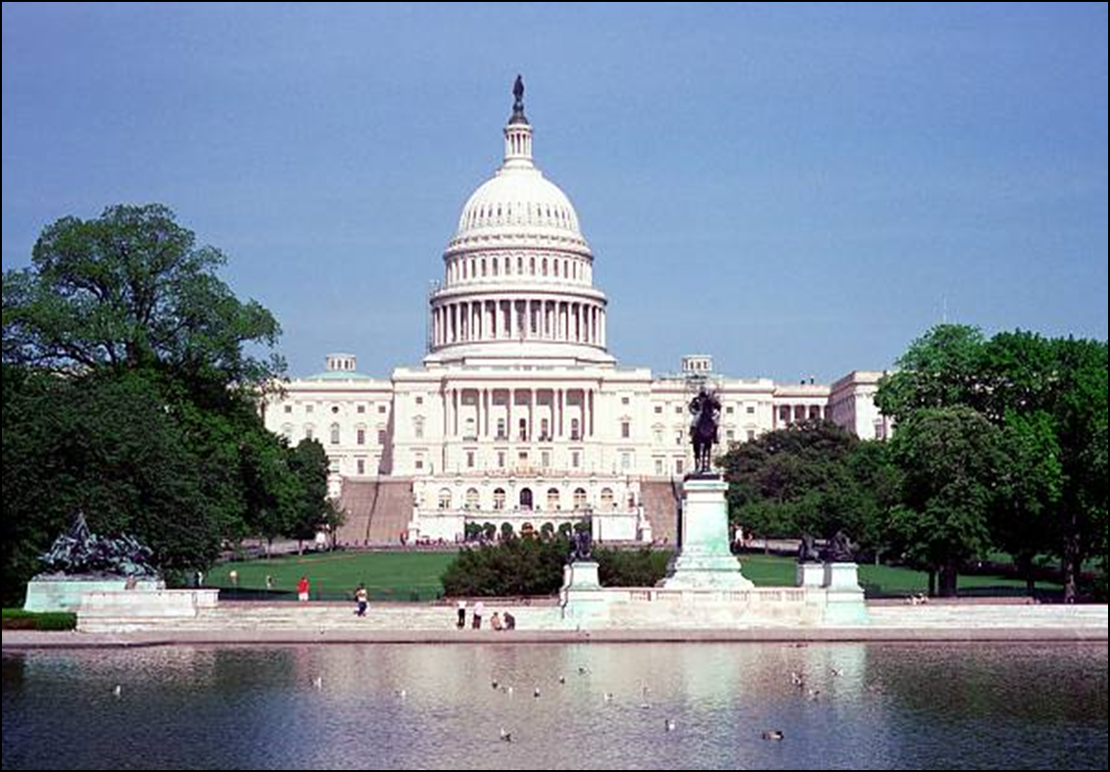
Legislature
Notes:
LEGISLATURE
Entity:
Federal – Congress
Bicameral (two chambers) – House/Senate
Role:
Makes the laws
Types of Laws/Authorities:
Statutes
The instructor might wish to add a slide describing the state government structure. For example, in your state what is your legislature called (State Legislature, State Assembly, etc.)?
Photo Credit: Thinkstock

Slide 13
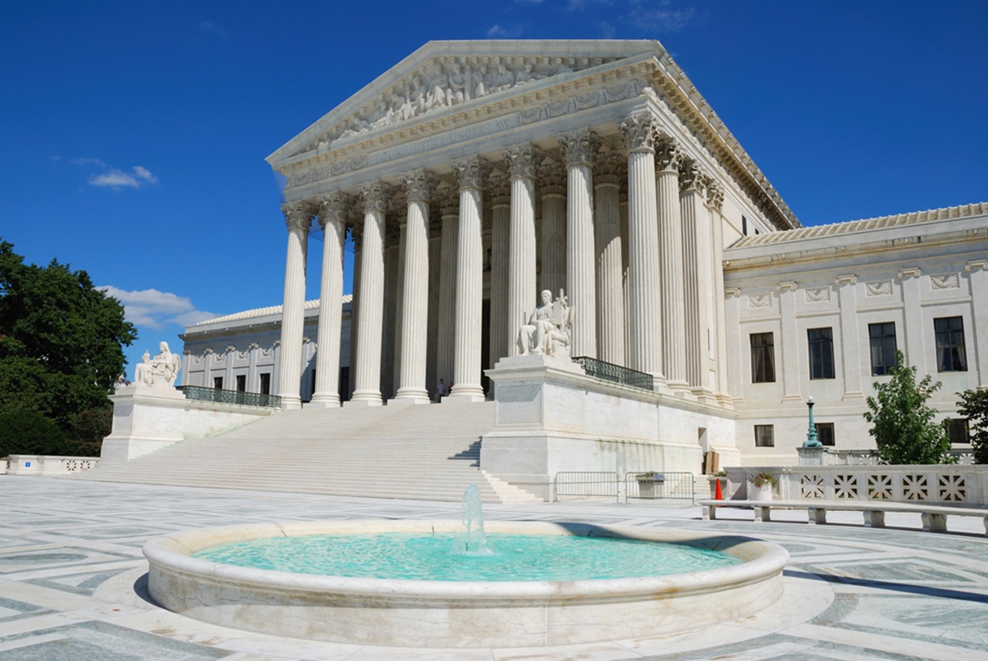
Judiciary
Notes:
JUDICIARY
Entity:
District courts (trial level)
Appellate courts
Supreme Court
Specialized courts (ex. bankruptcy)
Role:
Interpret the laws to resolve disputes
Types of laws/authorities:
Common law (laws that originated from judicial decisions in England before colonization)/case law (laws that originate from judicial decisions in America)
The instructor might wish to add a slide describing the state judicial structure. For example, in your state what is the lowest court called (district court, circuit court, etc.) and what is the highest court called (supreme court, court of appeals, etc.)?
Photo Credit: Thinkstock

Slide 14
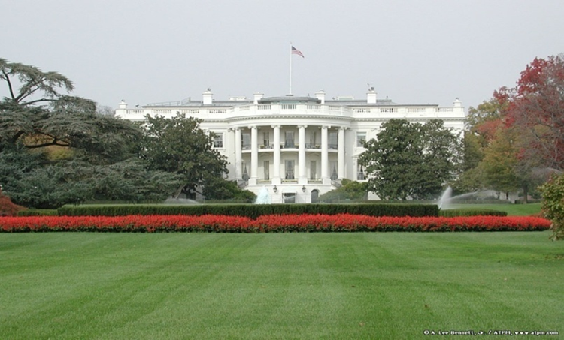
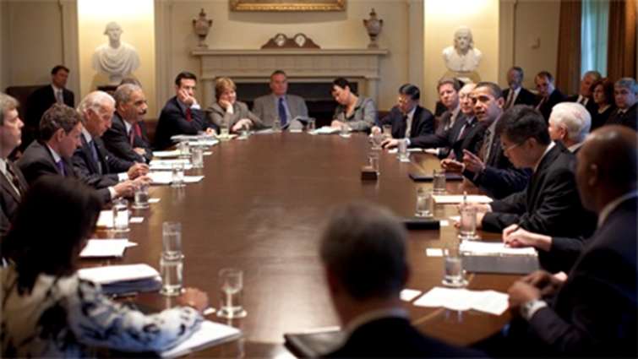
Executive
President Obama at a Cabinet meeting April 20, 2009, at the White House.
Notes:
EXECUTIVE
Entity:
Federal – president, vice president,
Heads of departments/agencies (Cabinet)
Role:
Execute/enforce the laws
Types of laws/authorities:
Executive orders
Agency regulations
Treaties
The instructor might wish to add a slide describing the state government structure. For example, in your state who is the governor? What is the name of the state’s health department?

Slide 15

The Cabinet
Department of Agriculture
Department of Commerce
Department of Defense
Department of Education
Department of Energy
Department of Health and Human Services
Department of Homeland Security
Department of Housing and Urban Development
Department of the Interior
Department of Justice
Department of Labor
Department of State
Department of Transportation
Department of the Treasury
Department of Veterans Affairs
Socratic question:
In which department is CDC is located?
Notes:
Answer: Department of Health and Human Services

Slide 16
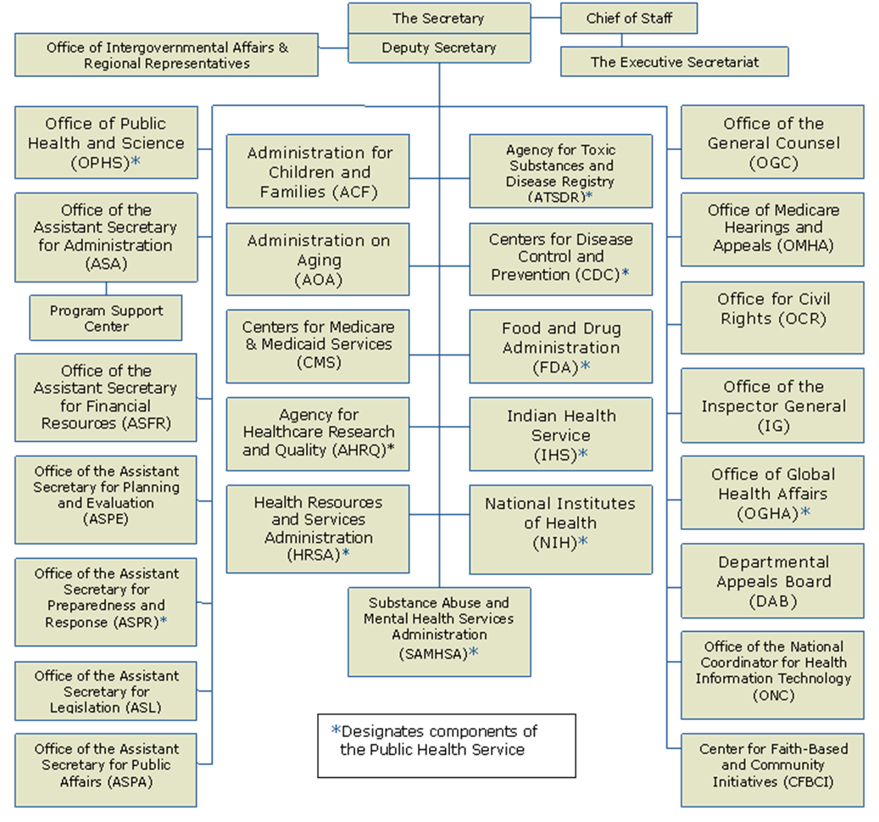


Department of Health and Human Services
Socratic question:
Who does the Director of CDC answer to?
Who does the Secretary of HHS answer to?
Notes:
*Designates components of the Public Health Service – in addition to CDC, these agencies have been assigned some public health function.
Answer: CDC Director answers to the Secretary of the US Department of Health and Human Services Secretary; the Secretary of the US Department of Health and Human Services Secretary answers to the President.*
*instructors may also want to see if the students know who these people are (CDC director, HHS director, President)

Slide 17
Key Source of Law: State Statute
The Department of Human Resources is created and established to safeguard and promote the health of the people of this state and is empowered to employ all legal means appropriate to that end. Illustrating, without limiting, the foregoing grant of authority, the department is empowered to:
(1) Provide epidemiological investigations and laboratory facilities and services in the detection and control of disease, disorders, and disabilities and to provide research, conduct investigations, and disseminate information concerning reduction in the incidence and proper control of disease, disorders, and disabilities . . .
Official Code of Georgia § 31-2-1.
Notes:
Here is an example of a foundational public health law: one that creates a health department and gives it the power to act.

Slide 18
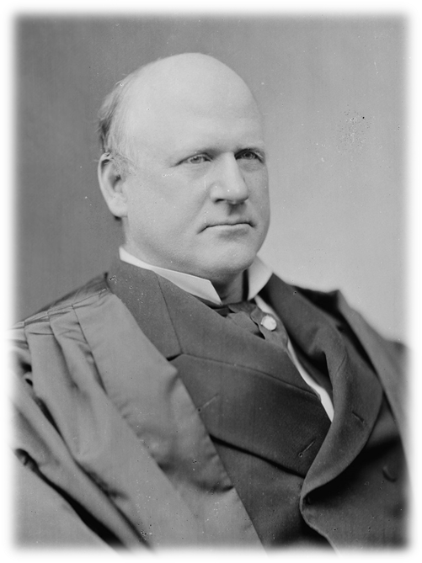
Key Source of Law: Cases
Jacobson v. Massachusetts
Setting: 1902 smallpox outbreak
Law: State statute compelling vaccination
Issue: Defendant refused vaccination and fined $5; challenged the constitutionality of the law
Holding: US Supreme Court upheld the law in 1905
  “[T]here are manifold restraints to which every person is necessarily subject for the common good.”
Justice Harlan
Notes:
Jacobson v. Massachusetts, 197 U.S. 11 (1905).
“The liberty secured by the Constitution of the United States to every person within its jurisdiction does not import an absolute right in each person to be, at all times and in all circumstances, wholly free from restraint. There are manifold restraints to which every person is necessarily subject for the common good. On any other basis organized society could not exist with safety to its members.”
Allowing a personal-choice exemption would “practically strip the legislative department of its function to care…for the public health…when endangered by epidemics of disease.” Jacobson v. Massachusetts, 197 U.S. 11 (1905).
The Supreme Court in Jacobson v. Massachusetts essentially lays out a balancing test between the need to protect the public and individual liberty. Collective action for the common good is predicated on aiding individuals infected or exposed while protecting others from inadvertent exposure.

Slide 19
Selected Legal Issues in Public Health
Balancing individual v. state interests
Jurisdiction
Duty
Authority to act
Liability
Property
Ethics
Privacy
Notes:
Individual liberties—The US Constitution is the source of individual liberties such as freedom of speech and religion, the right to assemble, and the right to be free of unreasonable searches and seizures. These liberties must be balanced with the states’ interest in protection the health and wellbeing of its citizens.
Jurisdiction—Who has jurisdiction? Is it federal, state, local? Ex. Quarantine –foreign and interstate - federal; intrastate - state
Duty—Does the government have to act to protect public health? Ex. Child welfare cases - DeShaney v. Winnebago (state has no affirmative duty to act – Due Process prevents improper governmental intrusion but doesn’t confer entitlement to government aid)
Authority to act—Who has the power to make a determination? Ex. Closing school during a pandemic – PH or Ed?
Liability—Who can be held liable? E.g., tobacco companies being sued for lung cancer; fast food companies being sued for obesity. What if someone is injured from a vaccine? If the government has said that certain people along the chain are immune from liability, where can victims find compensation?
Property - If the government takes property (such as diseased animals or crops) should the victim be compensated? What if the government has limited the use of the property ? E.g., zoning, no smoking in restaurants (supposedly revenues would decrease)
Ethics—Who will bear the burden of public health action and how is that decided? What ethical issues are involved when research involves people (informed consent, protecting subjects from harm, etc.)?
Privacy—What personal information can be disclosed and to whom? Federal govt. – privacy act; health care providers – HIPAA; What about notification of others who might be exposed?
The professor should encourage students to think of the Jacobson v. Mass balancing test—what weighs in favor of the public good? What weighs in favor of personal liberties? Should the government be able to compel vaccination? How do religious or philosophical exemptions play a part? What exemptions are available in this state? Have any outbreaks occurred in schools? What risks are associated from vaccinating? Not vaccinating? What if a particular individual has a higher risk (such as a child who is immuno compromised?)

Slide 20

Hypothetical Table Top Exercise
Super Duck Flu!
Notes:
Photo Credit: Thinkstock.

Slide 21
Hypothetical Table Top Exercise (Cont.)
Role play quarantine scenario
  Your role has been pre-assigned
  To make this fun and interesting, try to get into character
    Think like the person you are supposed to be
    Try to imagine what issues he or she would care about and why
  Try to refer to the laws and your own role description; if you have no idea . . . just use common sense!
  Be creative in thinking about potential legal and practical solutions!

Slide 22

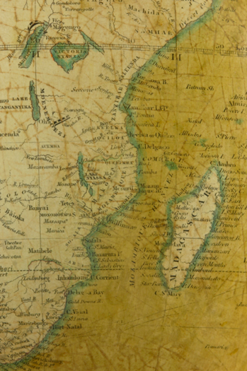
Introduction
New lethal disease
  Super Duck Flu (SDF)
  Incubation period 4–5 days
  Transmissible (can be spread) before onset of symptoms
    Spread through close person-to-person contact
  35% fatality rate (mainly 18–55 yrs old)
    Compare to seasonal flu = 3% fatality rate (mainly 55+)
  Origin: Madagascar
Notes:
Photo Credit: Thinkstock

Slide 23
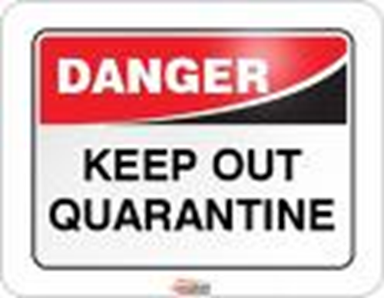
Isolation vs. Quarantine
What’s the difference?
What authority does CDC have?
Notes:
Isolation and quarantine help protect the public by preventing exposure to people who have or may have a contagious disease.
Isolation separates sick people with a contagious disease from people who are not sick.
Quarantine separates and restricts the movement of people who were exposed to a contagious disease to see if they become sick.
Source: http://www.cdc.gov/quarantine/quarantineisolation.html

Slide 24


The Flight – Day 1
Oceanic 815
  Johannesburg, South Africa to Atlanta, Georgia, USA
Incoming!

Slide 25


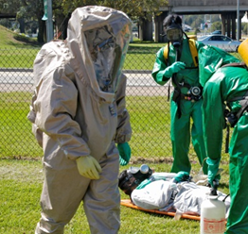

Detention – Day 1
Hangar 56
Protective gear?
Sick passenger taken to hospital?
Legal status?
How do we keep “healthy” people in the hangar?
Notes:
Photo credit: Thinkstock; FEMA Image Library

Slide 26
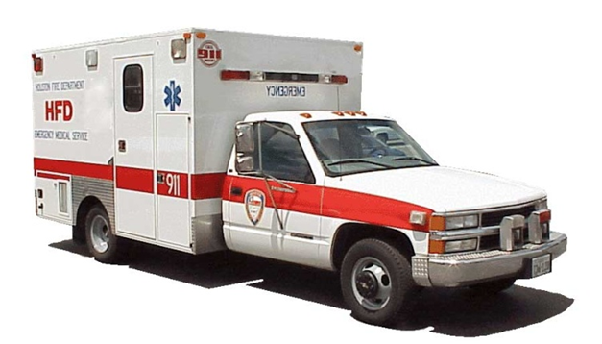
Formal Quarantine – Day 2
Sick passenger has preliminary positive test result for super duck flu (SDF)
Quarantine order by CDC
  6 days
    Atlanta residents go home
    Non-Atlanta residents go to hotel
  Good idea?
Notes:
Photo Credit: Thinkstock

Slide 27

I’m a Celebrity! Get Me out of Here! – Day 2
Rock star wants OUT!
Take the case?
Arguments?
Is CDC buying it?
Notes:
Photo Credit: Thinkstock

Slide 28

Habeas Corpus – Day 2
Habeas corpus
Arguments for release
Arguments for quarantine
Ruling . . .
Notes:
Photo Credit: Thinkstock

Slide 29

2 Weeks Later . . .
Everyone on the flight was SDF-free after all, BUT there are SDF cases confirmed in Georgia now . . .
  What should governor do?
Park Fest is coming up
  100,000+ people
  3 days
  Camping
Should the show go on?
  Political factors?
  Lost revenue?
Notes:
Photo Credit: Thinkstock

Slide 30

Shut It Down?
Can CDC do anything now?
Governor, what’s your decision?
And now, a performance by our very own rock star!
The End
Notes:
Photo Credit: Thinkstock

Slide 31
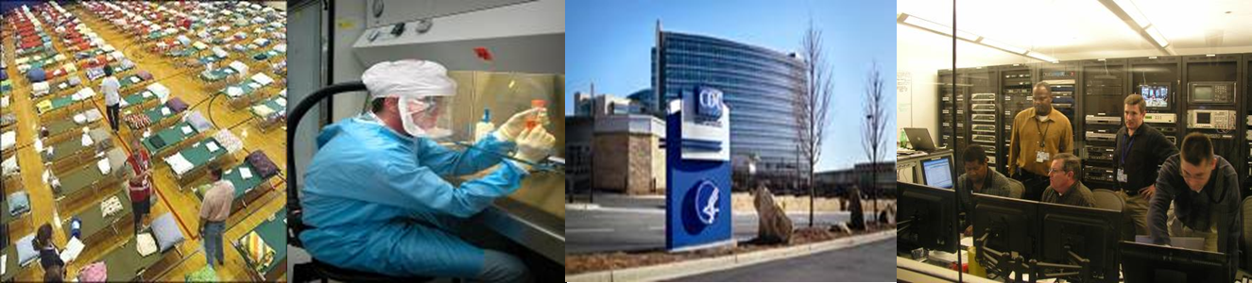
For More Information
Visit www.cdc.gov/phlp
  Subscribe to the monthly CDC Public Health Law News
  Take the Public Health Law 101 course online
Read “Law in Public Health Practice,” edited by Goodman, et. al., Oxford Univ. Press, 2007 (second edition)

Slide 32

For more information on PHLP, visit:
http://www.cdc.gov/phlp

