Slide 1
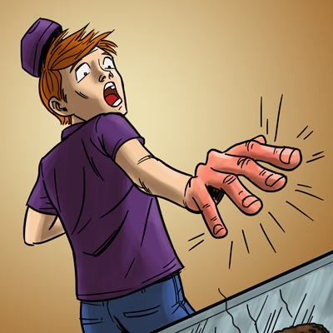
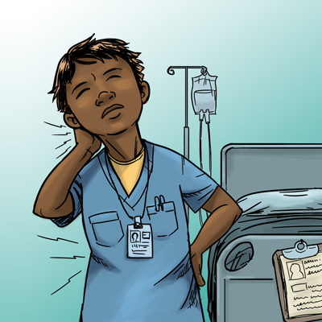
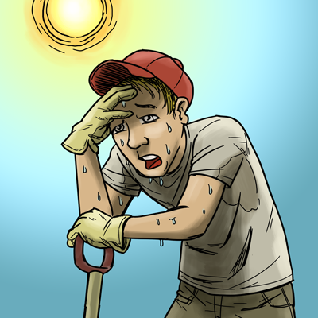
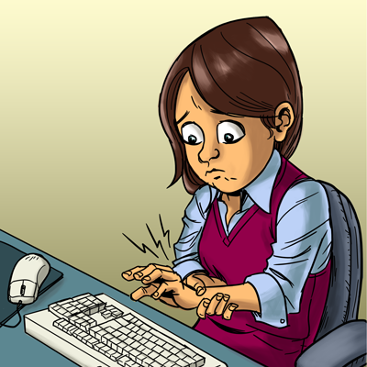
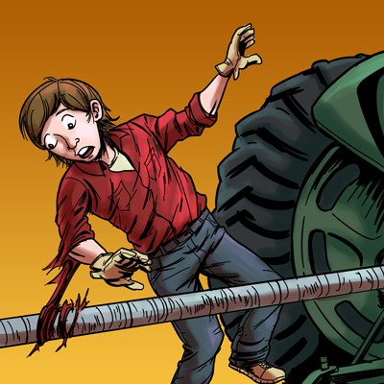


A Safety & Health Curriculum
for Young Workers
Alabama Edition
DEPARTMENT OF HEALTH AND HUMAN SERVICES
Centers for Disease Control and Prevention
National Institute for Occupational Safety and Health

Slide 2
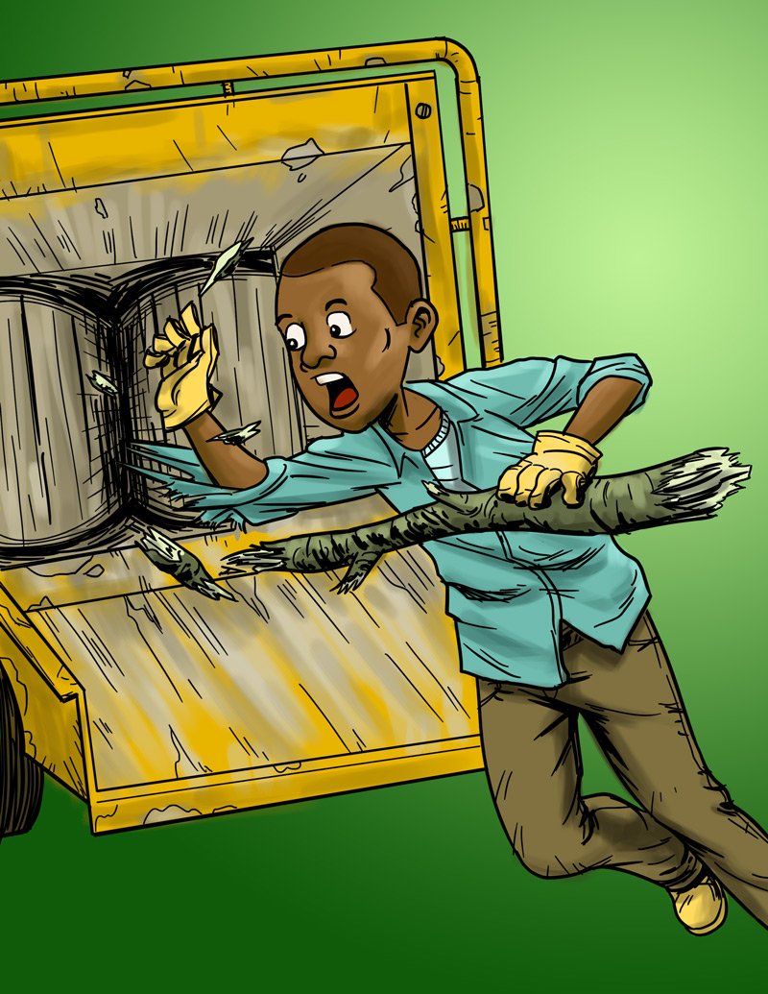
Young Worker Injuries
Lesson 1

Slide 3

You will learn about
Ways young workers can get hurt on the job
Common health and safety hazards on the job
Ways to reduce or control workplace hazards
Emergencies in the workplace and how to respond
What to do if you see something at work that could hurt you or make you sick
What legal rights and responsibilities young people have at work

Slide 4
What is Your Experience With Work?
How many of you have ever had a job?
Where did you work?
What did you do?
Have you ever been hurt at work, or do you know someone who has?
Have you ever been uncomfortable with a task you’ve been asked to do at work?
  Have you ever had any health and safety training at work?

Slide 5
Job Safety Quiz
The law says your employer is responsible for providing you with a safe and healthy workplace.
True False
The law sets limits on how late you can work on a school night if you are under 16.
True False
If you are 16 years old you are allowed to drive a car on public streets as part of your job.
True False

Slide 6
Job Safety Quiz (continued)
If you are injured on the job, your employer must pay for your medical care.
True False
How often do teens get injured on the job in the United States?
One per day One per hour
One every 9 minutes

Slide 7
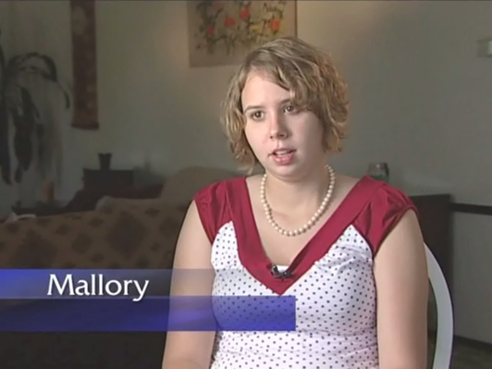
Why are Young Workers More Likely to be Hurt on the Job?
Video and Discussion
https://youtu.be/jy9YDD1LTiI

Slide 8
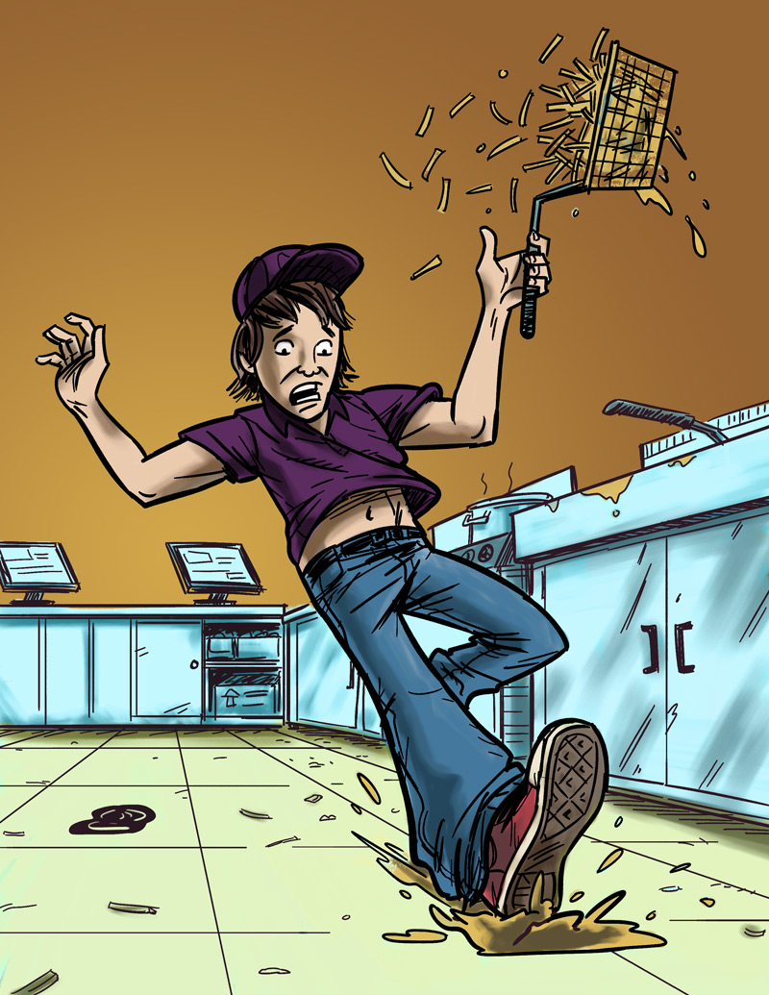
Examples of Teen Work Injuries
Jack’s Story
Job: Fast food worker
Hazard: Greasy, slippery floors
Injury: Injured tailbone
The Impact of Work Injuries
Why do you think this happened?
What could have prevented Jack from getting hurt?
How might this injury impact Jack’s daily life?

Slide 9
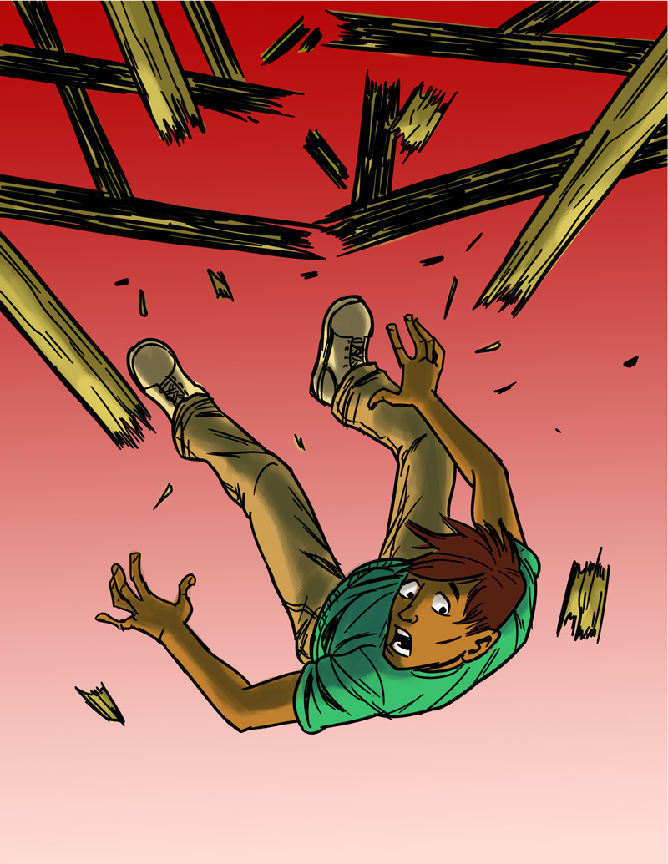
Teen Work Injuries
Antonio’s Story
Job: Construction helper
Hazard: Unguarded chimney hole (on an unfinished roof)
Injury: Broken back
The Impact of Work Injuries
Why do you think this happened?
What could have prevented Antonio from being injured?
How might this injury impact Antonio’s daily life?

Slide 10
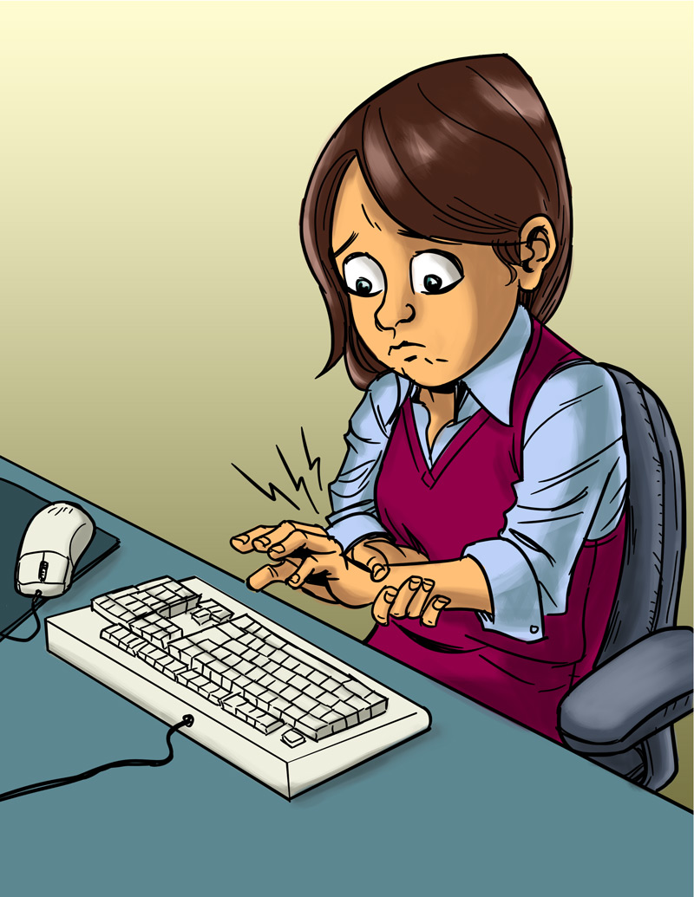
Teen Work Injuries
Angela’s Story
Job: Office worker
Hazard: Excessive typing in an awkward position
Injury: Repetitive stress injury
The Impact of Work Injuries
Why do you think this happened?
What could have prevented Angela from being injured?
How might this injury impact Angela’s daily life?

Slide 11
Teen Work Injuries
Terrell’s Story
Job: Landscape worker
Hazard: Wood chipper
Injury: Death
The Impact of Work Injuries
Why do you think this happened?
What could have prevented Terrell from being killed?

Slide 12
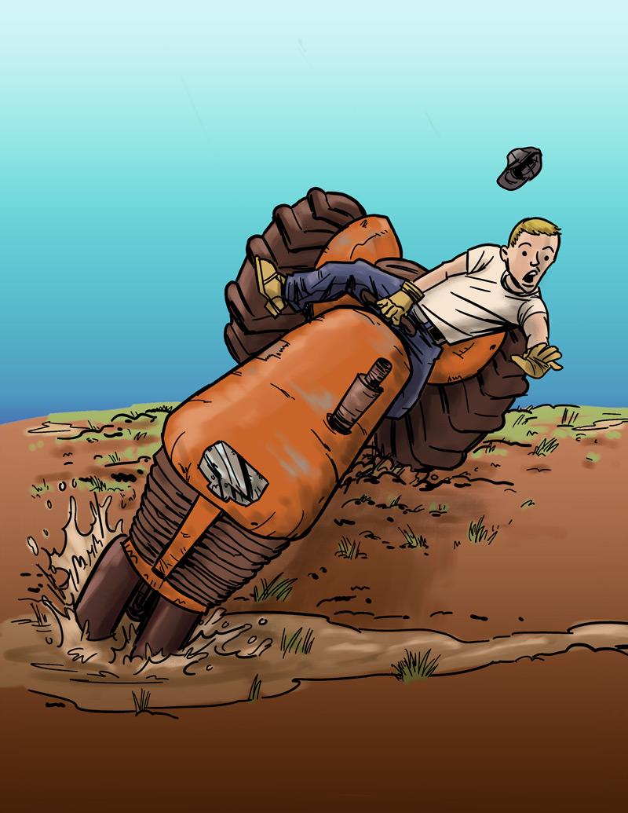
Teen Work Injuries
Cody’s Story
Job: Farm worker
Hazard: Tractor without roll bar
Injury: Legs crushed under tractor
The Impact of Work Injuries
Why do you think this happened?
What could have prevented Cody from getting hurt?
How might this injury impact Cody’s daily life?

Slide 13
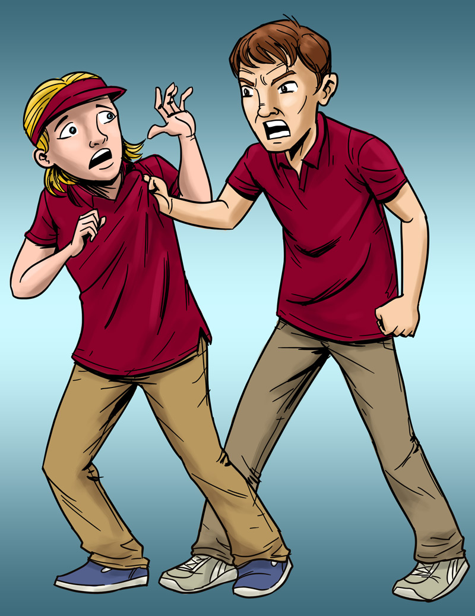
Teen Work Injuries
Lindsey’s Story
Job: Pizza shop cashier
Hazard: Violence (by a co-worker)
Injury: Bumps and bruises caused by abusive co-worker
The Impact of Work Injuries
What could Lindsey's employer have done to stop her abuser?
What would you do in this situation?
How might Lindsey’s life be affected by this incident?

Slide 14
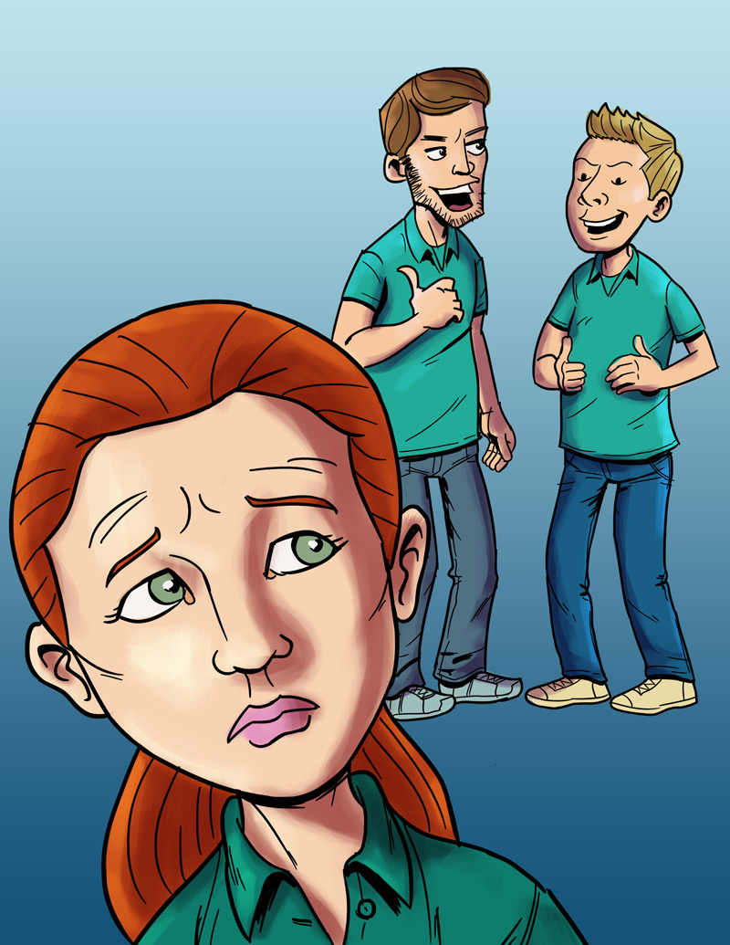
Teen Work Injuries
Anna’s Story
Job: Smoothie shop worker
Hazard: Sexual harassment
Injury: Emotional trauma
The Impact of Work Injuries
What could Anna's employer have done to stop her harasser?
What would you do in this situation?
How might Anna’s life be affected by this incident?

Slide 15
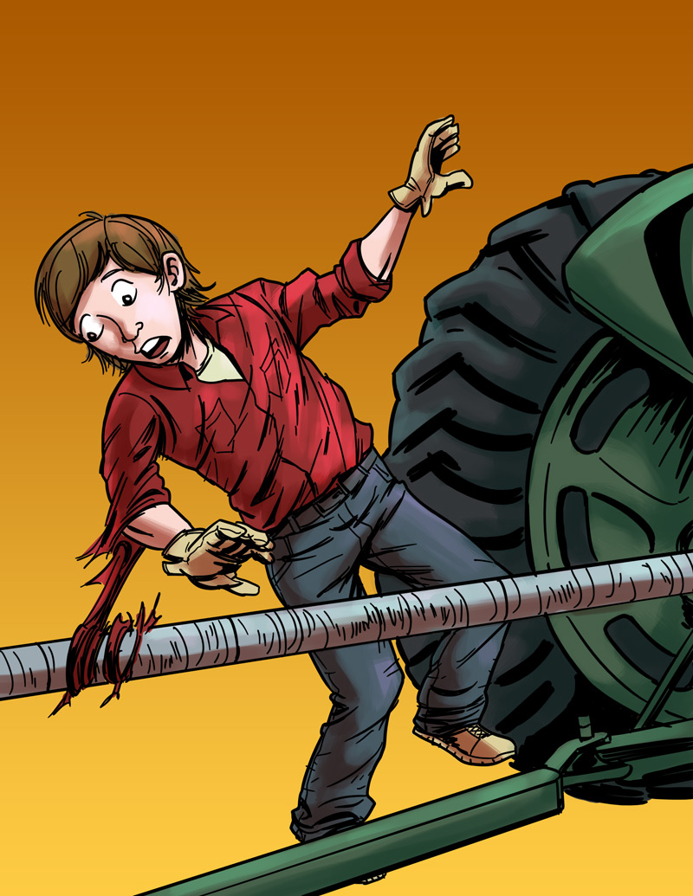
Teen Work Injuries
Logan’s Story
Job: Farm worker
Hazard: Unguarded, rotating bar on a tractor
Injury: Severed arm, broken neck
The Impact of Work Injuries
Why do you think this happened?
What could have prevented Logan from being injured?
How might this injury impact Logan’s daily life?

Slide 16
Teen Worker Injury Statistics
Approximately 1.6 million teens, ages 15–17, in the United States work. About 50% of 10th graders and 75% of 12th graders have jobs.
Many youths are injured on the job.
On average, each year
    59,800 workers younger than 18 are sent to the ER for job-related injuries, but actual injury statistics are much higher.
    37 workers younger than 18 die on the job.
  Young workers are two times more likely to be injured than adult workers.
NIOSH 2010 www.cdc.gov/niosh/topics/youth/chartpackage.html
www.cdc.gov/mmwr/preview/mmwrhtml/mm5915a2.htm

Slide 17
Teen Worker Statistics
Where Teens Work:
% of total workers, ages 15–17, per industry
*Includes restaurants
Based on national data, and may vary by state. Working teens under age 14 not represented. Youth farm workers not represented.
Source: NIOSH / CDC 2009 (www.cdc.gov/niosh/topics/youth/chartpackage.html)

Slide 18
Teen Worker Injury Statistics
Where Teens are Injured on the Job:
% of total workers, ages 15–17, per industry
*Includes restaurants.
These data are for injuries that require at least one day away from work. They do not include youth who work on small farms, work for government agencies, or are self-employed.
Source: NIOSH / CDC 2009 (www.cdc.gov/niosh/topics/youth/chartpackage.html)

Slide 19
Key Points of the Curriculum
By the end of the course, you will be able to
Recognize and reduce hazards on the job
Identify the laws that protect teens from working too late or too long
Identify the laws that protect teens from doing dangerous work
Identify the laws that protect teens from discrimination (including harassment) at work
Assess ways to solve health and safety problems at work
Name some of the agencies that enforce health and safety laws and child labor laws
Determine what to do in an emergency

Slide 20
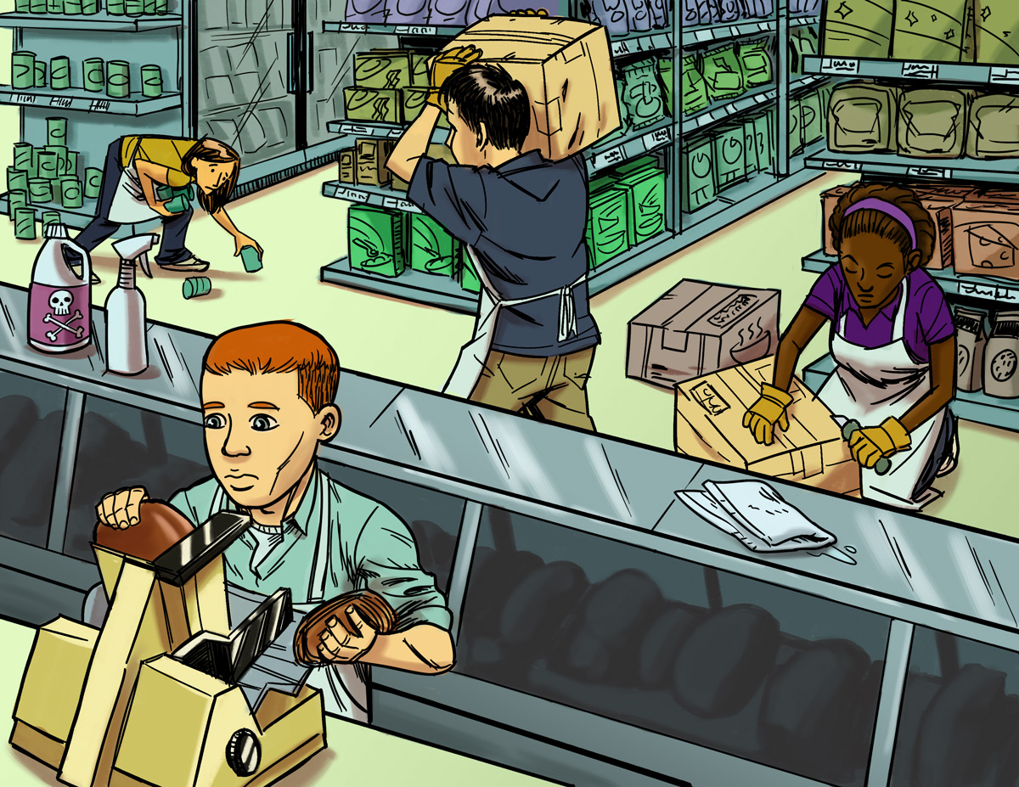
Finding Hazards
Lesson 2 (and 2B)

Slide 21
Job Hazards
A job hazard is anything at work that can hurt you either physically or mentally.
Some are obvious (easily seen), but others are not. Some hazards can hurt you now, while others may cause health problems in the future.
Safety hazards can cause immediate injuries
  Knives, hot grease
Chemical hazards are gases, vapors, liquids, or dusts that can harm your body
  Cleaning products, pesticides

Slide 22
Job Hazards (continued)
Biological hazards are living things that can cause sickness or disease, such as HIV/AIDS, hepatitis, tuberculosis.
  Bacteria, viruses
Other health hazards are other harmful things that can injure you or make you sick.
  Noise, radiation, repetitive movements, heat, cold, stress, harassment

Slide 23
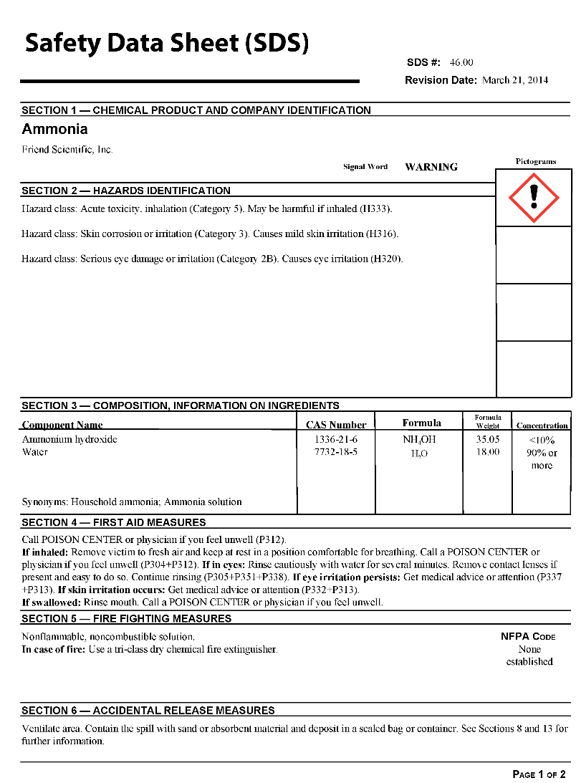
What is an SDS?
Safety Data Sheet (SDS)
  Information sheets that manufacturers must send to companies along with their chemical products
  An SDS tells you:
    What is in the product
    How it can harm you
    How to protect yourself

Slide 24
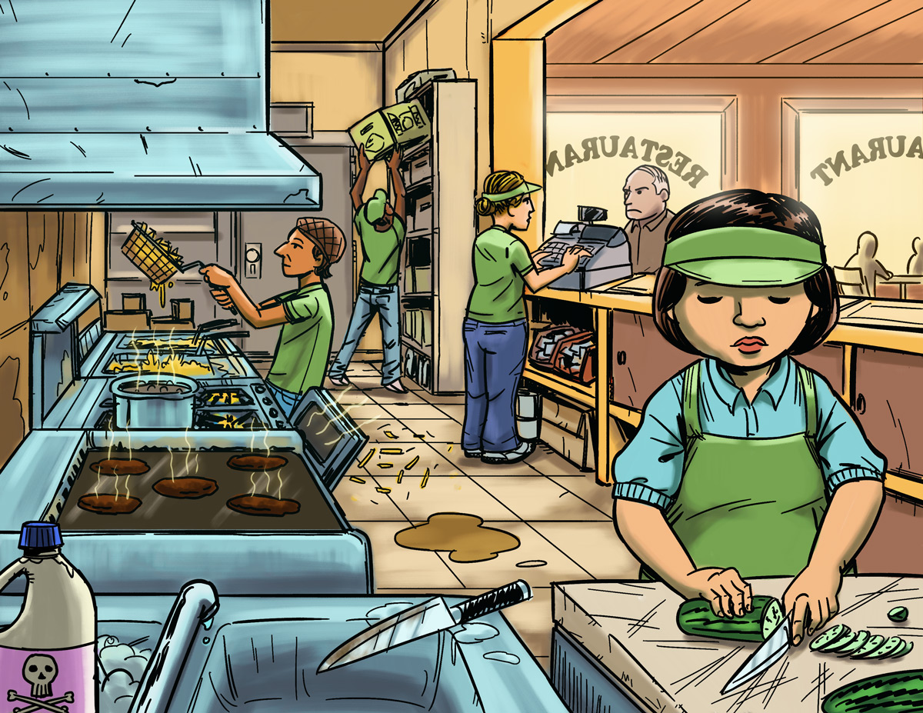
Find The Hazards: Fast Food Restaurant
a
Illustrated Workplaces

Slide 25
Find The Hazards: Grocery Store
a
Illustrated Workplaces

Slide 26
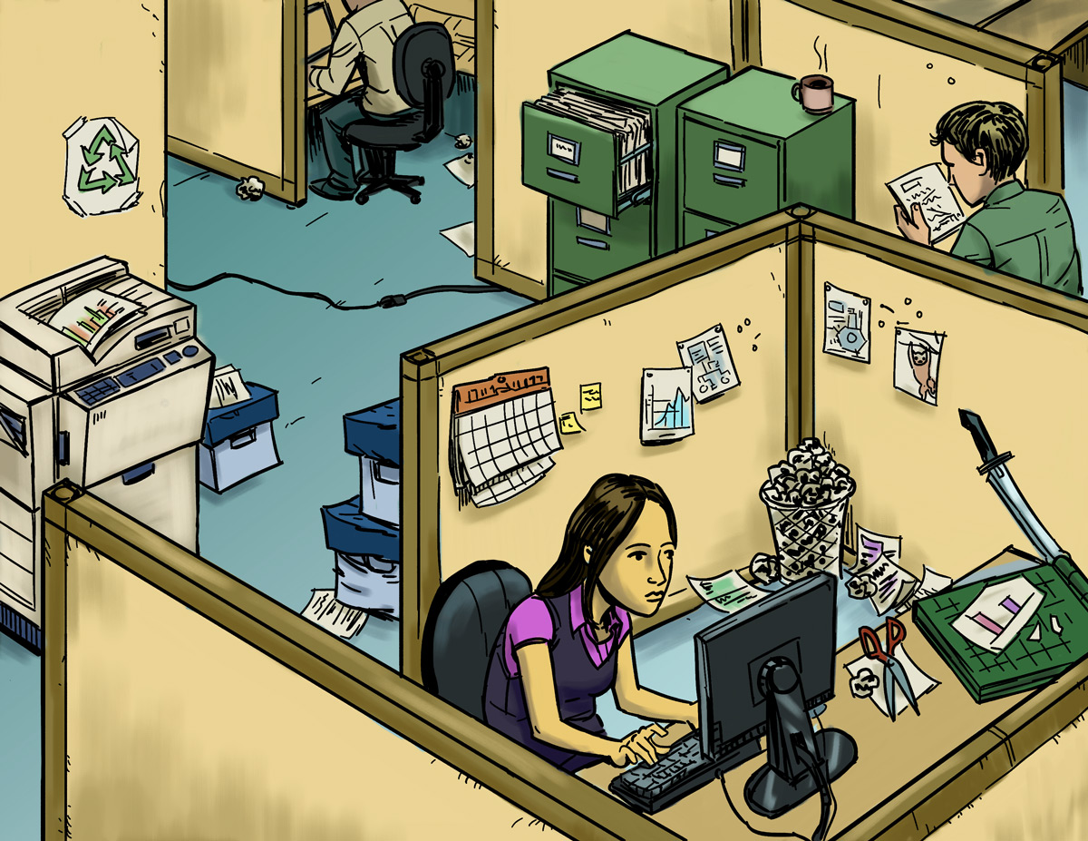
Find The Hazards: Office
a
Illustrated Workplaces

Slide 27
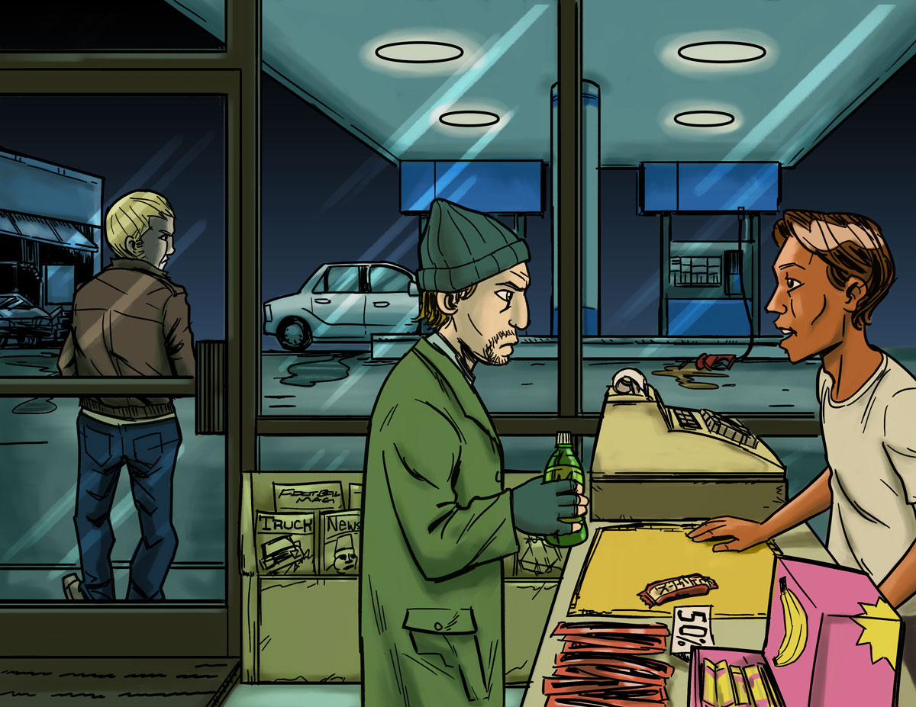
Find The Hazards: Gas Station
a
Illustrated Workplaces

Slide 28
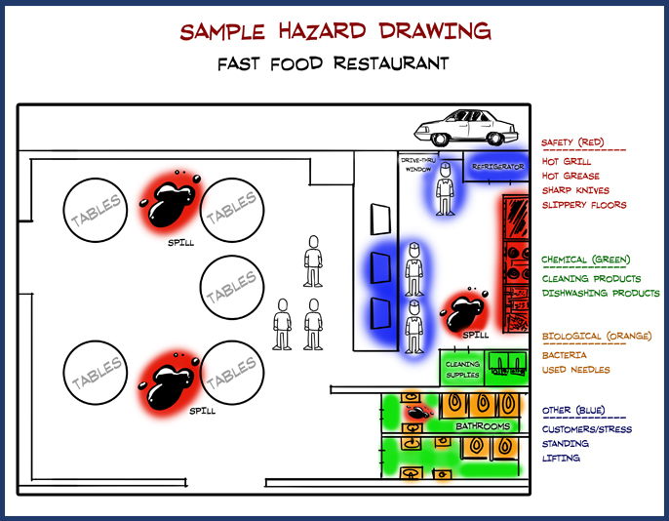
Hazard Mapping Activity

Slide 29
Finding Hazards: Main Points
All workplaces have hazards. A job hazard is anything at work that can hurt you, physically or mentally.
Some job hazards are obvious (easily seen), but others are not. Some hazards can hurt you now, while others may cause health problems in the future.
To be safe on the job, you must identify different types of hazards.
People have a right to know about chemicals and other hazardous substances in their workplaces! When using a new chemical, read labels and check the SDS (Safety Data Sheet).
An SDS tells you what is in a chemical product, how it can harm you, and how to protect yourself.

Slide 30
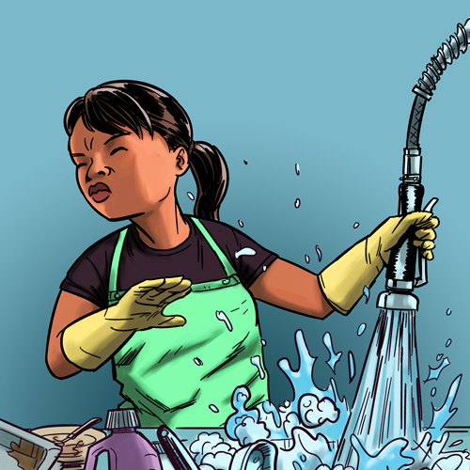
Making the Job Safer
Lesson 3 (and 3B)

Slide 31

Controlling Hazards
a
Remove
the Hazard
$2000
(for example, use safer
chemicals, use a machine guard)
Improve Work
Policies & Procedures
$1000
(for example, conduct training,
assign enough people to do the job)
Wear Personal Protective Equipment (PPE)
$500
(for example, wear gloves, use a respirator)

Slide 32
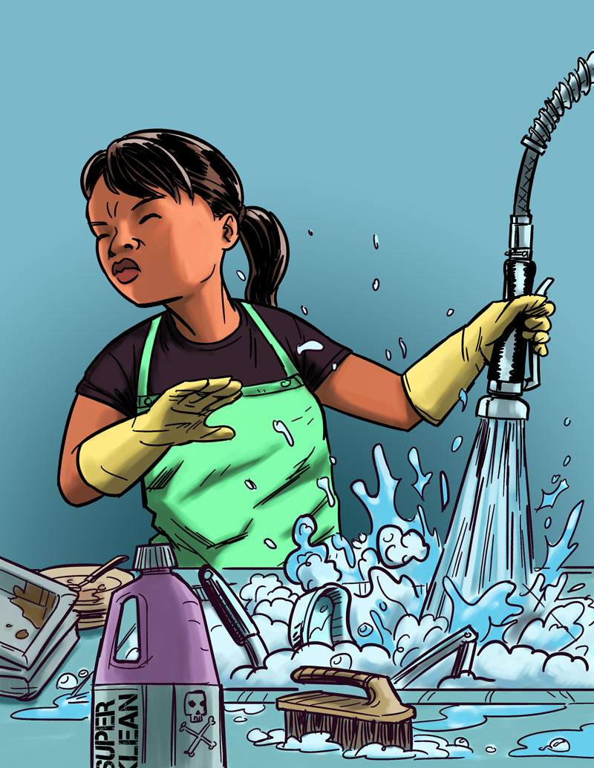
Eliminating or Reducing Hazards
Jasmin’s Story
Job: Hospital dishwasher
Hazard: Chemical dishwashing solution
Injury: Chemical burn to the eye
$25,000 Safety Pyramid Game

Slide 33
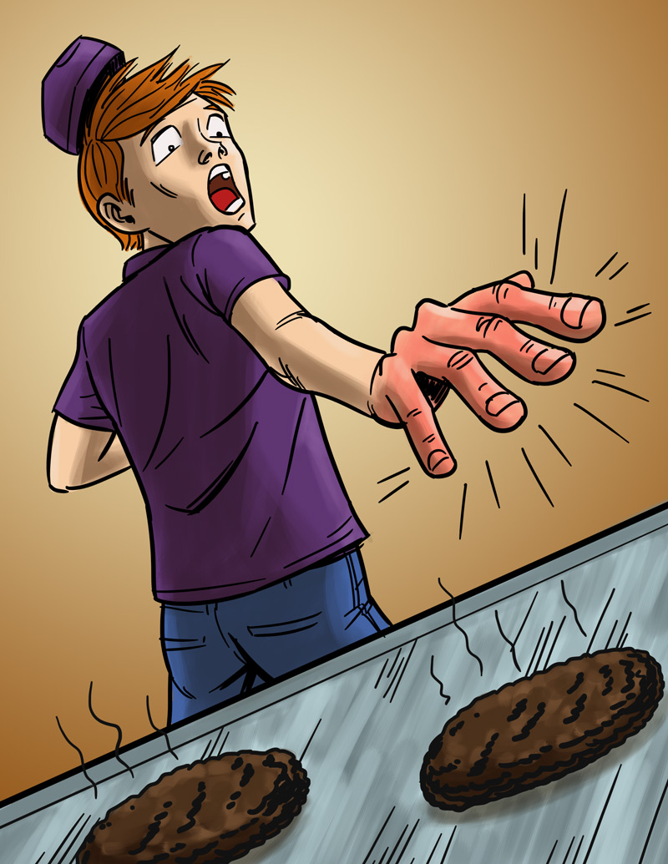
Eliminating or Reducing Hazards
Will’s Story
Job: Fast food worker
Hazard: Hot grill
Injury: Burned hand
$25,000 Safety Pyramid Game

Slide 34
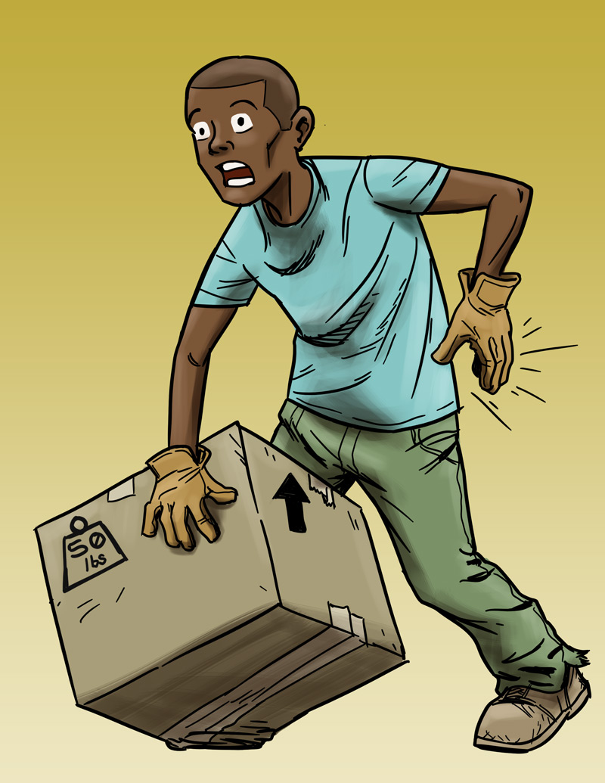
Eliminating or Reducing Hazards
Andre’s Story
Job: Grocery store clerk
Hazard: Lifting heavy boxes
Injury: Back strain
$25,000 Safety Pyramid Game

Slide 35
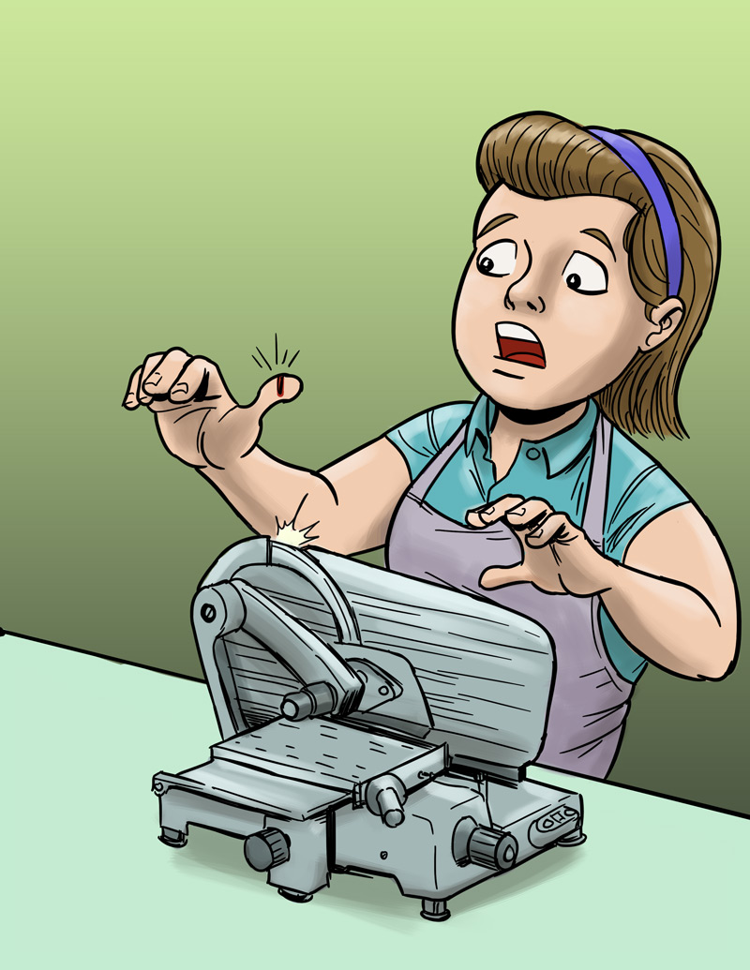
Eliminating or Reducing Hazards
Molly’s Story
Job: Grocery store deli clerk
Hazard: Meat slicer
Injury: Cut finger
$25,000 Safety Pyramid Game

Slide 36
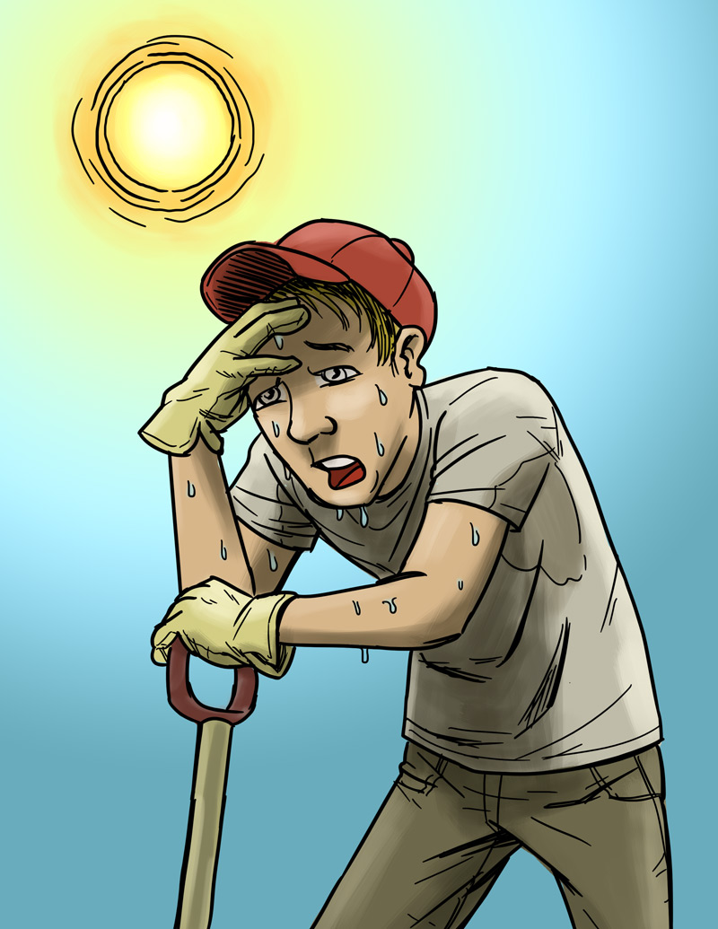
Eliminating or Reducing Hazards
Chris’s Story
Job: City public works employee
Hazard: Excessive heat
Injury: Heat stroke
$25,000 Safety Pyramid Game

Slide 37
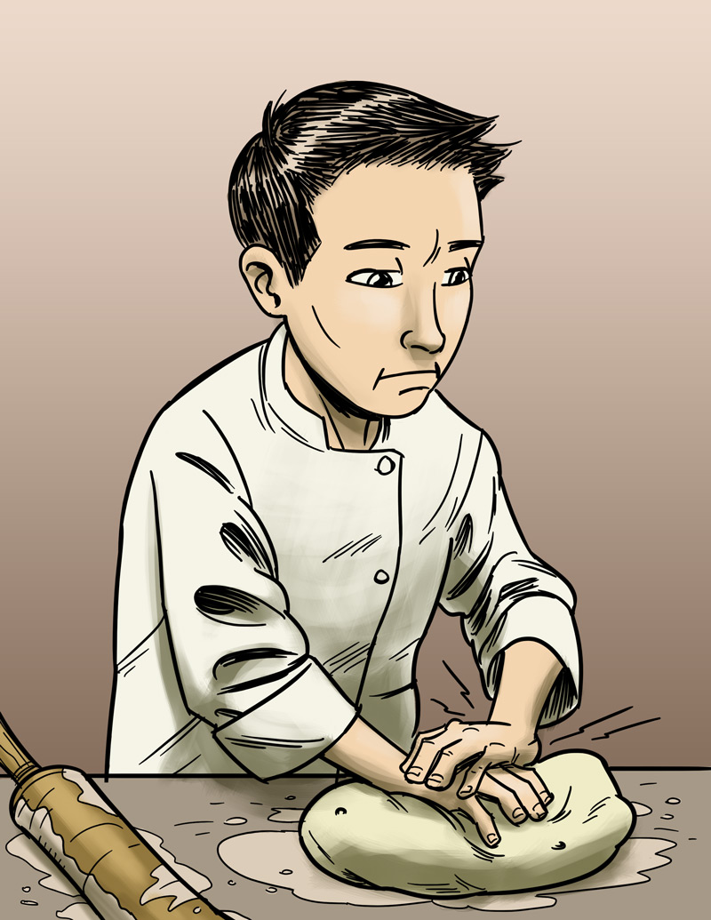
Eliminating or Reducing Hazards
James’s Story
Job: Pizza shop employee
Hazard: Repetitive motion
Injury: Hand, back injury
$25,000 Safety Pyramid Game

Slide 38
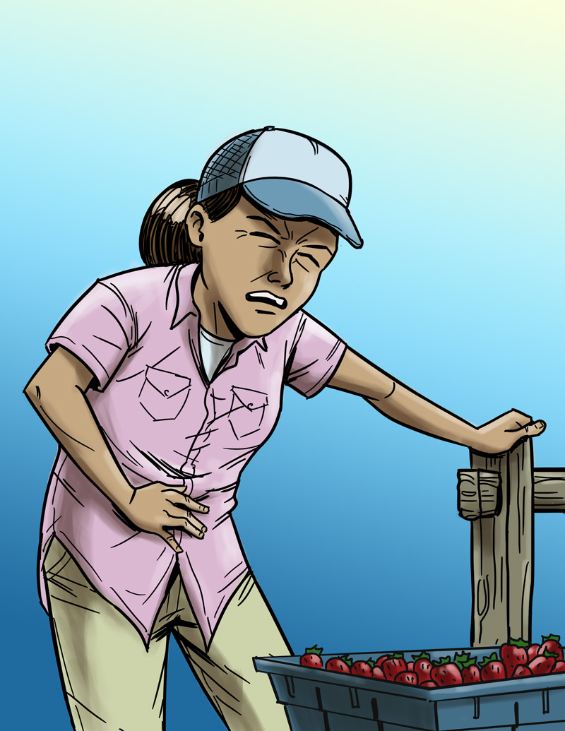
Eliminating or Reducing Hazards
Maria’s Story
Job: Farm worker
Hazard: Pesticide/chemical exposure
Injury: Illness due to poisoning
$25,000 Safety Pyramid Game

Slide 39
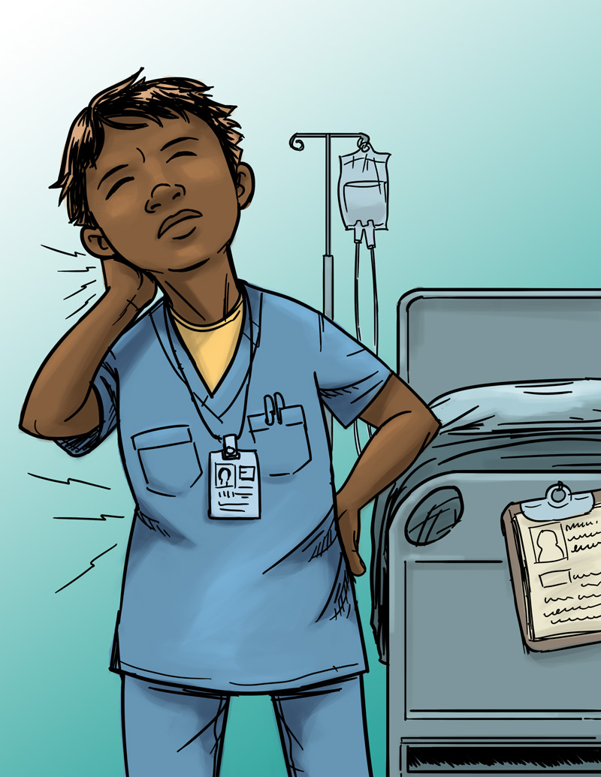
Eliminating or Reducing Hazards
Jada’s Story
Job: Nursing aide
Hazard: Heavy lifting
Injury: Back, neck, and shoulder pain
$25,000 Safety Pyramid Game

Slide 40
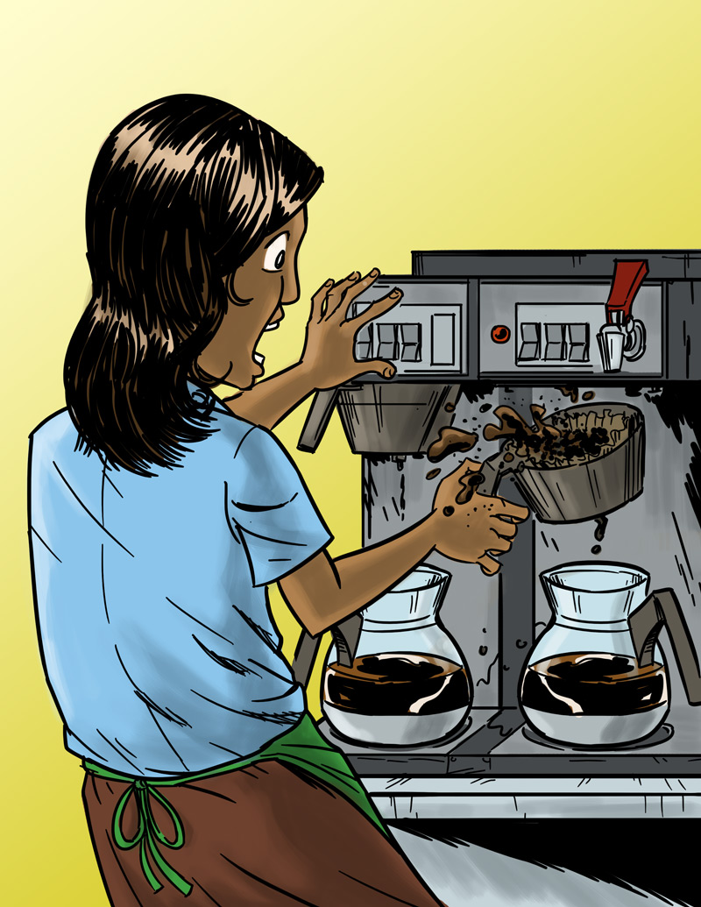
Eliminating or Reducing Hazards
Anita’s Story
Job: Barista
Hazard: Hot liquids
Injury: Burn
$25,000 Safety Pyramid Game

Slide 41
Making the Job Safer: Main Points
The best way to prevent a workplace injury or illness is to remove the hazard. If this can’t be done, then hazards can be controlled through work policies and procedures or the use of PPE (personal protective equipment), such as a respirator or hearing or eye protection.
Personal protective equipment is not usually the best way to protect workers because the hazard is still there, and because the equipment has to fit right and be used every time.
Most workplace injuries and illnesses are caused by unsafe environments—not human error.
A good way to think about addressing hazards in the workplace is, “Fix the workplace, not the worker.”

Slide 42
Emergencies at Work
Lesson 4 (and 4B)

Slide 43
Emergencies at Work
What is an emergency at work?
An unplanned event that harms or threatens employees, customers, or the public; that shuts down business operations; or that causes physical or environmental damage

Slide 44
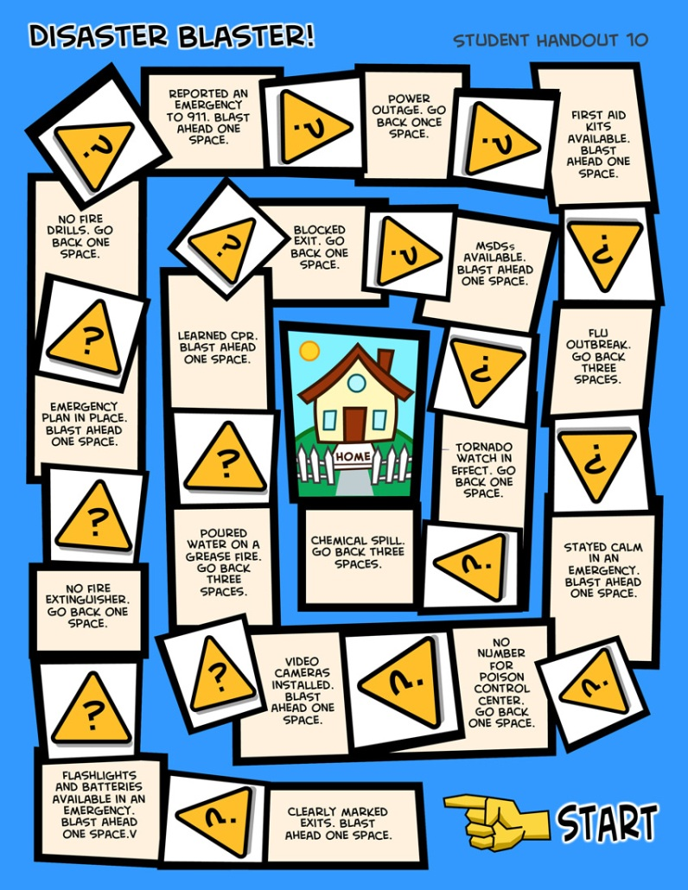

Emergencies at Work
Disaster Blaster! Game

Slide 45
Emergency Action Plans
Many workplaces need an emergency action plan. Workers should receive training on the plan.
The plan should include information about
  Different emergencies and how to respond
  Locations of meeting places
  Evacuation routes
  Emergency equipment and alert systems
  Key personnel (who’s in charge)
  Procedures to follow when someone is injured
  Individual worker responsibilities
  Practice drills

Slide 46
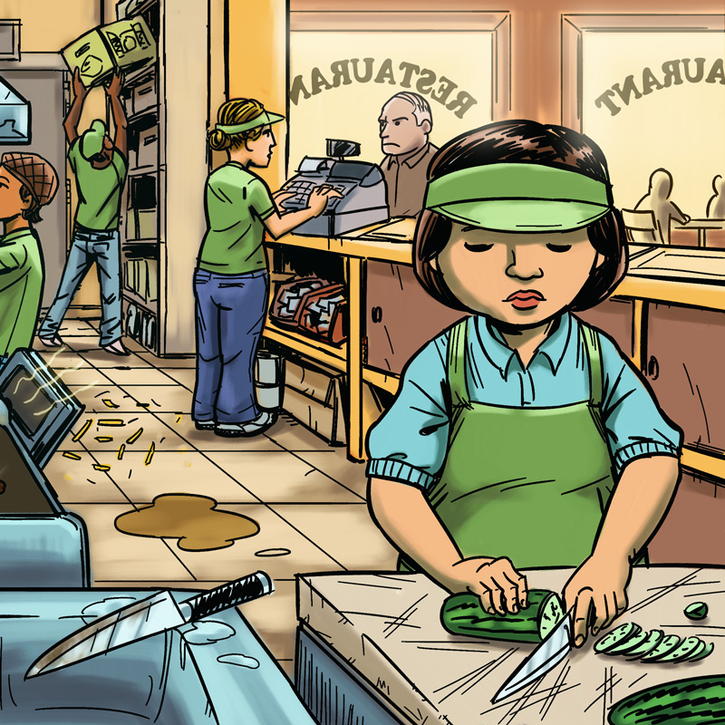
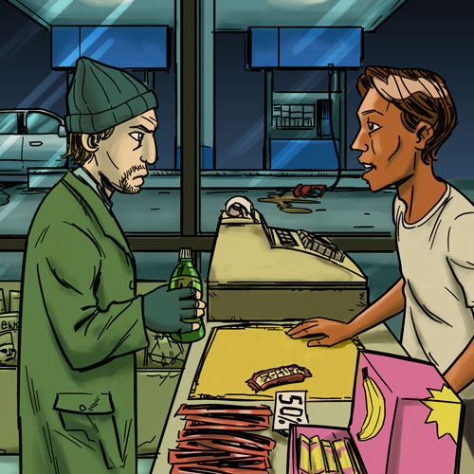
Know Your Rights and Responsibilities
Lesson 5 (and 5B)

Slide 47
Know Your Rights: Quiz Game
Questions
Rights on the Job | Dangerous Work and Work Permits | Child Labor Laws and Work Hours | Getting hurt, Getting help, Staying safe
$100
$100
$100
$100
$200
$200
$200
Some states require teens under 18 and still in school to get this before starting a job.
Click to close
It’s illegal for teens under 18
to operate these machines
(name 2).
Click to close
$200
These federal agencies handle complaints about workplace health and safety.
Click to close
Workers have rights on the job, including these (name 2).
Click to close
This type of insurance pays wages and medical benefits for workers hurt on the job. In exchange, the worker gives up the right to sue the employer.
Click to close
You can stay safe at work by doing these things (name 2).
Click to close
It’s illegal for teens under 18 to do these types of construction work (name 2).
Click to close
You have to be this old to operate a forklift.
Click to close
When you turn
this age, you aren’t protected anymore by child labor laws.
Click to close
Your employer must give you these health and safety protections on the job
(name 2).
Click to close
AL law says that this is
the latest time teens 16 and 17 can work on school nights.
Click to close
AL law says that this is
the maximum number of hours 14- and 15 year-olds can work in a school week.
Click to close
These laws protect teens from
working too long, too late,
or too early.
Click to close
These are two rights you
have if you’re hurt on the job.
Click to close
This federal agency handles complaints about wages and work hours.
Click to close
AL law says that
14- and 15-year-olds can
work until this time on
a school night.
Click to close
It’s illegal for your employer to punish you for doing this
(name 1).
Click to close
It’s illegal for 14-and 15-year olds to do some jobs, including these (name 2).
Click to close
The law says that
your employer must pay you this amount per hour, your state’s minimum wage.
Click to close
If you are hurt at work, you should take these steps
(name 2).
Click to close
$300
$300
$300
$300
$400
$400
$400
$400
$500
$500
$500
$500

Slide 48
Know Your Rights: Main Points
OSHA laws protect workers from job hazards. Employers must provide a safe and healthy workplace, training, and safety equipment.
Tell your supervisor right away if you’re injured at work! You can’t be fired for reporting work hazards.
Departments of Labor enforce child labor laws. The Equal Employment Opportunity Commission (EEOC) protects workers from discrimination and harassment at work.
Child labor laws protect teens from working too long, too late, too early, or in certain dangerous jobs.
Young people have rights and responsibilities at work.

Slide 49
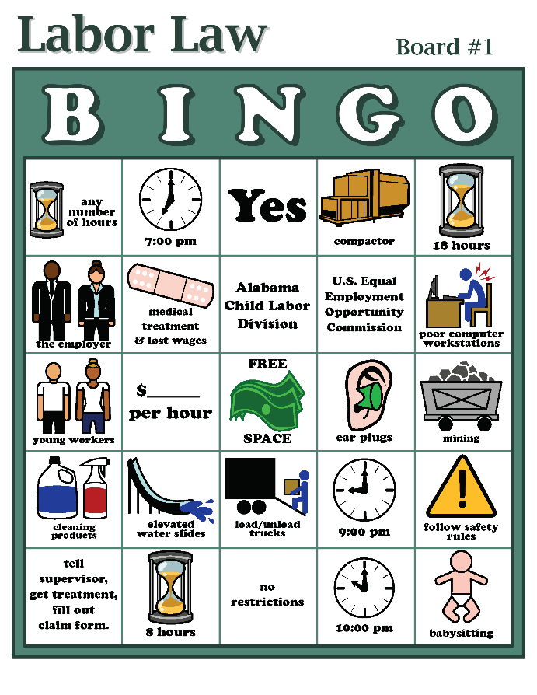
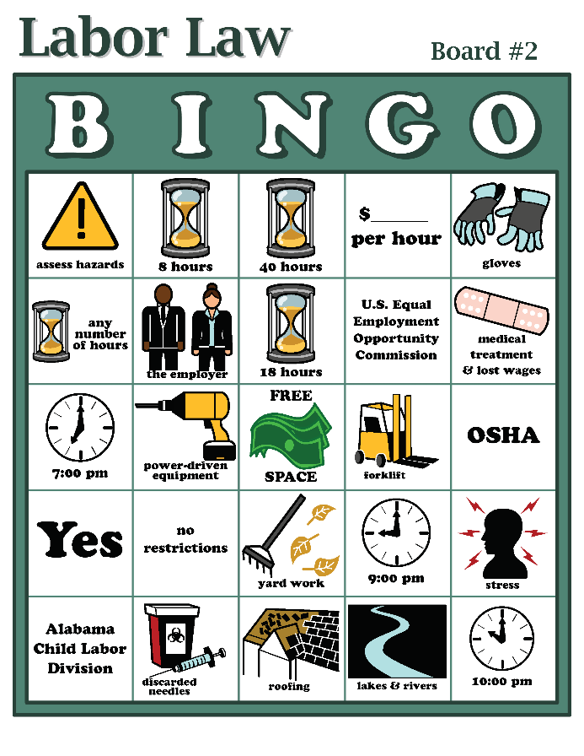
Know Your Rights
Labor Law Bingo Game

Slide 50
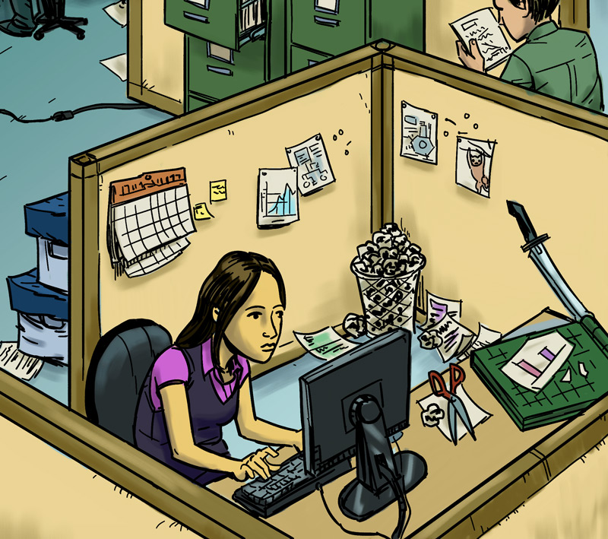
Taking Action
Lesson 6 (and 6B)

Slide 51
How to Approach a Workplace Problem
Steps in Problem Solving
Define the problem.
Get advice.
Choose your goals.
Know your rights.
Decide the best way to talk to the supervisor.
Contact a state or federal Wage & Hour Division or OSHA for help, if necessary.
Talk to a teacher, parent, co-worker, or other trusted adult.

Slide 52
Taking Action: Main Points
Steps for approaching a workplace problem include: defining the problem; getting advice; choosing goals; knowing your rights; talking to your supervisor.
If you don’t feel comfortable talking with your boss, speak with a trusted adult, OSHA, or another agency.
Trust your instincts! Don’t be afraid to speak up if you have a problem at work!

