Slide 1
Data Modernization Initiative: Updates from the National Vital Statistics System (NVSS)
Paul D. Sutton, Ph.D.
Deputy Director, Division of Vital Statistics
Board of Scientific Counselors | May 26, 2022

Slide 2
NVSS Modernization
We are reinventing the NVSS to make vital information more available for action
Moving vital
information faster
Improving
data quality
Informing
emergency response
Enhancing data
analysis methods
Build a broad community to implement new technologies, like FHIR, that create interoperability across our nation’s systems
Offer guidance, training, technology, and support to make birth and death data more accurate and complete
Release provisional data that can be used for public health surveillance and response that are made available in advance of our final data releases.
Apply methods to better analyze available data, (e.g., mining information from the written (literal) cause of death text on the death certificate)

Slide 3
Interoperability: APIs and FHIR Standards

Slide 4
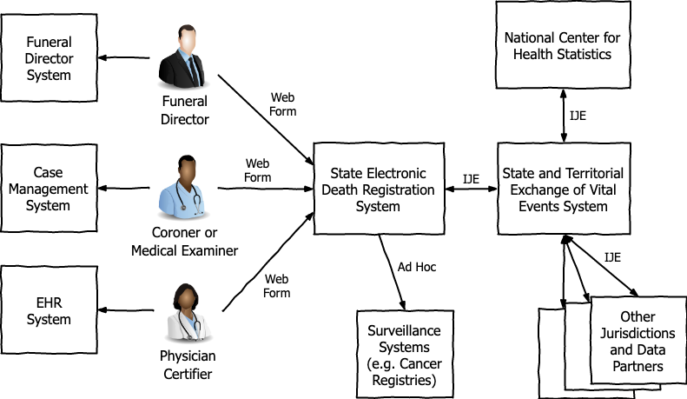
Current State of Mortality Data Interoperability
IJE = Inter-Jurisdictional Exchange Format

Slide 5
Improved Interoperability
Record level exchange
Improve timeliness both sending data to NCHS and receiving responses from NCHS
Automation
Less time shepherding the process and more time deriving value from the data
Reliability and robustness
Build reliable message delivery into the architecture

Slide 6
Application Programming Interface (API)
The NVSS API will allow vital records jurisdiction mortality data systems to automate communication with NCHS in a robust and repeatable way.
Automation improves timeliness of data exchange and reduces burden on vital records stakeholders.
The NVSS API implements the NCHS Messaging Infrastructure section of the FHIR Messaging for NVSS documentation.
Notes:
http://build.fhir.org/ig/nightingaleproject/vital_records_fhir_messaging_ig/branches/main/appendix.html#nchs-fhir-messaging-infrastructure

Slide 7
Fast Healthcare Interoperability Resources (FHIR) Standards
Standard for the electronic exchange of health information.
Created by the Health Level Seven (HL7) International standards organization.
Uses standard data representations that allow health information to be reused by multiple parties for multiple purposes.
Follows the 80/20 rule: the base standard covers 80% of health use cases and is extensible to support the remaining 20%.
The Vital Records Death Reporting (VRDR) FHIR Implementation Guide builds on the base FHIR standard to support the capture and exchange of mortality data.

Slide 8
Why FHIR for Vital Records?
Standardization within vital records
Standardization against non-vital records systems
Automated validation
Developer support
Common technologies
Shared tools
Large technical community
Transferable skills
Process improvements

Slide 9
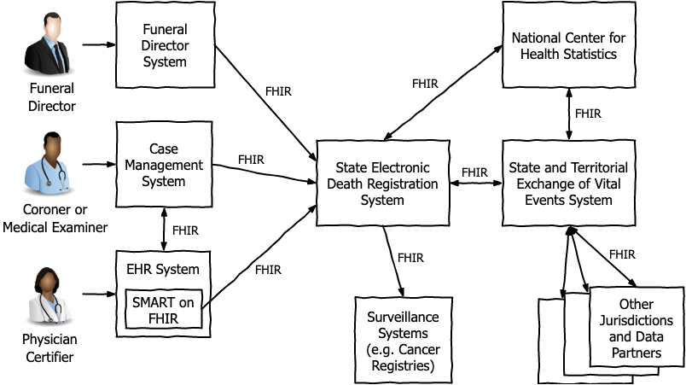
FHIR-based Mortality Data Interoperability

Slide 10
Application Programming Interfaces (APIs)
complete
NCHS has implemented a fully functional NVSS API that is available to jurisdictions for testing. The NVSS API can receive and process test massages from the jurisdictions and generate appropriate response messages. The production NVSS API server will be rolled out later this year.
https://github.com/nightingaleproject/Reference-NCHS-API
An opensource Reference Client API is also available to all jurisdictions to download. The Reference Client API is an example implementation for jurisdictions that handles submitting VRDR FHIR Messages, reliable delivery (acknowledgements and retries), and retrieving message responses from the NVSS API server.
https://github.com/nightingaleproject/Reference-Client-API

Slide 11
VRDR STU v1.3 FHIR Implementation Guide http://build.fhir.org/ig/HL7/vrdr/
complete
Maps all Inter-Jurisdictional Exchange (IJE) fields currently in use to FHIR Profiles
Submission of Death Records to NCHS
TRX and MRE-equivalent Coding Responses to Jurisdictions
Provides full documentation of the mapping
Data dictionary shows how each IJE field is mapped to FHIR elements
Complete value sets included in Implementation Guide
Examples for all profiles and extensions
VRDR .NET and Java libraries available to map all fields to/from IJE
Plan to start HL7 process after feedback from June testing event

Slide 12
Vital Records Messaging FHIR Implementation Guide http://build.fhir.org/ig/nightingaleproject/vital_records_fhir_messaging_ig/
complete
Now provided as a complete FHIR Implementation guide
Supports all messages in Vital Records Workflow
Submission/Update of Death Records to NCHS
Submission/Update of Coding (Demographic and Cause of Death) to Jurisdictions
Void and Alias of Death Records

Slide 13
Vital Statistics Modernization Community of Practice

Slide 14
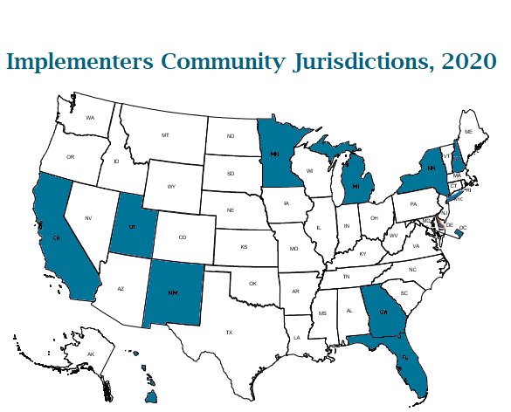
From an Implementers’ Community to a Community of Practice
Building on the same ideas that have worked well for the Implementers’ Community to modernize death data.
This Vital Statistics Modernization Community of Practice does not replace the Implementers’ Community and other workgroups but is an overarching body that remains open to any jurisdiction or partner working in the space of vital records modernization.

Slide 15
Vital Statistics Modernization Community of Practice
The Vital Statistics Modernization Community of Practice is a virtual forum for sharing ideas, technical tools, resources, and promising practices to improve birth and death data. We welcome all jurisdictions and partners interested in modernizing the vital records system, at any level of experience.
https://www.cdc.gov/nchs/nvss/modernization/cop.htm

Slide 16
Goals of the Vital Statistics Modernization Community of Practice
Create an environment that fosters technical collaboration, knowledge transfer, and sharing of lessons learned
Promote the adoption of modern standards for interoperability
Identify challenges and work toward solutions
Explore opportunities to collaborate with new partners
Promote best practices
Share advances and lessons learned with communities outside of the CoP who have relevant touchpoints
Foster innovation
Create “bi-directional” understanding of where participating entities are in terms of modernization efforts

Slide 17
Vital Statistics Modernization Community of Practice Offerings
Community Meetings | Communications | SharePoint Knowledge Management Site | On-demand Resources | Virtual Testing
Monthly CoP call Monthly technical subgroup call Weekly office hours | Monthly NVSS Newsletter List of email addresses of all CoP members NVSS Modernization Mailbox: NVSSModernization@cdc.gov | Meeting minutes Recordings Testing event artifacts Documents Peer-to-peer connection folder where jurisdictions can share relevant materials with each other | Training PowerPoints and videos Virtual helpdesk NVSS Modernization website NVSS Modernization SharePoint site | Scheduled quarterly virtual testing sessions

Slide 18
Active and Engaged Community
ongoing
Attendance by Month | Main Call | Technical Subgroup Call
April 2022 | 180 | 141
March 2022 | 219 | 140
February 2022 | 154 | 126
January 2022 | 137 | 135
Implementing a Community of Practice Steering Committee with representatives from jurisdictions, NAPHSIS, and NCHS. Steering Committee will assist with developing agendas for monthly community calls and help ensure the community understands and is effectively supporting all jurisdictions in their modernization efforts.

Slide 19
NCHS hosted Quarterly Testing Events (aka mini connect-a-thons)
ongoing
Next testing event scheduled for June 27-28th, 2022
Provide jurisdictions with an opportunity to test bidirectional FHIR based interoperability between EDRS, STEVE, and NCHS using the NVSS API
Testing event is free, less formal than traditional connect-a-thon events, and focus on assisting jurisdictions with achieving milestones in their ELC cooperative agreement project plan
Also, helps NCHS with validating recent changes/updates to the VRDR FHIR IG and Vital Records Messaging FHIR IG.

Slide 20
Coordinating Office for Medical Examiners and Coroners (COMEC)

Slide 21
FHIR-based Mortality Data Interoperability
Toxicology
FHIR

Slide 22
Medicolegal Death Investigation (MDI) Data Modernization
Develop MDI FHIR Implementation Guide (MDI IG)
Identify commonly collected and exchanged MDI data
Build tools and provide support for interoperability
Design API for MDI Case Management System to jurisdictions’ Electronic Death Registration Systems
Support design, test, build approach, including MDI participating in connect-a-thons to test MDI FHIR IG

Slide 23
MDI STU v1.0 FHIR Implementation Guide http://hl7.org/fhir/us/mdi/2022MAY/index.html
complete
Tested at HL7 Jan. 2022 FHIR Connectathon
NH, CT, GA and FL all participated and successfully tested
Balloted April 30-May 4
Met requirements for total number and positive votes to be published as standard for trial use

Slide 24
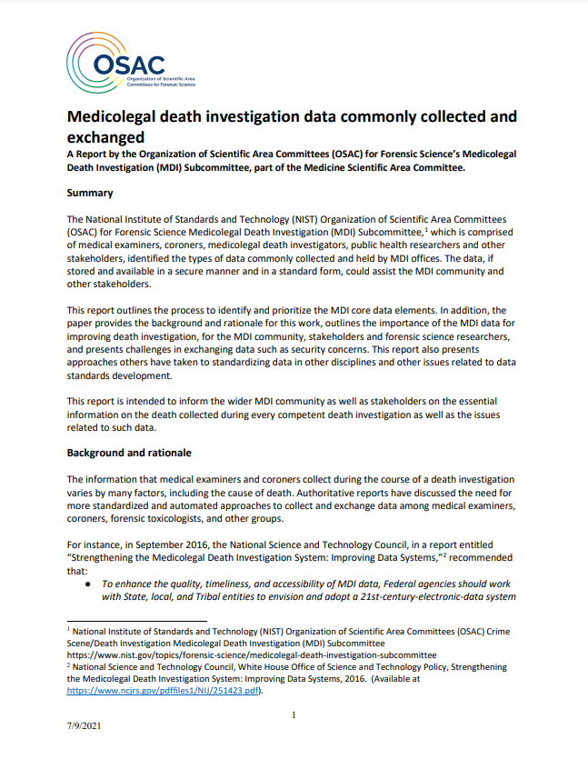
MDI Data: Commonly Exchanged
ongoing
Report from National Institute of Standards and Technology, Organization of Scientific Advisory Committees, Medicolegal Death Investigation Subcommittee
Working the medical examiner and coroner community to establish MDI data commonly collected and exchanged with stakeholders
Source: https://www.nist.gov/osac/medicolegal-death-investigation-subcommittee

Slide 25
MedCoder - Cause of Death Coding System

Slide 26
MedCoder
A new NCHS system for coding causes of death literal text from death certificates to ICD-10 codes
Based on a fusion of newer natural language processing and machine learning technologies with well-established rule-based approaches.
Benefits:
Much easier to maintain system
Streamlined process to make corrections
Systematic process to test changes/updates before they are implemented in production
Processes death records one record at a time
Prepares NCHS for FHIR standard-based record transmission

Slide 27
MedCoder Evaluation – Approach and Objectives
The entire 2020 dataset (about 3.4 million records) were processed through MedCoder and compared against the 2020 final data
Not strictly a comparison between MedCoder and legacy coding system (MMDS)
Evaluate consistency (i.e., % agreement) between MedCoder and final data
Identify systematic errors in MedCoder that will need manual review
Assess the effective throughput of MedCoder, i.e., % of records that can be autocoded correctly

Slide 28
MedCoder Evaluation - Results
Consistency was generally very good
Lack of consistency in some cases resulted from existing errors in the legacy system (MMDS)
No evidence of random errors. Some systematic errors identified and documented… these will be automatically rejected for manual review.
Estimated MedCoder throughput rate, i.e., % of records autocoded correctly by the system = approximately 85% (compared to ~70% with MMDS)
Conclusion: performance of MedCoder significantly exceeds performance of MMDS

Slide 29
MedCoder Implementation
coming next month
Blackout to begin June 6th (expected to last up to 2 weeks)
Cause of death coding of 2022 data will be paused during the blackout
Any data received from Jurisdictions will be queued and processed after the blackout
During the blackout all 2022 data will be reprocessed through MedCoder
When the reprocessing is complete all jurisdictions will be sent a new 2022 Year to Date file that contains the MedCoder coded cause of death

Slide 30
Data Dissemination
Improved Timeliness and Enhanced Access

Slide 31
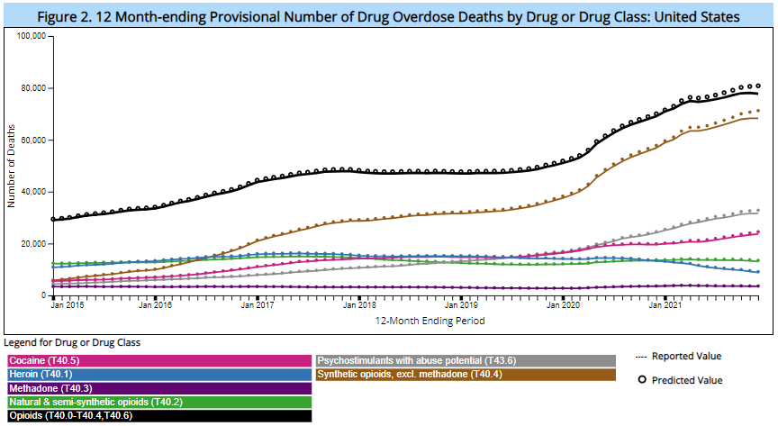
Improved Timeliness of Provisional Drug Overdose Counts
ongoing
Reporting lag for provisional drug overdose counts shortened by 2 months (from 6 months to 4 months).
Most recent provisional drug overdose counts available for 12-months ending December 2021.
https://www.cdc.gov/nchs/nvss/vsrr/drug-overdose-data.htm

Slide 32
Enhanced Access to Provisional Mortality Data via CDC WONDER
complete
https://wonder.cdc.gov/mcd-icd10-provisional.html

Slide 33
Enhanced Access to Provisional Birth Data via CDC WONDER
planning underway
Currently documenting requirements with development beginning soon thereafter.
Expect to launch later this year.

Slide 34
NVSS Modernization Discussion Questions
Are our goals and priorities consistent with the needs of the public health surveillance and research community?
What are we missing in our data modernization efforts (i.e., what should we be doing that we aren’t)?

