Slide 1
Provisional Mortality Data on WONDER Vital Statistics Rapid Release
National Center for Health Statistics
Farida B. Ahmad, MPH
Mortality Surveillance Lead
Division of Vital Statistics

Slide 2
Vital Statistics Rapid Release Program
Provides timely access to provisional mortality data to government agencies, researchers, and the public.
Provisional mortality data are non-final, preliminary estimates based on the current flow of death certificate data to the National Vital Statistics System
Data Modernization Initiative efforts have helped improve data quality and timeliness.

Slide 3
Proportion of U.S. Mortality Records Received Within 10 Days of the Date of the Event by Year

Slide 4
Expansion of VSRR Provisional Data Releases
2015
Quarterly Provisional Estimates, State and National Provisional Counts
2020
COVID-19 Surveillance and release of daily counts, Expanded Quarterly Provisional Estimates
2021
Provisional County-level Drug Overdose Death Counts, Early Model-based Provisional Estimates, Provisional Data released on WONDER
2016
2017
Provisional Monthly Drug Overdose Death Report
Vital Statistics Rapid Release Report on Timeliness, FluView Interactive switches to using NCHS Death Data
2016
2018
2020
2015
2017
2019
2021

Slide 5
CDC WONDER
“Wide-ranging Online Data for Epidemiologic Research”
Easy to use, menu-driven system that produces tables as output
Provides access to a wide array of public health information originated by CDC

Slide 6
WONDER Features
Customize queries by time period, geography, place of death, demographics and cause of death
Visualize results through charts
Save and share queries
Easily export results into text files
Set up APIs for web pages or widgets

Slide 7
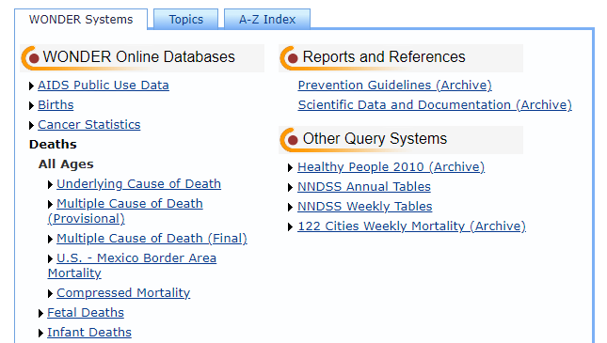
Provisional Data Available on WONDER
First added in December 2021
Updated monthly, first full week of the month
Data years available
Final data from 2018-2020
Provisional, non-final data through the most recent month
As of February 2022: January 2021 through January 22, 2022
NOTE: Data for injury-related deaths (e.g. drug overdose, suicide) are lagged by 6 months to account for delays in death certificate completion.

Slide 8
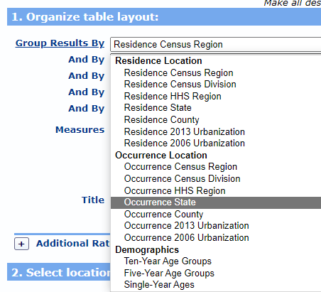
New Feature: Jurisdiction of Occurrence
NVSS provisional data are generally reported by jurisdiction of occurrence
WONDER previously only allowed queries by the decedent’s place of residence

Slide 9
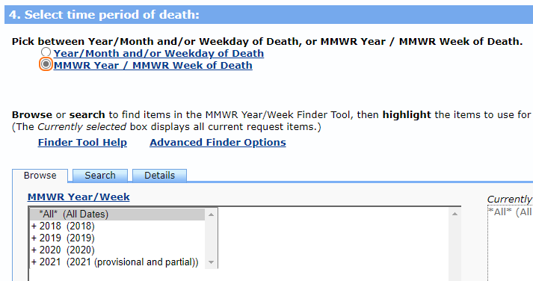
New Feature: MMWR week/year
Query deaths by the MMWR week in which the death occurred
Provides additional granularity to look at deaths over time.
NVSS COVID-19 surveillance data and FluView mortality data are reported by MMWR week of death.

Slide 10
Future improvements for Provisional WONDER
Weekly updates for provisional data
Link additional years of final data (1999-2017)
Including MMWR Year/Week
Add exclusion criteria for cause of death searches

Slide 11
Thank you

