Slide 1
NHANES Update:
NCHS Board of Scientific Counselors
National Center for Health Statistics (NCHS)
Alan Simon, MD, Director
Division of Health and Nutrition Examination Surveys
September 14, 2023

Slide 2
A new era of NHANES
National Health and Nutrition Examination Survey (NHANES)
We left the field in August 2023
Completing a 10 year contract cycle

Slide 3
Back in the field—January 2025
National Health and Nutrition Examination Survey (NHANES)
With a new contractor – RTI
Original aim was 2024
Delays obtaining contract meant started working with RTI just this year
Extremely aggressive timeline
Submitting ERB now

Slide 4
What will be the same?
National Health and Nutrition Examination Survey (NHANES)
Population-based survey
In-home interviews
In-person exams in Mobile Examination Centers

Slide 5
What will be different?
National Health and Nutrition Examination Survey (NHANES)

Slide 6
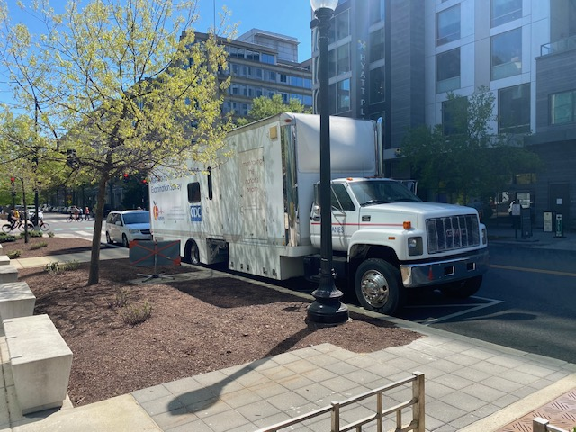
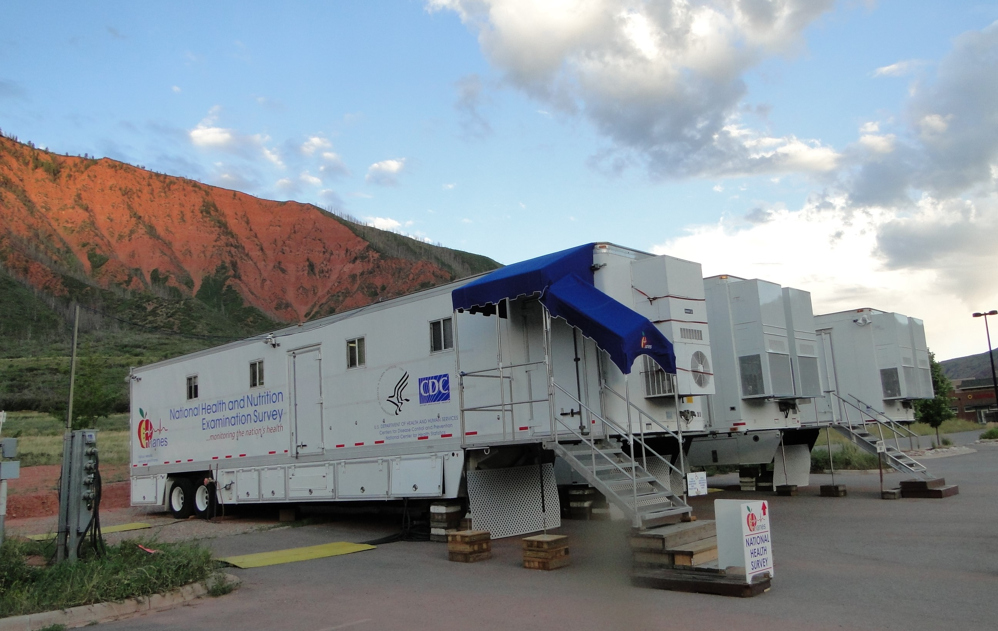
Trucks vs. Trailers
Trucks will allow us to be more nimble
More than one location within a PSU
Increase response rates
Three truck set will form a Mobile Examination Center

Slide 7
More Statistical Power
Going to more PSUs in the US each year – from 15 per year to 20
Still 5000 participants per year
Change from counties to Census Public Use Microdata Areas (PUMAs)
Decrease number from each household sampled
Spreading out sample across more households increases power
Create estimates for smaller groups than before

Slide 8
What will be in the survey in 2025?
For 2025
Anthropometry
Dental exam
Labs (Blood, Urine, return of genetics!)
BP (3-7 requires more testing)
Vision
Hearing
DXA
Spirometry returns
Nasal Microbiome
Medications
Dietary Recall

Slide 9
Collaborating with state and local data collections
October 4th Webinar with state and local NHANES-like collections
Allows us to learn from one another
Possibility for future collaborations?
Details and registration on website

Slide 10
Questions?
www.cdc.gov/nchs

