Slide 1
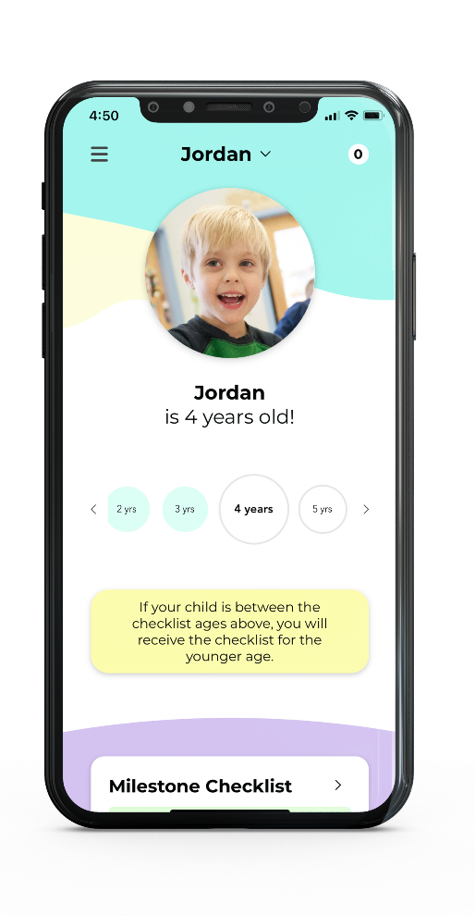
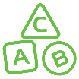
Help your child grow and thrive
Your child’s early years are so very important. Tracking how
your little one plays, learns, speaks, acts, and moves helps
you support their development.
Download CDC’s free Milestone Tracker app to find fun and easy activities for each age.
Track & Share
Milestones
Get Tips & Activities
Learn When
to Act Early
Learn more at cdc.gov/MilestoneTracker

