Slide 1


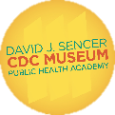

Smallpox Eradication
Notes:
At least 3,000 years ago, the variola virus (smallpox virus) emerged and began causing illness and deaths in human populations, with smallpox outbreaks documented in the historical record from time to time. More than 300 million people died from smallpox in the 20th century alone. Thanks to the success of global vaccination and disease surveillance programs in the 1960s and 1970s, the World Health Assembly declared smallpox the first disease to be globally eradicated in 1980.
Note: These slides are made possible by the David J. Sencer CDC Museum Public Health Academy. https://www.cdc.gov/museum/education/lessons/

Slide 2
 | the regular presence of a disease or infectious agent in a population
 | the reduction to zero of an infectious disease's presence in the global host population
 | the use of biological agents for the purpose of terrorism
 | study of the distribution and control of health-related issues, including diseases
 | the habitat in which an infectious agent normally lives, grows, and multiplies
 | brick or oval shaped viruses with large double-stranded DNA strands
Word Bank
bioterrorism
endemic
epidemiology
eradicate
poxvirus
reservoir
Notes:
Terms to Know
Bioterrorism - the use of biological agents for the purpose of terrorism (ex: anthrax, smallpox)
Endemic - the regular presence of a disease or infectious agent in a population
Epidemiology - study of the distribution and control of health-related issues, including diseases
Eradicate/Eradication - the reduction to zero of an infectious disease's presence in the global host population
Poxvirus - brick or oval shaped viruses with large double-stranded DNA strands; includes smallpox, monkeypox, and several others
Reservoir - the habitat in which an infectious agent normally lives, grows, and multiplies; can be human, animal (non-human), or environmental

Slide 3
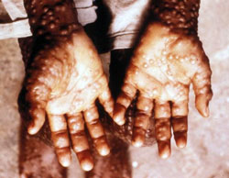
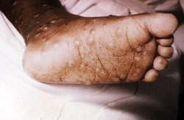
Understanding Smallpox
Smallpox is an infectious disease
  Caused by variola virus
  Skin rash beginning on tongue or mouth
  Fever
  Passed from person to person
  Only in humans
Has serious consequences
  3 out of 10 patients die
  Permanent scarring
  Some cases of blindness
Smallpox was eradicated in the
United States in 1949 through
vaccination
Notes:
Smallpox is a serious infectious disease caused by the variola virus. It is contagious, meaning it can spread from one person to another, but is only carried and spread by humans. People with smallpox have a fever and a distinctive, progressive skin rash that usually begins on the tongue or in the mouth. Most people with smallpox recover, but about 3 out of every 10 people with the disease die. Many smallpox survivors have permanent scars over large areas of their bodies, especially their faces, and some people are left blind.
Thanks to the success of vaccination, smallpox was eradicated, and no cases of naturally occurring smallpox have happened worldwide since 1977. The last natural outbreak of smallpox in the United States occurred in 1949. Smallpox research in the United States continues and focuses on the development of vaccines, drugs, and diagnostic tests to protect people against smallpox in the event that it is used as an agent of bioterrorism.

Slide 4

Think About It
What resources do you think were required to eradicate smallpox from the world?
The first smallpox vaccine was introduced in 1796. Why was it almost 200 years before smallpox was eradicated from the planet?
Why is smallpox considered to be a serious bioterrorism threat?

Slide 5
Smallpox and CDC
Global smallpox eradication efforts began in 1966
  Smallpox was still endemic in Brazil, West and Central Africa, eastern and southern Africa, much of southern Asia, and Indonesia
Ring vaccination strategy employed due to limited number of vaccine doses
  Identify smallpox cases
  Vaccinate all contacts surrounding those cases
Last naturally occurring case occurred in 1977
Smallpox declared globally eradicated by the World Health Organization in 1980
Notes:
Smallpox and the Centers for Disease Control and Prevention (CDC)
The global smallpox eradication program started with CDC’s venture in West and Central Africa in 1966. Funded by the U.S. Agency for International Development, CDC worked with governments and health workers in 20 countries to eradicate this ancient disease. CDC recruited a group of young physicians and public health advisors, who for the most part were unskilled in international work. Not only did they help the countries achieve disease eradication for the first time, but they also developed the technique of containment that would be used to eradicate smallpox in the rest of the world. The eradication campaign required massive mobilization of resources and coordination with local communities. Each campaign was always seen as the country’s program, with CDC staff giving technical advice and providing vaccines, transport, and encouragement. Based on success in West Africa, CDC provided technical expertise and personnel to the World Health Organization (WHO) as the campaign to eradicate smallpox proceeded. In 1967, smallpox was endemic in Brazil, West and Central Africa, eastern and southern Africa, a block of countries across southern Asia, and Indonesia.
The two countries that posed the greatest obstacle to smallpox eradication were India and Bangladesh. CDC assigned full-time staff to both countries and hundreds of CDC staff members served short-term assignments. The eradication strategy evolved from mass vaccinations to improved surveillance and containment, vaccinating villages and communities on a case-by-case basis. Both countries were declared smallpox-free in 1975. The last naturally occurring smallpox case in the world was observed in Ali Maow Maalin, a 23-year-old Somali hospital cook. He became sick on October 26, 1977 after transporting several children with smallpox to an isolation center. He survived and later became an important member of the polio eradication team in Somalia. WHO declared global eradication of smallpox in May 1980.

Slide 6
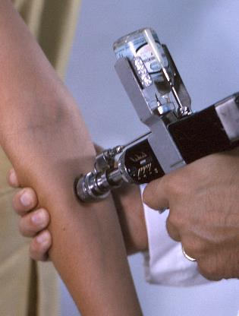
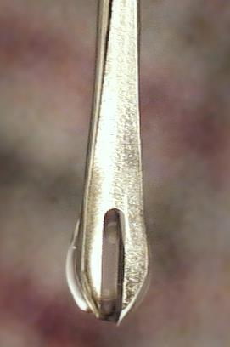
Smallpox and CDC
Smallpox Vaccinations
Vaccine uses live vaccinia virus to stimulate an immune response
Ped-O-Jet (pictured top)
  Foot-driven vaccine injector
  Uses pressure instead of needles to push vaccine just under the skin
  Quick and easy for mass vaccinations
Bifurcated needle (pictured bottom)
  Double-pronged needle that holds vaccine between prongs
  Used to make 15-20 shallow punctures
  Useful for door-to-door vaccinations or working in remote areas
Notes:
During the first year of the West African campaign, 1966-67, an astounding 25 million people were vaccinated against smallpox. The smallpox vaccine is made of live vaccinia virus, a weaker form of poxvirus. Because vaccinia is similar to smallpox, its presence causes an immune system response that also provides smallpox immunity. One challenging aspect of smallpox vaccination is that it must be administered just under the outer skin layer, not with a traditional needle. As such, the U.S. Army developed a tool called the Ped-O-Jet for CDC field use. It was a foot-driven injector that used intense pressure instead of needles to deliver the vaccine to the correct skin layers. The operator used a foot pump to apply pressure, and the vaccine would shoot out into the patient’s skin in only a fraction of a second. It was quick and effective, but it was also large and bulky.
As the eradication strategy changed, mass vaccinations were phased out in favor of house-to-house procedures. Bifurcated needles were developed for the smallpox vaccine as a more portable vaccine delivery tool. The single needle split into two sharp points. These double-pronged needles were dipped in vaccine vials. The vaccine stuck to the space in between the two prongs and was administered to the skin through a series of shallow pokes to the surface of the skin.

Slide 7
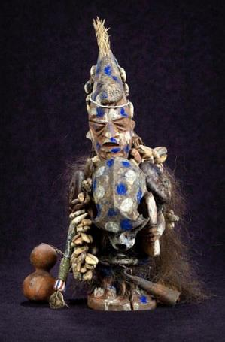

Smallpox and CDC
Understanding culture and religion is an important part of solving outbreaks
Shapona, Yoruban god of smallpox
  Given control of earth by his father
  Grains coming out of the skin (pox) were a sign of his displeasure
  Decorated with monkey skull, cowrie shells, and a bush porcupine tail
Shitala Mata, Hindu goddess of smallpox
  Her spilled grain became smallpox
  Affected people survived if she used her water pitcher to wash away pox but did not if she used her broom
Notes:
Cultural and Religious Considerations in Public Health
Approaching global public health issues requires an understanding of local cultural and religious practices that may impact the way in which measures are received. Strong partnerships with locals make for more effective interventions. In the case of smallpox, religion played a role in eradication.
In Nigeria, Shapona is the god of smallpox, worshipped among the Yoruba people. Shapona was given control of the earth by his father. He nourished humans by giving them all the grains of the earth, but when he punished, he caused those grains people had eaten to come out on their skins. Thus, smallpox was an indication of divine displeasure. The statue of Shapona is traditionally decorated with a monkey skull, cowrie shells, and the tail of a bush porcupine. The figure pictured was commissioned in 1969 to commemorate the efforts of public health officials and to remind us of the challenges CDC faces in adapting to and respecting local beliefs as it fulfills its global mission.
In Hinduism, Shitala Mata is the dreaded goddess of smallpox. She holds a pitcher of water in one hand and a broom in the other. It is believed that whenever Shitala Mata shakes her head, she spills grain and each grain turns into a smallpox pustule, leading to an outbreak of the disease. Affected people survived if she used the water from her pitcher to clean the spilt grain; they did not survive if she used her dry broom. Representations of Shitala Mata could be found in shrines dedicated to her around the countryside in northern India.

Slide 8
Think About It
What role does communication play in eradicating a global disease?
Why did the tools used for vaccinations change over time?
Why must epidemiologists always consider cultural and religious factors when developing plans to stop an outbreak of disease?

Slide 9

From the Expert
https://youtu.be/FZY3aHKigDU
Notes:
From the Expert:
May 8, 2020 marked the 40th anniversary of the declaration of smallpox eradication. Listen to a clip from this date in which Dr. Tedros Adhanom Ghebreyesus, World Health Organization Director-General, speaks about the monumental achievement that is smallpox eradication. Looking ahead to current and future public health threats, we must still remember and apply the lessons learned during the smallpox campaign.

Slide 10
Think About It
Why are vaccines so important in stopping a disease epidemic/pandemic?
In the video, Dr. Tedros issued a rallying cry for nations to come together to defeat COVID-19 just as we did to beat smallpox. How do you think we are doing?
What training would you suggest for public officials learning to stop outbreaks?

Slide 11
Give it a Try
Call to Action!
Solve the Outbreak
Write a Field Handbook or Case Study
Share Your Findings
Why do you think participation is important?
Notes:
Call to Action
1. Solve the outbreak. Smallpox was eradicated through the hard work of thousands of individuals working together with a common goal using the principles of epidemiology. These disease detectives used data to stop outbreaks. Now it’s your turn! Use CDC’s Solve the Outbreak game to stop up to 20 outbreaks using disease surveillance.
2. Write a field handbook or case study. After solving the outbreaks, you have a choice of product. Option 1: Write a field epidemiology manual for new disease detectives describing the strategies you used to solve the outbreaks. Option 2: Write a case report for one of the 20 investigations you completed.
3. Share your findings. One of the ways CDC communicates information is through social media. Your demonstrations can help CDC communicate the work they have done to eradicate smallpox across the globe.
Why Participate?
Although smallpox no longer occurs naturally, the threat of smallpox remains. There are concerns that variola virus, the virus that causes smallpox, may exist outside of the two World Health Organization (WHO)-designated collaborating centers in the United States and Russia. The risk for an intentional or accidental release of the smallpox virus is believed to be low, but the effects of such an event could be devastating. These potential consequences make planning for a smallpox emergency critical. In a smallpox emergency, the entire community would need to respond in a coordinated and planned manner. No single organization could take care of the sick, stop the spread of disease, deliver supplies, give vaccinations, and handle everything else that would be required. Partnerships within communities and across regions would be essential to a successful response. https://www.cdc.gov/smallpox/bioterrorism-response-planning/index.html

Slide 12
Use the
Public Health Approach
Surveillance
What is the problem?
Risk Factor Identification
What is the cause?
Intervention
What works?
Implementation
How did we do it?

Slide 13
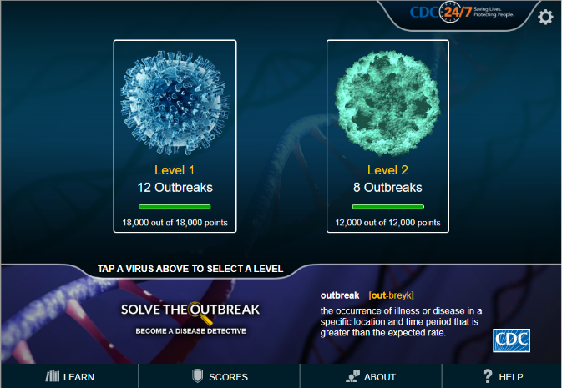
Give it a Try
1. Solve the Outbreak
Epidemic Intelligence Service (EIS) investigates disease outbreaks
Become an EIS disease detective and investigate outbreaks using the
Solve the Outbreak game from CDC
Notes:
Solve the Outbreak
Although smallpox has been globally eradicated, many other infectious diseases that could potentially be eradicated, such as measles and polio, have not. The epidemiology principles used on smallpox are currently being used worldwide to eradicate diseases like polio and to control outbreaks of other diseases that cannot be eradicated due to the presence of disease reservoirs. Training programs on these principles are needed to prepare healthcare workers and other public health officials in epidemiology.
The Epidemic Intelligence Service (EIS) was created in 1951. Originally part of the U.S. government’s efforts to detect biological warfare during the Korean War, its success in detecting and responding to outbreaks led to it continuing today. Now, it is a 2-year training program for health professionals interested in the practice of applied epidemiology, or the study of diseases in populations. During their time at CDC, these professionals are called EIS officers. EIS Officers earned the nickname of “disease detectives” because they practice “shoe-leather” detective work, wearing down their shoes as they go door-to-door to investigate outbreaks.
CDC has created a disease detective game for students to solve disease outbreak mysteries. You will study a disease outbreak just as an EIS officer would and determine a plan to treat the affected individuals and to stop the outbreak from spreading. There are 20 different outbreaks for you to explore. See how many you can complete!
https://www.cdc.gov/mobile/applications/sto/web-app.html

Slide 14
Give it a Try
2. Write a Field Handbook or Case Study
Use the public health approach to outbreak investigation
  Surveillance
  Risk factor identification
  Intervention evaluation
  Implementation
Summary Option 1: Field guide handbook
  Summarize the general steps of outbreak case investigation
Summary Option 2: Case study report
  Summarize the details of one of the outbreak case
Notes:
Write a Field Handbook or Case Study
You have two possible summary projects to choose from for this task: write a field handbook for epidemiologists or write a case study for one of the cases you explored. Though each of the 20 cases is very different, they do have things in common. Using their disease detective skills, epidemiologists can systematically narrow down the possibilities to isolate the pathogen or other agent responsible. The public health approach has four general steps:
Surveillance – What is the problem?
Risk factor identification – What is the cause?
Intervention evaluation – What works to solve the problem?
Implementation – How will you solve the problem?
As you reflect on the cases, how did you use these four steps to stop the disease in its tracks?
You may choose to make a physical handbook or a digital one. Whichever format you choose, be prepared to share it with others.
Option 1: Field Handbook
While you were working your way through the cases, you gained skills that helped you solve the outbreaks. This task asks you to write a field handbook for epidemiologists that summarizes what you learned to help those who come after you.
In your handbook, you will also want to include:
Interview Guidelines: Who should you interview? What information do you need to collect?
Analyzing Interview Data: Once you have completed interviews, how do you analyze the data?
Attack Rate: How do you calculate the attack rate? How do you use it to identify the source of the illness?
Epidemic Curves: Why might you want to make an epi curve? What can it tell you?
Identifying the Cause(s): What steps might you take to identify the cause using the data you have collected?
Stopping the Spread: How do you work with organizations in the area to implement your plan to stop the spread?
Preventing Further Cases: What other measures might be needed to prevent the outbreak from reoccurring?
Option 2: Case Study Report
Reporting your findings after investigating a disease outbreak is a critically important task. The next time an outbreak of this disease occurs, case notes from previous outbreaks can prove to be valuable tools for preventing illness and saving lives.
Choose one of the available outbreak case studies and create a summary report.
Summary: Start with a quick 2-3 sentence intro summarizing the entire case study.
Affected Individuals: Who was affected? How many people? Describe their demographics.
Symptoms: What symptoms did the affected individuals show?
Common Factors: What did all the affected individuals have in common?
Data: What tests did you run? What data did you analyze? Include screenshots of tables or graphs used.
Cause: What did you determine to be the cause of this outbreak?
Treatment Plan: How did you treat the affected individuals? Did they survive?
Prevention Plan: What measures were put in place to prevent this from happening again?

Slide 15
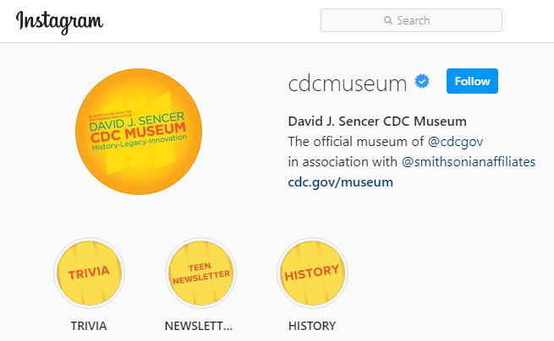
Give it a Try
3. Share Your Findings
Instagram @CDCmuseum
Notes:
Share Your Findings
The David J. Sencer CDC Museum uses award-winning exhibits and innovative programming to educate visitors about the value of public health and presents the rich heritage and vast accomplishments of CDC. Your demonstration could be a valuable contribution! Share your demonstration with the CDC Museum on Instagram using @CDCmuseum.

Slide 16

Questions?

