Slide 1




Focusing on Health Equity
Notes:
CDC’s vision is to create a world where all people – in the United States and around the globe – live healthier, safer, and longer lives, regardless of identity or background. We all have a role to play to address injustices and overcome obstacles to health and health care to achieve health equity.
Note: These slides are made possible by the David J. Sencer CDC Museum Public Health Academy. https://www.cdc.gov/museum/education/lessons/

Slide 2
Terms to Know
 | preventable difference in the burden of disease, injury, violence, or opportunities to achieve optimal health
 | when factors like education, income, gender, environment, and ethnicity cause unfair differences in health outcomes
 | the human-made environment where people live, work, and play each day
 | when everyone has the opportunity to be as healthy as possible
 | the science of protecting and improving the health of people and their communities
 | the conditions in which people live, work, learn, and play; these can contribute to health inequities
Word Bank
built environment
disparity
health equity
health inequity
public health
social determinants of health
Notes:
Terms to Know
Built environment - the human-made environment where people live, work, and play each day
Disparity - preventable difference in the burden of disease, injury, violence, or opportunities to achieve optimal health
Health equity - when everyone has the opportunity to be as healthy as possible
Health inequity - when factors like education, income, gender, environment, and ethnicity cause unfair differences in people’s health
Public health - the science of protecting and improving the health of people and their communities
Social determinants of health - the conditions in which people live, work, learn, and play; these can contribute to health inequities

Slide 3
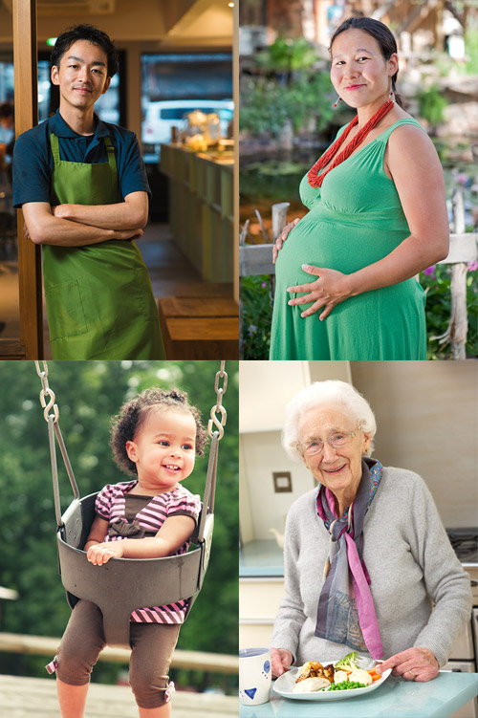
Understanding Health Equity
Health equity is achieved when no one is disadvantaged from achieving their full health potential because of social position or other socially determined circumstances.
Health equity affects:
  Length of life
  Quality of life
  Rates of disease, disability,
  and death
  Severity of disease
  Access to treatment
Racial and ethnic minority groups
are often disproportionately
affected by health inequities
Notes:
What is Health Equity?
Health equity is achieved when no one is disadvantaged from achieving their full health potential because of social position or other socially determined circumstances. Health inequities are reflected in differences in length of life; quality of life; rates of disease, disability, and death; severity of disease; and access to treatment. Recently, the population health impact of COVID-19 has exposed longstanding inequities that have systematically undermined the physical, social, economic, and emotional health of racial and ethnic minority populations and other population groups that are bearing a disproportionate burden of COVID-19. Achieving health equity requires valuing everyone equally with focused and ongoing efforts to address avoidable inequities, historical and contemporary injustices, and the elimination of disparities in health and healthcare.

Slide 4

Think About It
What are a few reasons why a person might not go to the doctor?
How often do you go outside? Do you think this affects your health?
How far do you have to travel from your home to find a store that sells affordable fresh vegetables, meat, and fruit? Could you get there on foot or by public transportation if you needed to? Use an online map if you need help.

Slide 5
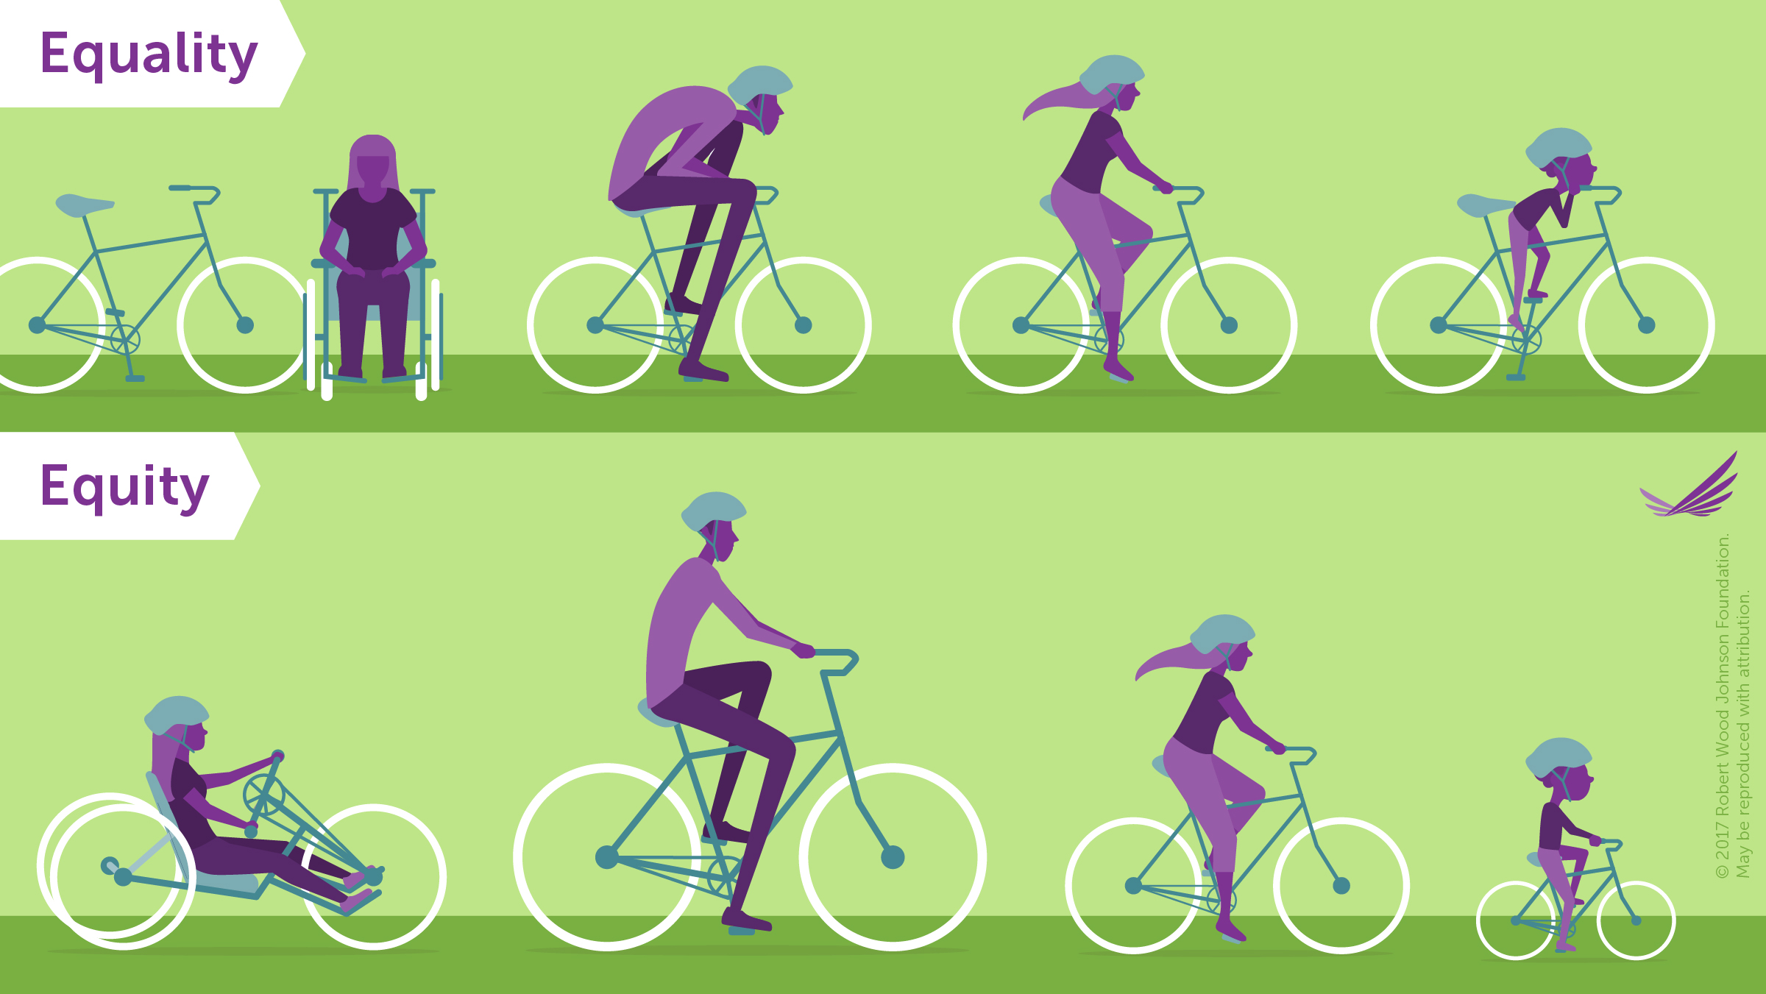
Health Equity and CDC
Health equity means that each person gets what they need to achieve optimal health. Some people need more than others to reach the same level of health.
Disparities are differences in health outcomes that may arise due to health inequities.
Notes:
Health Equity and the Centers for Disease Control and Prevention (CDC)
Equity and equality are not the same thing. In the cartoon, the equality example shows four people who are all given the same bicycle. The child can’t reach the pedals, the man is hunched over with his knees at his chest, and the person who uses a wheelchair cannot ride at all. Only the woman can comfortably use the bicycle. Equal distribution of resources has not produced equal outcomes. However, in the equity example, all riders were provided bikes that match their sizes and abilities. When provided with specialized bikes that were tailored to their needs, everyone was able to achieve the same outcome.
Social determinants of health are factors that can include social, economic, and environmental conditions in a person’s life that have an impact on a person’s health. These conditions can cause differences in people’s health for different groups of people, known as called health disparities. An example could be higher incidence of lung diseases among persons who smoke. This difference is based on a controllable behavior. When the disparities are caused by social determinants of health, they often result in health inequities, where one group is unfairly disadvantaged compared to another. An example is that Black women are three times more likely than White women to die from pregnancy-related causes. Correcting health inequities often requires rebuilding entire systems to fix discriminatory imbalances.

Slide 6
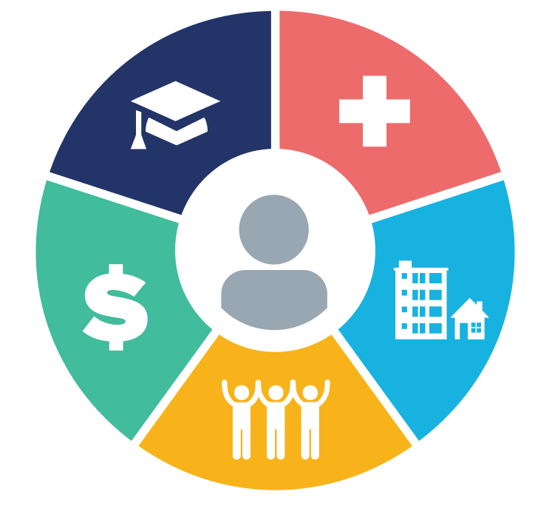
Health Equity and CDC
Social determinants of health are factors that can include social, economic, and environmental conditions in a person’s life that have an impact on their health.
  Healthcare Access and Quality
  Education Access and Quality
  Social and Community Context
  Economic Stability
  Neighborhood and
  Built Environment
Addressing these factors can help improve overall health
Notes:
Healthcare Access and Quality
In the United States, having access to healthcare often begins with having health insurance. Without insurance, many people do not have access to preventive medicine that can catch growing health issues early. People who live in rural or lower income areas often do not have access to health and dental providers simply because there are none in the area. Access to healthcare is also limited for people with limited English proficiency. Reliance on emergency rooms for basic medical care puts strain on the healthcare system, lengthens wait times for people with medical emergencies, and costs more money than preventive care does.
Education Access and Quality
People with higher levels of education are most likely to be healthier and live longer. Children from low-income families, children with disabilities, and children who routinely experience forms of social discrimination, like bullying, are more likely to struggle with math and reading. They’re also less likely to graduate from high school or go to college. This means they’re less likely to get safe, high-paying jobs and more likely to have health problems like heart disease, diabetes, and depression. In addition, some children live in places with poorly performing schools, and many families can’t afford to send their children to college. The stress of living in poverty can also affect children’s brain development, making it harder for them to do well in school. Access to quality early childhood education programs, which have been shown to increase school performance, is limited for children who live in poverty. Interventions to help children and adolescents do well in school and help families pay for college can have long-term health benefits.
Social and Community Context
People’s relationships and interactions with family, friends, co-workers, and community members can have a major impact on their health and well-being. Many people face challenges and dangers they can’t control, like unsafe neighborhoods, discrimination, or trouble affording the things they need. This can have a negative impact on health and safety throughout life. Positive relationships at home, at work, and in the community can help reduce these negative impacts. But some people, like children whose parents are in jail and adolescents who are bullied, often don’t get support from loved ones or others. Interventions to help people get the social and community support they need are critical for improving health and well-being.
Behavioral interventions for parents and children can help foster communication between them. Increasing healthy interactions between parents and children, such as reading bedtime stories, allows for more open and positive communication skills to develop. Improving outcomes for bullied students and children in foster care
Economic Stability
In the United States, 1 in 10 people lives in poverty. Many people can’t afford things like healthy foods, health care, and housing. People with steady employment are less likely to live in poverty and more likely to be healthy, but many people have trouble finding and keeping a job. People with disabilities, injuries, or conditions like arthritis may be especially limited in their ability to work. In addition, many people with steady work still don’t earn enough to afford the things they need to stay healthy. Employment programs, career counseling, and high-quality childcare can help more people find and keep jobs. In addition, policies to help people pay for food, housing, health care, and education can reduce poverty and improve health and well-being.
Neighborhood and Built Environment
The neighborhoods people live in have a major impact on their health and well-being. Many people in the United States live in neighborhoods with high rates of violence, unsafe air or water, and other health and safety risks. Racial/ethnic minorities and people with low incomes are more likely to live in places with these risks. In addition, some people are exposed to things at work that can harm their health, like secondhand smoke or loud noises. Interventions and policy changes at the local, state, and federal level can help reduce these health and safety risks and promote health. For example, providing opportunities for people to walk and bike in their communities — such as adding sidewalks and bike lanes — can increase safety and help improve health and quality of life.

Slide 7
Think About It
How does education access and quality connect to other categories of social determinants of health?
Describe four reasons why someone might be unable to get medical care.
Generational poverty occurs when two or more generations of a family live in poverty. Why do you think the cycle of poverty is so hard for families to break?

Slide 8
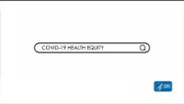
From the Experts
https://youtu.be/s8dK3s5xGos
Notes:
From the Experts:
Health equity can be impacted by various factors in the environment. Organizations and communities can help end health inequity by investing in public health and addressing health disparities that affect many, making health equity available for all. The pandemic made disproportionate disparity in communities more visible. Since the beginning of COVID-19, CDC has made gathering data regarding race and ethnicity a focal point. Watch the linked video to see more about how CDC addresses health inequities. https://youtu.be/s8dK3s5xGos
CDC’s Racism and Health page: https://www.cdc.gov/healthequity/racism-disparities/index.html

Slide 9
Think About It
What were some disparities and inequities exposed by the COVID-19 pandemic?
What items, features, and services does a person who uses a wheelchair need in their built environment?
Property taxes are frequently used to pay for improvements and amenities in the built environment. How does this contribute to poorer community health in lower income areas with lower property values and less tax revenue?

Slide 10
Give it a Try
Call to Action!
Examine your built environment
Compare the environments of two different places
Reexamine your built environment
Share your findings
Why do you think participation is important?
Notes:
Call to Action
In order to understand health equity, it is essential that people understand how social determinants of health affect health outcomes for different groups. You can help people by following these steps:
Examine your built environment. Conduct an audit of the built environment in one area of your community using a checklist.
Compare the environments of two different places. Use CDC’s Environmental Justice Dashboard to compare the environmental exposures, community characteristics, and health burden of two areas with different median incomes.
Reexamine your built environment. Use CDC’s Environmental Justice Dashboard to view your community’s data. Then revisit and revise the built environment audit checklist to make it broader and more inclusive.
Share your findings. One of the ways CDC communicates information is through social media. Your demonstrations can help CDC communicate the work they have done and are doing to improve healthy equity.
Why Participate? A Message from CDC
CDC and its partners work to identify and address the factors that lead to health disparities among racial, ethnic, geographic, socioeconomic, and other groups so that barriers to health equity can be removed. The first step in this process is to shine a bright light on the problems to be solved. Providing accurate, useful data on the causes of illness and death in the United States and across the world is a foundation of CDC’s mission and work. Your exploration of health equity and your conversations with peers and community members help to bring these issues to the forefront of the public consciousness. Going forward, we can use your community support to continue the process of addressing and correcting the disparities so that all can live healthy lives.

Slide 11
Use the Scientific Method
Ask
Ask a question
Research
Do background research
Hypothesis
Construct hypothesis
Test
Test with an experiment
Analyze
Analyze data
Draw conclusions
Conclusions
Share
Communicate results
Ask
Ask a question
Research
Do background research
Hypothesis
Construct hypothesis
Test
Test with an experiment
Analyze
Analyze data
Conclusions
Draw conclusions
Share
Communicate results

Slide 12

Give it a Try
1. Examine Your Built Environment
Use a built environment checklist to evaluate a place in your community
You will examine:
  Walkability/Transportation
  Amenities
  Maintenance
  Facilities
Notes:
Examine your Built Environment
Choose an area of your community to study. It could be the downtown area, your trip from home to school, or just a random place you visit. Keep the area small to make sure it is easy to study. The checklist below contains features of healthy, accessible communities. Visit your chosen area and run through this checklist. You can also use street view online mapping tools if you are unable to visit in person.

Slide 13
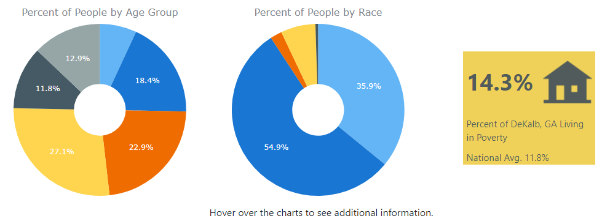
Give it a Try
2. Compare the Environments of Two Different Places
Use CDC’s Environmental Justice Dashboard to collect data on two places with very different median incomes
Evaluate your data and look for disparities that may have arisen due to each of the five social determinants of health
Notes:
Compare the Environments of Two Different Places
Where we live, work, and play affects our health. Environmental justice will be achieved when everyone enjoys the same degree of protection from environmental and health hazards and equal access to the decision-making process to have a healthy environment. Racial and ethnic minority, low-income, and indigenous communities are often disproportionately affected by environmental hazards, such as environmental pollutants and climate-related events. These types of exposures, along with historical injustices, racism, inadequate community design, limited access to resources, and other socio-economic factors, can lead to poor health outcomes, such as increased chronic disease and and complications involving pregnancy and infants.
In this activity, you will use CDC’s Environmental Justice Dashboard to explore data on environmental exposures, community characteristics, and health burden - factors important to understanding and addressing environmental justice issues. https://ephtracking.cdc.gov/Applications/ejdashboard/
On the main dashboard page, scroll down to the map at the bottom. Use the “Median Income” map to locate two areas to compare:
One area with high median income (dark blue)
One area with low median income (yellow)
Scroll over an area, and its name will pop up. Write the names of each place in the chart provided in the lesson documents.
Compare Your Selected Environments
Find information from your charts that represents each of the five social determinants of health.
Health Care Access and Quality
Education Access and Quality
Social and Community Context
Economic Stability
Neighborhood and Built Environment
Compare the data you recorded for the two places you selected.
Propose interventions that might reduce the disparities identified.
Identify any disparities you see and explain how they might affect residents’ health.

Slide 14
Give it a Try
3. Reexamine Your Built Environment
Return to the original place you evaluated and look more closely at it
Think about the environment from different perspectives, not just your own
Notes:
Reexamine your Built Environment
Use the Environmental Justice Dashboard to look up your zip code. Examine the data provided for environmental exposures, community characteristics, and health burden. Pay close attention to the various maps and look for inequities within the larger map area. Add the points of interest layers to the maps. Consider the following questions:
Does the data provided match your preconceived ideas of the place where you live?
When you looked at the smaller map areas, did you notice any inequities?
Where there any points of interest on the maps that surprised you?
How did your town’s data compare to the two places you examined earlier?
Go back to your original checklist and reevaluate with a more critical eye. View the environment from different lenses. What would a person with a visual or hearing impairment need? A person who uses a wheelchair? A person with a lower income? An older adult? A parent with young children? A teenager? Add categories to the checklist to make it more inclusive to all.
What do you think of your community’s built environment? What changes are needed?
If you find yourself really interested in this topic, check out community strategies to improve physical activity from CDC’s Division of Nutrition, Physical Activity, and Obesity.
https://www.cdc.gov/physicalactivity/community-strategies/index.htm

Slide 15
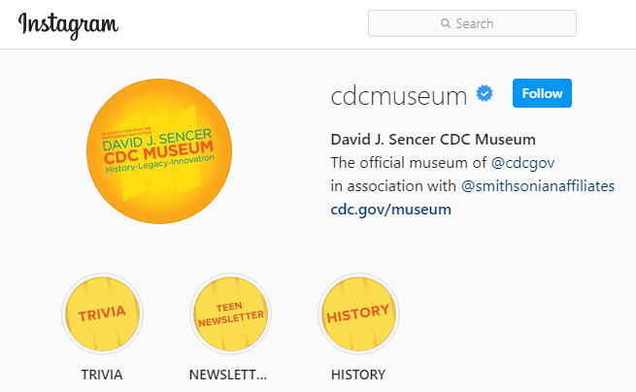
Give it a Try
3. Share Your Findings
Instagram @CDCmuseum
Notes:
Share Your Findings
The David J. Sencer CDC Museum uses award-winning exhibits and innovative programming to educate visitors about the value of public health and presents the rich heritage and vast accomplishments of CDC. Your investigation could be a valuable contribution! Share your results with the CDC Museum on Instagram using @CDCmuseum.

Slide 16

Questions?

