Slide 1
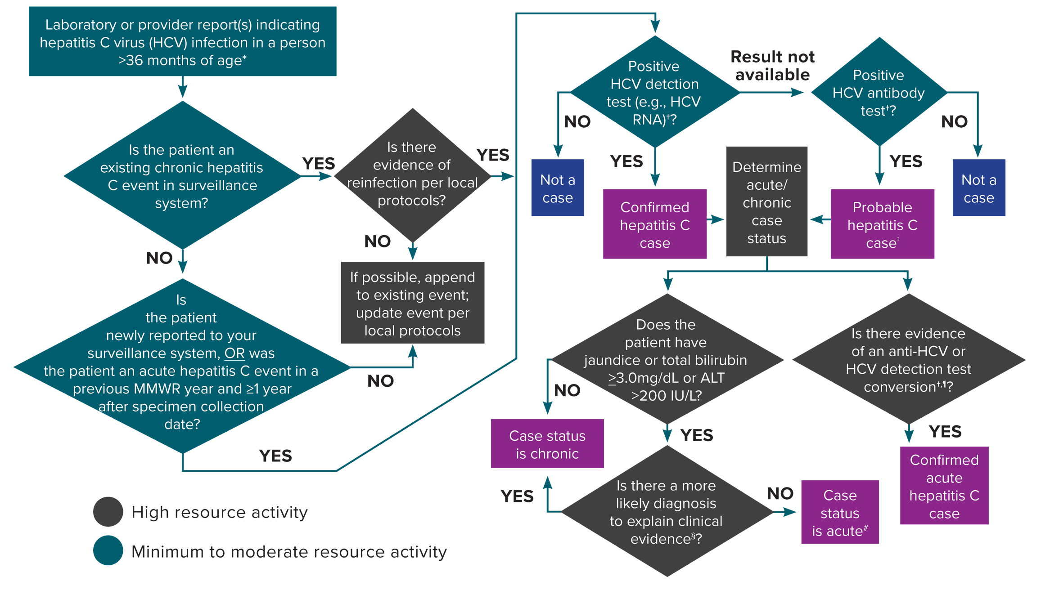
Figure 4-2. Process for acute and chronic hepatitis C case ascertainment and classification
*A child <36 months of age whose mode of exposure is not perinatal (e.g., health care-acquired) should be classified under the 2020 acute or chronic hepatitis C case definition. A child 2–36 months of age whose mode of exposure is perinatal should be classified under the 2018 perinatal hepatitis C case definition.
†Surveillance programs should provide prevention programs with information on people who have positive test outcomes for post-test counseling and referral to treatment and care, as appropriate. HCV detection testing includes nucleic acid testing for HCV RNA (including qualitative, quantitative, or genotype testing) or a test indicating the presence of HCV antigen. At present, no HCV antigen tests are approved by the US Food and Drug Administration (FDA). These tests will be acceptable laboratory criteria, equivalent to HCV RNA testing, when an FDA-approved test becomes available.
‡May re-classify as confirmed if a positive HCV detection test is later received before the National Notifiable Diseases Surveillance System (NNDSS) close-out date for national notification purposes. Jurisdictions with a longitudinal system can update probable cases to confirmed within their system at any time regardless of the NNDSS close-out date.
§May include evidence of acute liver injury from infectious, autoimmune, metabolic, drug or toxin exposure, neoplastic, circulatory or thromboembolic, or idiopathic causes.
¶A documented negative HCV antibody followed within 12 months by a positive HCV antibody test (anti-HCV test conversion) OR a documented negative HCV antibody OR negative HCV detection test (in someone without a prior diagnosis of HCV infection) followed within 12 months by a positive HCV detection test (HCV detection test conversion).
#A new, acute hepatitis C case is either an incident case that has not been previously reported or a case among someone previously reported as having hepatitis C who has laboratory evidence of reinfection⁽¹⁴⁾. Some jurisdictions are creating a local condition specific for reinfection as opposed to creating a new acute condition to maintain a deduplicated registry.
Reference:
14. Council of State and Territorial Epidemiologists. Position statement 19-ID-06: revision of the case definition for hepatitis C. Available at: https://cdn.ymaws.com/www. cste.org/resource/resmgr/2019ps/final/19-ID-06_HepatitisC_final_7..pdf. Accessed on January 16, 2020.
Notes:
Figure 4-2 illustrates an approach for acute and chronic hepatitis C case ascertainment and classification. The flow chart begins with receipt of a provider report, laboratory report, or other report indicating hepatitis C virus infection and walks through follow-up and case classification decisions based on available information. Recommended follow-up activities are color-coded based on if they are minimum-to-moderate resource or high resource activities.

