Slide 1
Advisory Committee on Breast Cancer in Young Women (ACBCYW)
MENTAL/ BEHAVIORAL HEALTH WORKGROUP

Slide 2
Members
Mylin Torres, MD (Workgroup Co-chair) Michele M. Cerullo, JD (Workgroup Co-chair) Shonta Chambers, MSW Ricki Fairley Jean Rowe, LCSW, OSW-C, CJT Marisa C. Weiss, MD

Slide 3
Charge
Provide the Committee with an overview of current issues in mental/behavioral health, including resources, gaps, and evidence-based interventions for young women facing breast cancer.

Slide 4
Approach
Pubmed and web search for evidence and available resources
Interviews with Experts and Thought Leaders in Mental Health and Young Women with Breast Cancer
Brad Zebrack, PhD, MSW, MPH, FAPOS, Professor, University Of Michigan Social Work
Patricia Ganz, MD, Professor of Medicine, Professor of Health Policy and Management, Director of Cancer Prevention and Control Research, UCLA
Ann H. Partridge, MD, MPH, Founder and Director, Program for Young Women with Breast Cancer, Director, Adult Survivorship Program, Professor of Medicine, Harvard Medical School, Dana Farber Cancer Institute

Slide 5
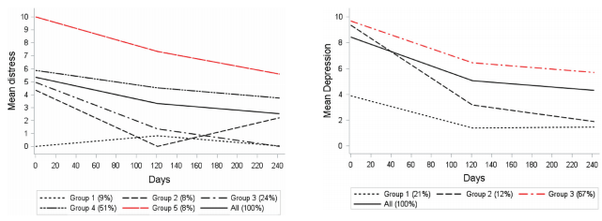
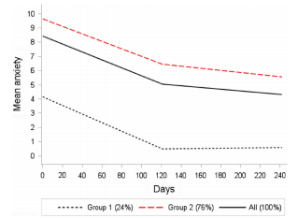
Mental Health Challenges in Young Women with Breast Cancer
Fear of recurrence (~50% of patients 5 years after treatment)
Depression (highest at diagnosis and through treatment, ~26% but some studies indicating ~30% of women with signs of clinical depression 6 years out from treatment)
Anxiety/Distress (Rates improve after completing treatment but impacts ~50% of patients 5 years after treatment; 44% of metastatic patients, associate with physical symptoms)
Stress
Bidstrup et al. Acta Oncologica, 2015

Slide 6
Depression, Anxiety, and Stress
Presence of comorbidities associated with increased risk of depression and anxiety ~3 years after diagnosis
Yang et al. International Journal of Cancer, 2017

Slide 7
Mental Health Challenges in Young Women with Breast Cancer
Survivors may experience moments of depression several years after treatment, some data (personal communication with Dr. Patricia Ganz) to suggest increased rates of attempted suicide 2 years after completing treatment
Fatigue
Sleep Disturbances
Non-specific pain
Childhood trauma impacts ability to cope with diagnosis and treatment
Cognitive dysfunction may be influenced by post-traumatic stress
PTSD symptoms (mean of 3-4) may impact patients at diagnosis (97%), after completion of chemotherapy (62%), and up to 1 year after diagnosis (50%)

Slide 8
Resources
Organization | Primary Link | Services
ABCD (After Breast Cancer Diagnosis) | https://www.abcdbreastcancersupport.org/ | Peer Matching
American Psychological Association | https://www.apa.org/helpcenter/breast-cancer | Reference Find a Psychologist
Association of Oncology Social Workers | www.aosw.org | International professional society with 1400 members. OSWs are often a consistent support and contact with patients
Breastcancer.org | https://www.breastcancer.org/ | Go to for research, information and education
Breast Cancer Now Research and Care Charity (England and Wales) | www.breastcancernow.org | Educational materials for Fear of Recurrence, anxiety, depression
CancerCare | www.cancercare.org | Education, information, support
Cancer.net | www.cancer.net | Education, information, support
Cancer Support Community | www.cancersupportcommunity.org | Education, information, support
Triple Negative Breast Cancer Foundation | https://tnbcfoundation.org/living-with-tnbc/survivorship | Education, information
Dana Farber Young & Strong | https://www.dana-farber.org/young-and-strong-program-for-young-women-with-breast-cancer/ | Education, information, support

Slide 9
Resources
Organization | Primary Link | Services
For the Breast of Us | https://www.breastofus.com/ | Educate, inspire, connect
Friend for Life (cancer support network) | https://www.friend4life.org/ | Peer Matching
Gulf States Young Breast Cancer Survivor Network | https://survivedat.org/history | Education, information, support
Know Cancer | https://www.knowcancer.com/ | Portal Directory
Living Beyond Breast Cancer | https://www.lbbc.org/ | Education, information, support
National Suicide Prevention Lifeline | 1-800-273-8255 | Crisis counseling and support
SHARE | https://www.sharecancersupport.org | Education, information, support
Sisters Network | https://www.sistersnetworkinc.org/ | Education, information, support
Stupid Cancer | www.stupidcancer.org | Education, information, support
Triple Negative Breast Cancer Foundation | https://tnbcfoundation.org/ | Education, information, support
Cancer.gov | https://www.cancer.gov/about-cancer/coping/adjusting-to-cancer/spouse-or-partner | Education, information to address partners, relationships of cancer patients
Susan G. Komen | https://ww5.komen.org/BreastCancer/AboutBreastCancer.html | Education, information to address partners, relationships of cancer patients

Slide 10
Gaps
Lack of patient awareness regarding mental health resources and support services
Lack of provider awareness regarding prevalence of mental health challenges in young women with breast cancer and available mental health resources and support services
Use of mental health resources/support services is low, even among patients who are aware of their availability:
Difficulty finding time and resources to take part in such resources due to competing responsibilities
Feelings of guilt when taking time to take care of themselves when they have children
Research indicates that young women prefer online resources
Unclear who needs resources and when (at diagnosis, during or after treatment)
Under appreciation, lack of research on how many women continue to suffer from mental health issues as survivors
Research on PTSD
Range and variety of mental health challenges based on geographic location (urban vs. rural), race, culture
Lack of research on co-morbidities in these patients, particularly alcohol and opioid use

Slide 11
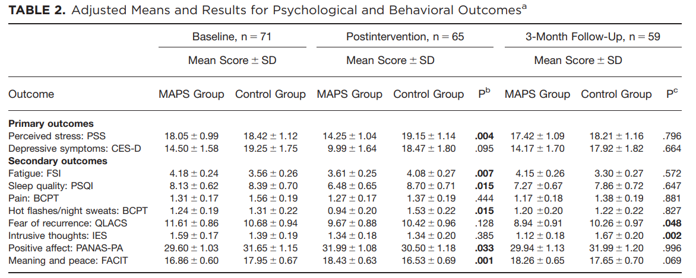
Evidence-based Interventions (Current)
Mindfulness meditation – 6 weekly, 2 hour classes
Cognitive Behavioral Therapy
Greater physical health, yoga, exercise
Better social support/larger social networks – married or partnered women
Better emotional and physical functioning related to QOL
Bower et al. Cancer 2014

Slide 12
Evidence-based Interventions (Current)
Educational information and support provided to partners/family members lowers anxiety, depression, and marital distress
Internet-based interactive content may be effective in providing educational interventions and reach a large number of people
Existing research supports use of psychoeducational support interventions to improve symptoms and emotional wellbeing for 6-12 months
Educational interventions show greater promise than relaxation-based or supportive group therapies
Bower et al. Cancer 2014

Slide 13
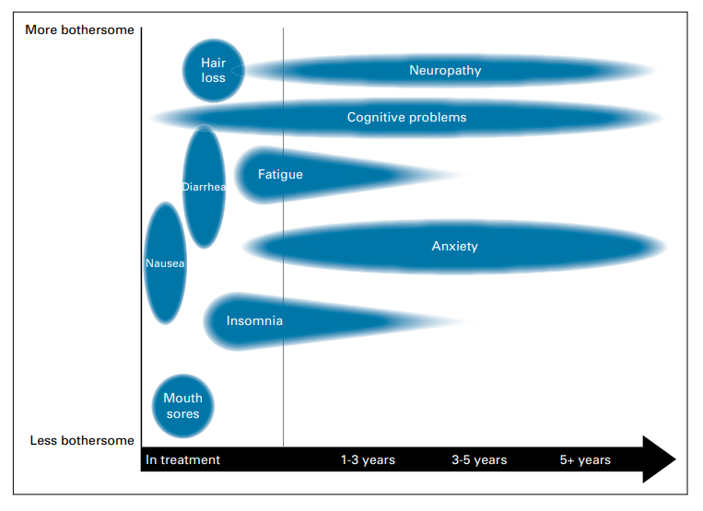
Evidence-based Interventions (Promising)
Enhanced communication with visual tools
Conceptual Diagram of potential treatment effects over time
Brauer et al. JOP 2019

Slide 14
Recommendations
Advocate for screening method to identify high risk patients and survivors for mental health issues; “Ask, advise, refer” (AAR model used by health care providers to assess tobacco use and initiate linkage tobacco cessation support)
Use a short, validated clinical instrument to identify mental health issues in patients and survivors
Routine screening could enhance patient-provider communication
Make appropriate referrals as needed
Funding for Dedicated Research on Mental Health in Young Women with Breast Cancer
Why are mental health issues underutilized?
When is the best time for intervention and what are the best interventions?
What is the best medium for providing help (in-person, online, support groups?)
What is the most effective communication strategy in routine discussions about treatment risks and potential impact on quality of life?
What are long-term outcomes related to treatment effects and accurate post-treatment expectations (need for large, longitudinal studies)?

Slide 15
Thank You

