Slide 1
Cristina M Checka MD
Associate Professor of Breast Surgical Oncology
MD Anderson Cancer Center, Houston TX
Centers for Disease Control and Prevention
Division of Cancer Prevention and Control

Slide 2
Overview
Review statistics and epidemiology
Specific needs faced by young patients
Overview of patient journey
Review minutes and workgroup recommendations from last meeting, Nov 2020
Consider:
Workgroup membership and leadership
Plans for meetings in 2023

Slide 3
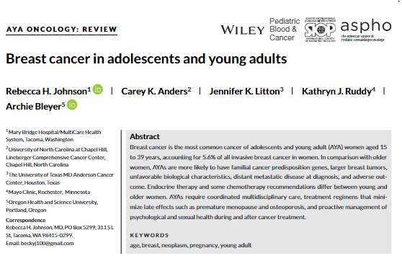
Review Article about Breast Cancer in Young Women

Slide 4
Breast Cancer In Young Women
Defined as in situ and invasive disease occurring in patients younger than 45 years ¹
11% of breast cancer diagnoses occur in women <45 yrs, representing about 26,500 annual cases ¹
AYA ages 15-39 account for 5.6% of all invasive disease ²
Uptick in incidence after age 40 yrs reflects asymptomatic disease detected by screening protocols
Center for Disease Control and Prevention Statistics
Johnson et al, Breast Cancer in Adolescents and Young Adults, 2018

Slide 5
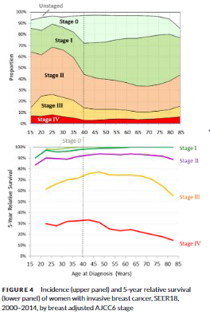
Epidemiology
Compared to older women, young patients tend to present with more advanced disease, including more cases of de novo stage IV disease ¹
Likely reflects unscreened age group
The subset of patients with known high risk (family history or genetic status) undergoing high-risk surveillance tends to present with earlier-stage disease
1. Johnson et al, Breast cancer in adolescents and young adults, 2018

Slide 6
Race and Outcomes
Black women <35 yrs have a higher incidence of invasive breast cancer and a 3x higher mortality, compared to young white women ¹
Advanced stage disease is more common in young patients who are Black, Hispanic, Native American, and in all patients with a lower SES ²
Johnson et al, Breast cancer in adolescents and young women, 2018.
SEER Database

Slide 7
Risk Factors for Breast Cancer in Young Women
Family history of cancer, particularly early-onset disease
Knowledge of personal risk is important
Family pedigree is key
Hormonal: earlier menarche, later age >30 yrs at FFTB, post-partum milieu is a risk for PABC¹
Lifestyle and other personal risk factors:
Mantle XRT, EtOH use², substantial risk associated with increase in BMI after age 18 (2-fold increased risk for ER-negative breast cancer), physical inactivity, diet high in red meats/fast food
Johnson et al, Breast cancer in adolescents and young adults, 2018
Allen et al, Moderate Alcohol Intake and Cancer Incidence in Women, 2009

Slide 8
Issues for Young Women with Breast Cancer
Fertility preservation, including access/cost/options
Premature menopause
Post-surgical reconstruction (including access/cost/options)
Body image
Sexual health
WHO: state of physical, emotional, mental and social well-being in relation to sexuality; not merely the absence of disease or dysfunction
Psychosocial support of mental health
Surveillance
Late effects of treatment
Survivorship

Slide 9
Multimodal Treatment Journey
Screening,
High risk surveillance
Timely diagnosis, access to care
Survivorship
Late effects of treatment
Surveillance
Genetics
Impact on sexuality
Cardiotoxicity
Premature
menopause
Bone density
Neurocognitive
PTSD
Cost, type of studies
Medical gaslighting?
Access to PRS
Impact on sexuality
WELLNESS
Psychosocial support

Slide 10
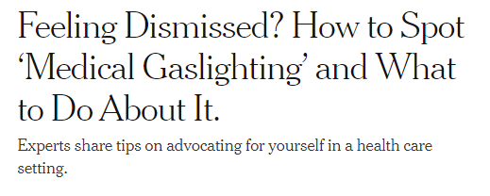
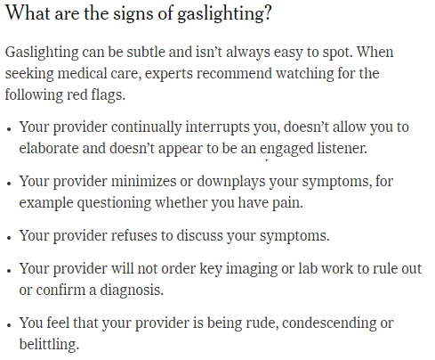
Medical Gaslighting
“I was told I was too young to have cancer.”
“I had to advocate for myself to have a breast biopsy.”
NYT Health, July 29, 2022

Slide 11
Current ACBCYW Workgroups
Mental/ Behavioral Health Workgroup
Provider Workgroup
Sexual Health and Fertility Workgroup
Genetics and Genomics Workgroup

Slide 12
Review of Last Committee Meeting, Nov 2020
CDC Updates:
Bring Your Brave Campaign, launched 2015
CME course co-sponsored with ACOG, “Early Onset Breast Cancer Education Program,” June 2020
Co-sponsored podcast with NSGC (Natl Soc Gen Counselors)
Barriers to Care Presentation (FORCE)
Previous work centered on BRCA carriers now expanded to other high risk patients due to family history and/or other gene mutations
Multigene panel testing has become the SOC, done for $250 or less
USPSTF recommendations do not address all high risk patient needs and carriers who rely on these for coverage decisions may exclude some
Equity lens: nominal cost vs exacerbating cost

Slide 13
Mental/Behavioral Health Workgroup
Work centered on :
1. Extensive literature review
2. primary interviews with patients/SMEs
Major concerns persist even years after active treatment including fear of recurrence, depression, anxiety/stress, and SI, PTSD
Gaps identified re effective uptake of services

Slide 14
Mental Health Workgroup Recommendations

Slide 15
Provider Workgroup
Work centered on (early) impact on COVID-19 on rate of diagnoses, delayed presentation, decreased screening
These effects and outcomes are still being examined in 2022

Slide 16
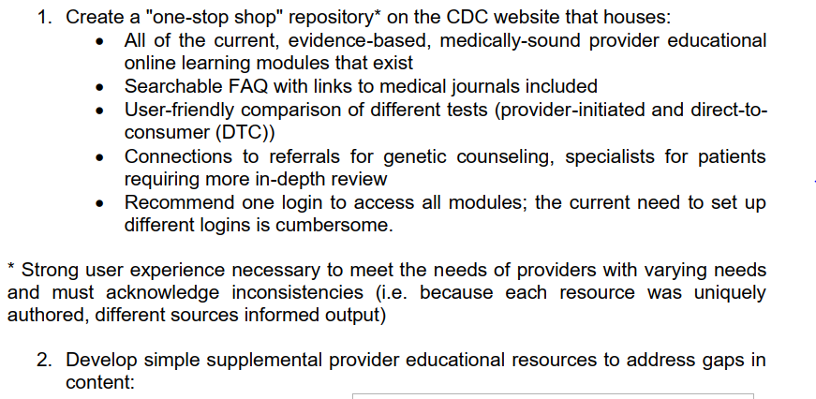
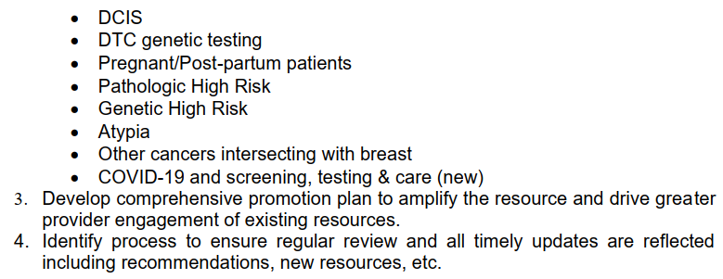
Provider Workgroup Recommendations

Slide 17
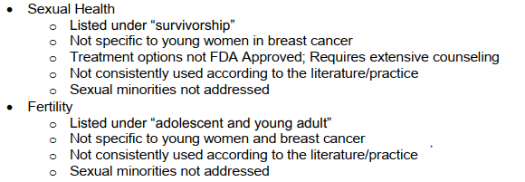
Sexual Health & Fertility Workgroup
Two problems when the group was first formed:
1. Lack of consistent acknowledgement/assessment/interventions offered for sexual health concerns in young women w breast cancer
2. Lack of consistent acknowledgement/assessment/interventions offered for fertility concerns in young women w breast cancer
NCCN guidelines = insufficient (Feb 2020) and lacked advice that would address the nuances of needs in young women

Slide 18
Sexual Health & Fertility Workgroup Recommendations

Slide 19
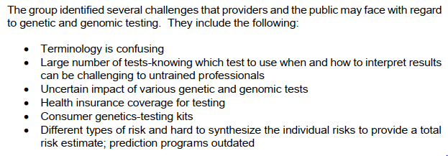
Genetics & Genomics Workgroup

Slide 20
Genetics & Genomics Workgroup Recommendations

Slide 21
Conclusions
Thank you for welcoming me to the group
There is much work yet to be done and our predecessors in the four workgroups have given us meaningful avenues to pursue and continue
As we consider the upcoming Open Discussion, please be thinking about:
Committee membership (and leadership)
Cadence of workgroup meetings
Consider adding 3rd meeting to 2023 calendar
Review attached article for our post-lunch visiting guest speaker

