Slide 1
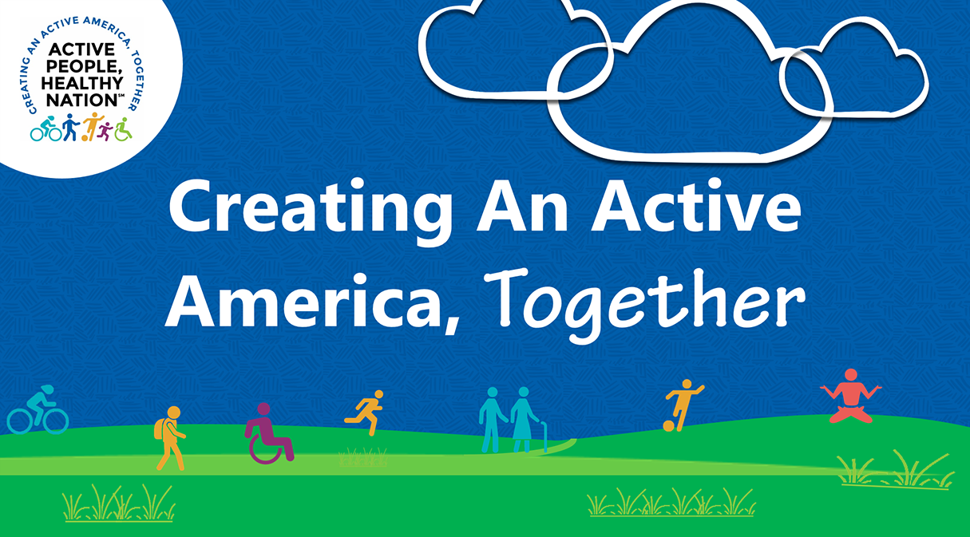

[Insert Organization and/or Presenter Name]
[Insert Date]

Slide 2
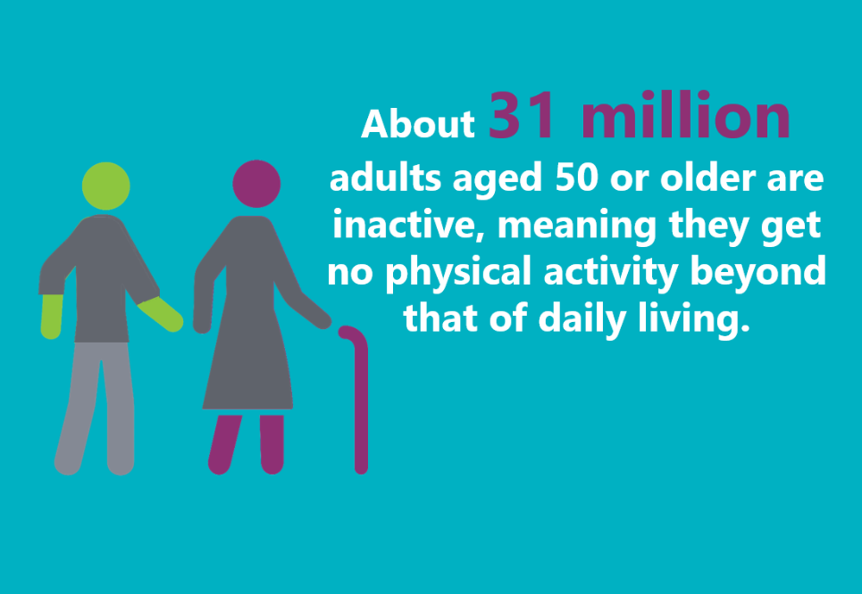
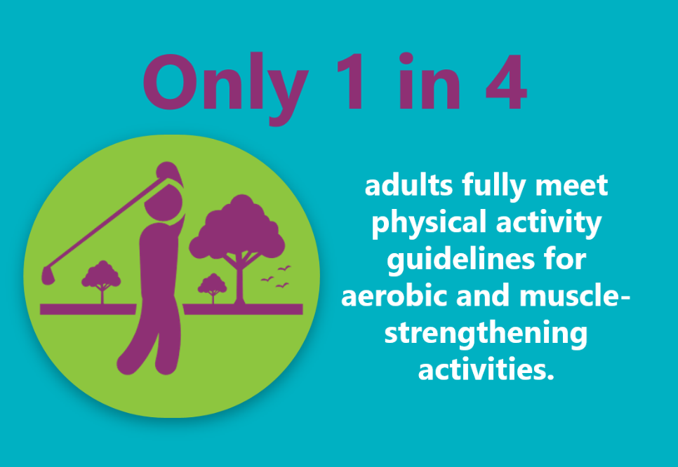
Too Few Americans Get the Recommended Amount of Physical Activity

Slide 3
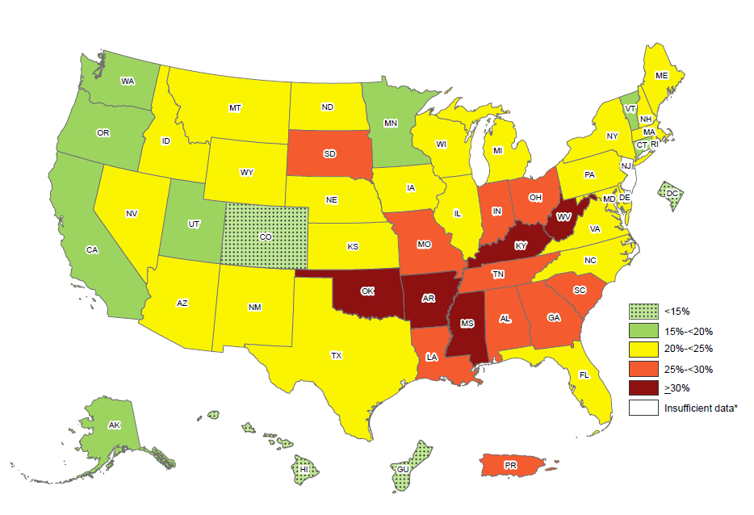
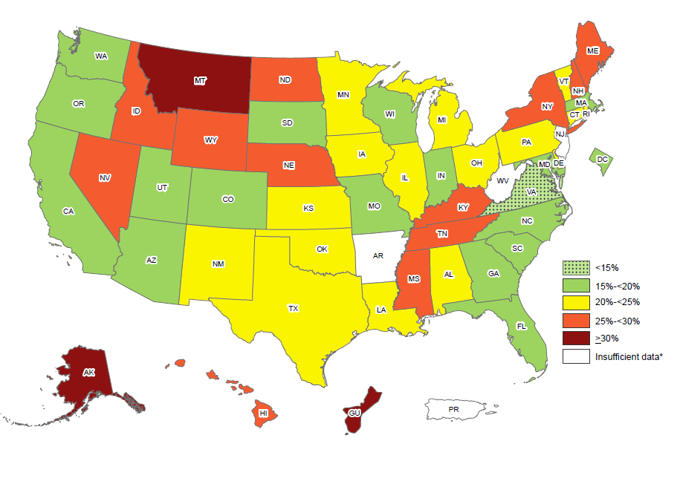
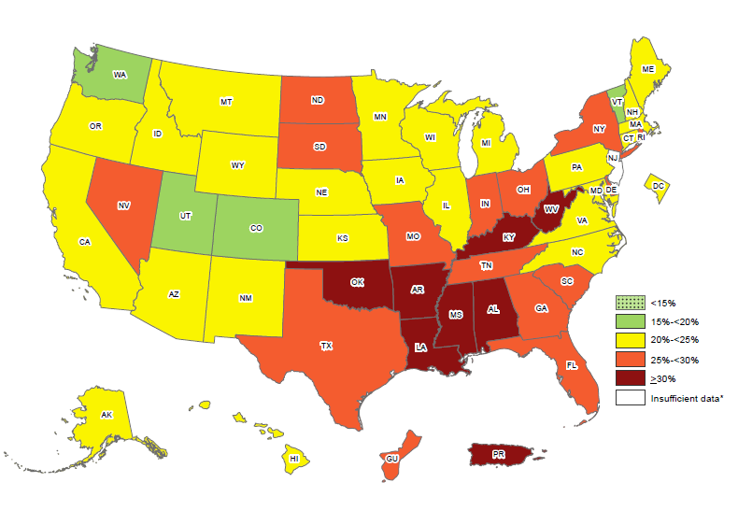
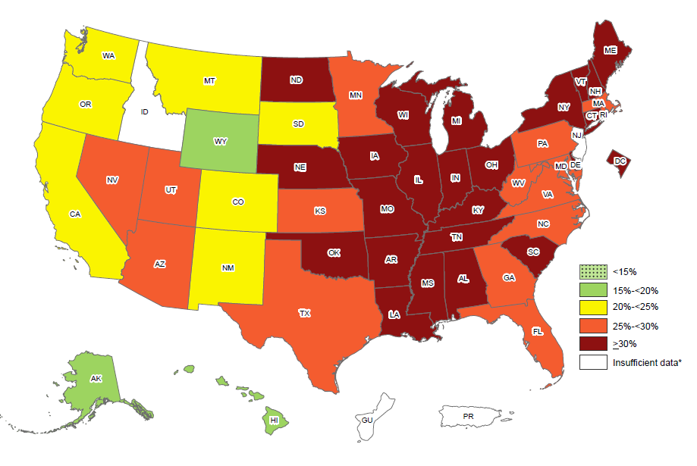
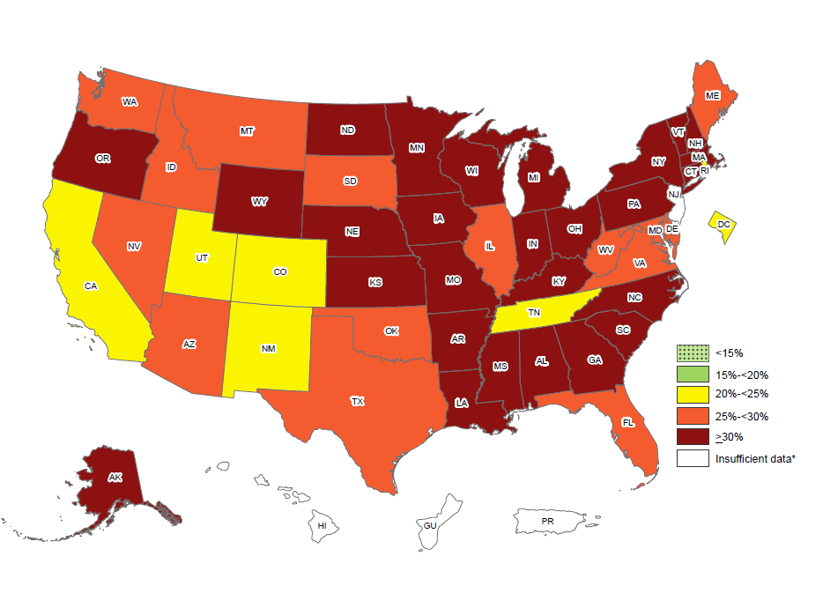
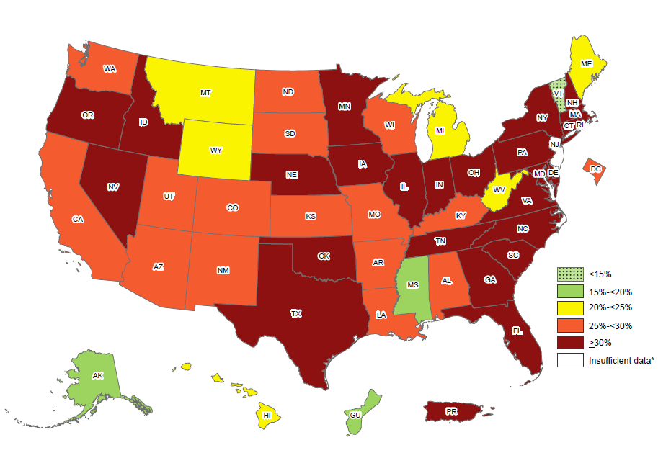
2022 Adult Physical Inactivity Prevalence Maps by Location and Race/Ethnicity
Non-Hispanic White Adults
Asian Adults
Non-Hispanic Black Adults
Non-Hispanic American Indian and Alaska Native Adults
Overall
Hispanic Adults

Slide 4
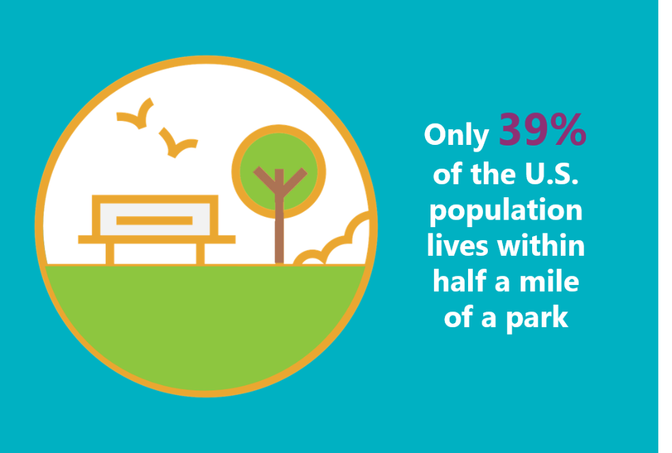
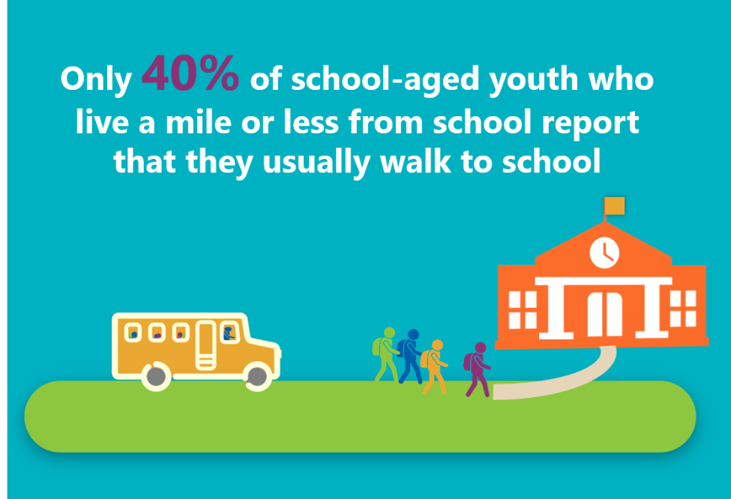
Many Americans Do Not Have Safe or Convenient Places To Be Active

Slide 5
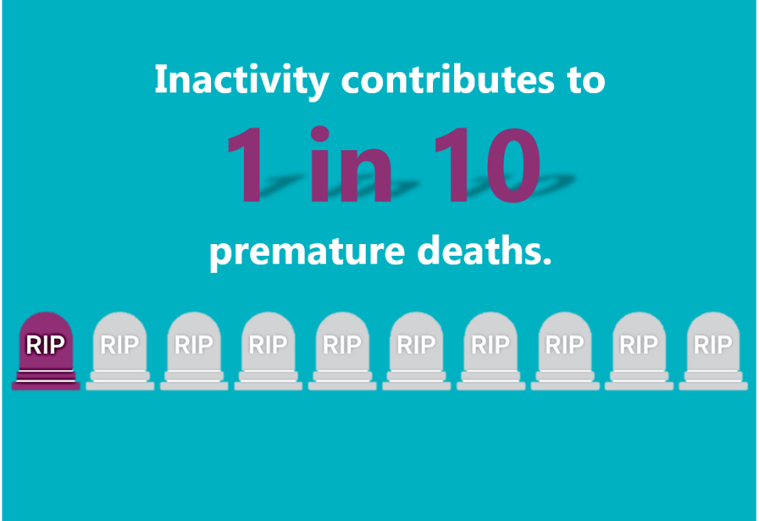
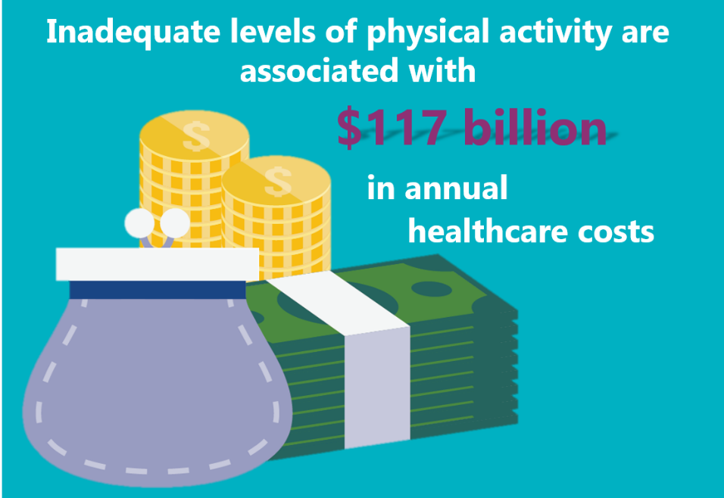
Inadequate Physical Activity and Obesity Costs Lives and Dollars

Slide 6



And Yet…Physical Activity Is One of the Best Things People Can Do to Improve Their Health
Benefits for Children
Improves academic performance*
Reduces risk of depression
Improves aerobic fitness
Improves muscular fitness
Benefits for Adults
Reduces short-term feelings of anxiety*
Improves sleep outcomes*
Lowers risk of high blood pressure Improves mental health
Reduces arthritis symptoms
Prevents weight gain
Benefits for Older Adults
Improves sleep outcomes*
Reduces risk of falling
Extends years of active life
Helps prevent weak bones and muscle loss
Delays onset of cognitive decline
*immediate benefits
Just to name a few…

Slide 7
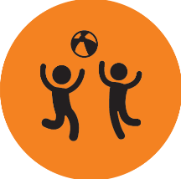

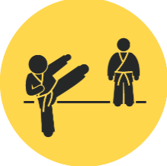

Physical Activity Recommendations by Age Group
Preschool-Aged Children
Adults
Active throughout the day
Adult caregivers encourage active play
Move more and sit less throughout the day
150 to 300 minutes a week of moderate intensity activity
School-Aged Children and Adolescents
Older adults
60 minutes or more of moderate-to-vigorous intensity activity daily
Adult guidelines
Multicomponent activity
*Muscle strengthening activity is recommended for school-age children and adolescents, adults, and older adults.

Slide 8



What if I Told You We Could Help…
$117
Billion
Reduce healthcare spending
Reinvigorate local economies
Improve military readiness

Slide 9
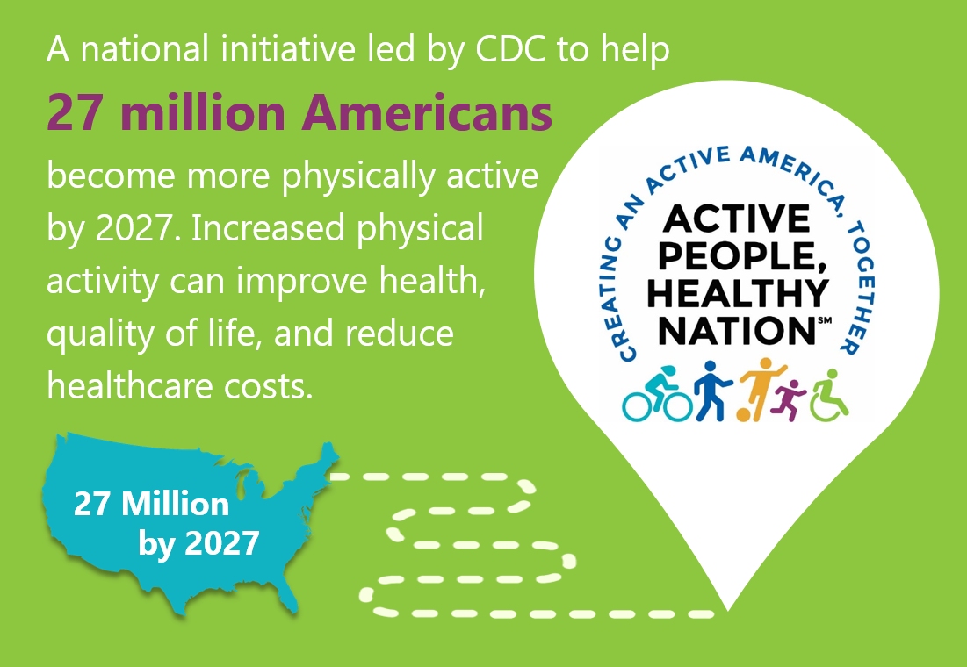
A national initiative led by CDC to help 27 million Americans become more physically active by 2027.
Notes:
[COMMUNITY/ORGANIZATION] is supporting Active People, Healthy Nation, a national initiative to promote physical activity nation-wide.
It is a comprehensive national movement to help 27 million Americans become more physically active by 2027.
This initiative promotes the recommendations from the Physical Activity Guidelines for Americans (2018) and the effective strategies recommended by the Community Preventive Services Task Force (CPSTF) to improve physical activity.

Slide 10
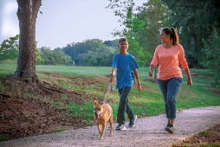
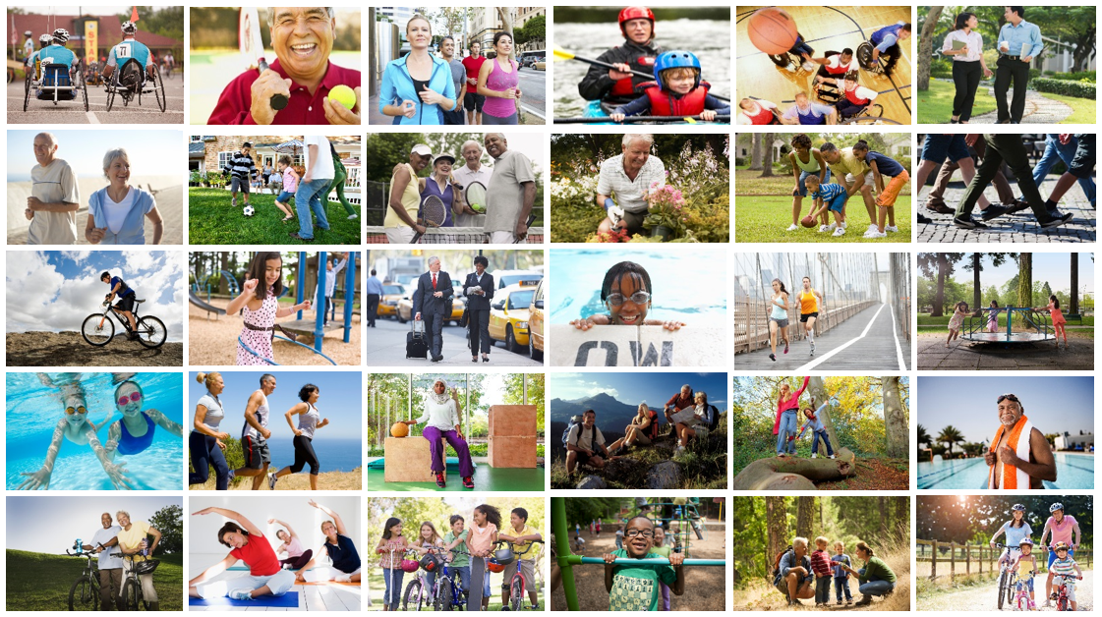
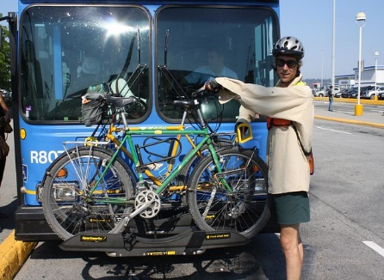
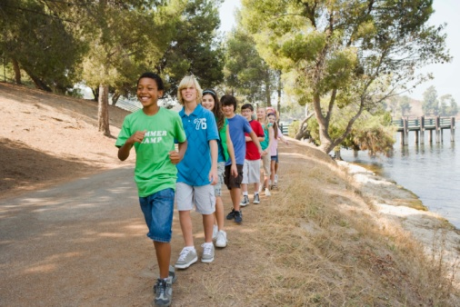

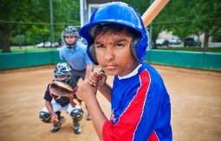
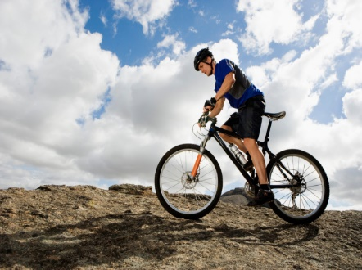
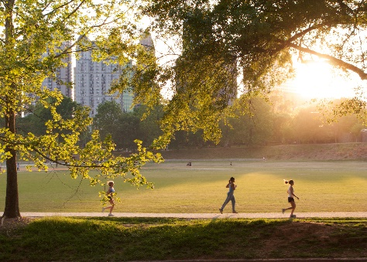
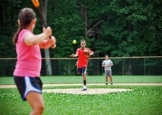
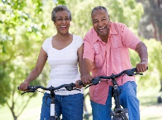

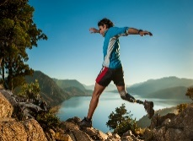
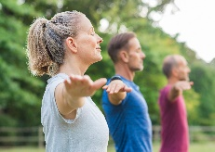

Safe and Convenient Opportunities for
Everyone to be Active

Slide 11
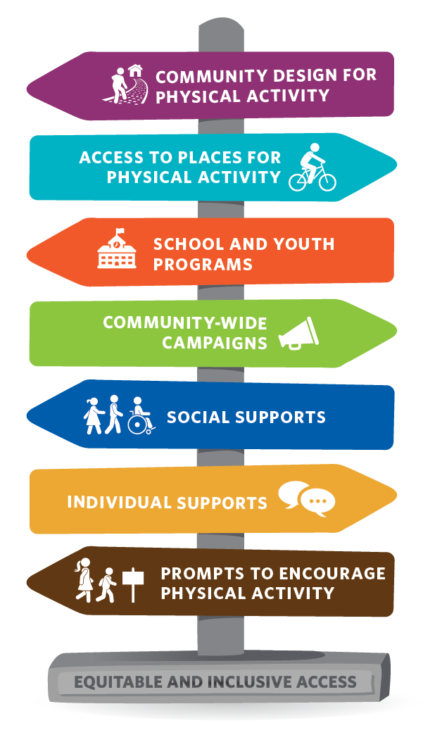
A National Movement

Slide 12
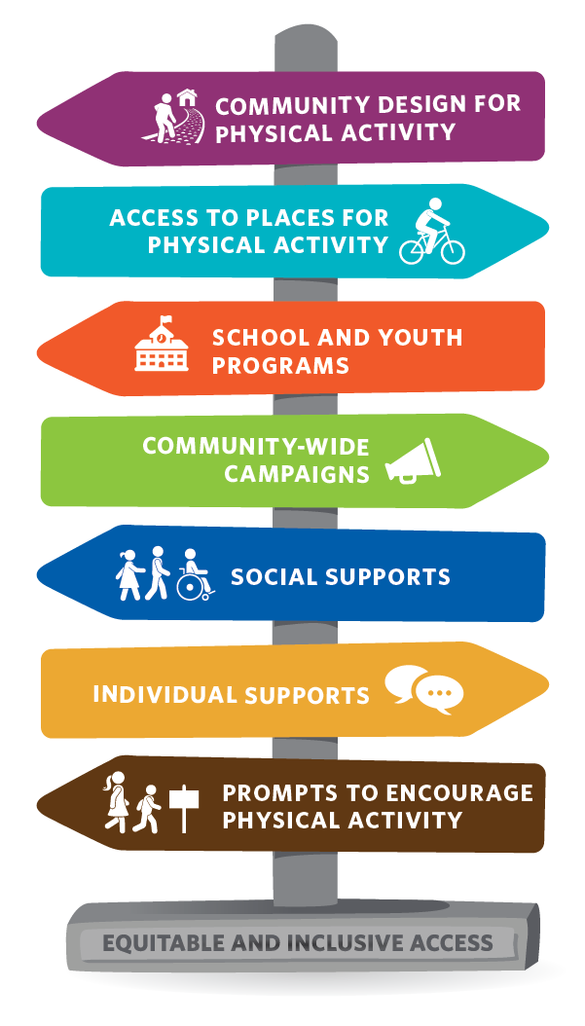
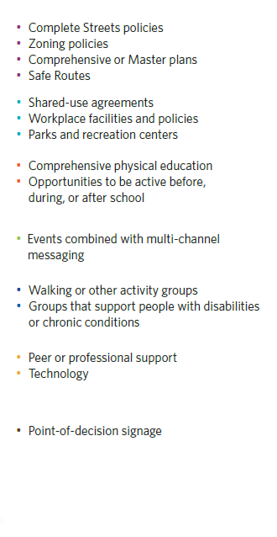
Strategies That Work to Promote
Physical Activity

Slide 13

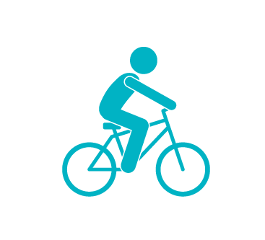

Strategies That Work to Promote
Physical Activity
Community Design for Physical Activity
  Complete Streets policies
  Zoning policies
  Comprehensive or Master plans
  Safe Routes
Access to Safe Places for Physical Activity
  Shared-use agreements
  Worksite facilities and policies
  Parks and recreation centers
School and Youth Programs
  Comprehensive physical education
  Opportunities to be active before, during, or after school
Notes:
[INCLUDE DETAILS ABOUT WHAT THE PRESENTER/ORGANIZATION IS DOING AROUND THESE STRATEGIES.]

Slide 14

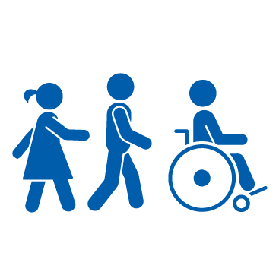


Strategies That Work to Promote
Physical Activity (cont.)
Community-Wide Campaigns
  Events combined with multi-channel messaging
Social Supports
  Walking or other activity groups
  Groups that support people with disabilities or chronic conditions
Individual Supports
  Peer or professional support
  Technology
Prompts to Encourage Physical Activity
  Point-of-decision signage
Notes:
[INCLUDE DETAILS ABOUT WHAT THE PRESENTER/ORGANIZATION IS DOING AROUND THESE STRATEGIES.]

Slide 15



How We Are Partnering to Support Active People, Healthy NationSM
Public Health
Transportation
Land Use and Community Design
Military
Education
Nonprofit
Health Care
Parks, Recreation, and Greenspaces
Employers
Sports and Fitness
Arts and Culture
Mass Media
Notes:
[INCLUDE SECTORS PRESENTER/ORGANIZATION IS WORKING WITH TO IMPROVE PHYSICAL ACTIVITY.]

Slide 16

What You Can Do to Help Build the Momentum
Plan & implement active-friendly routes to everyday destinations
Create places for [INSERT SPECIFIC ACTIONS]
Build support among [INSERT SPECIFIC PARTNER GROUPS]
Promote [INSERT SPECIFIC ACTIONS]
Share messages that encourage physical activity across the lifespan
Include Active People design, hashtags, etc. in own and partner outreach
Notes:
[INSERT DETAILS ABOUT THE WORK BEING DONE BY THE PRESENTER/ORGANIZATION.]

Slide 17
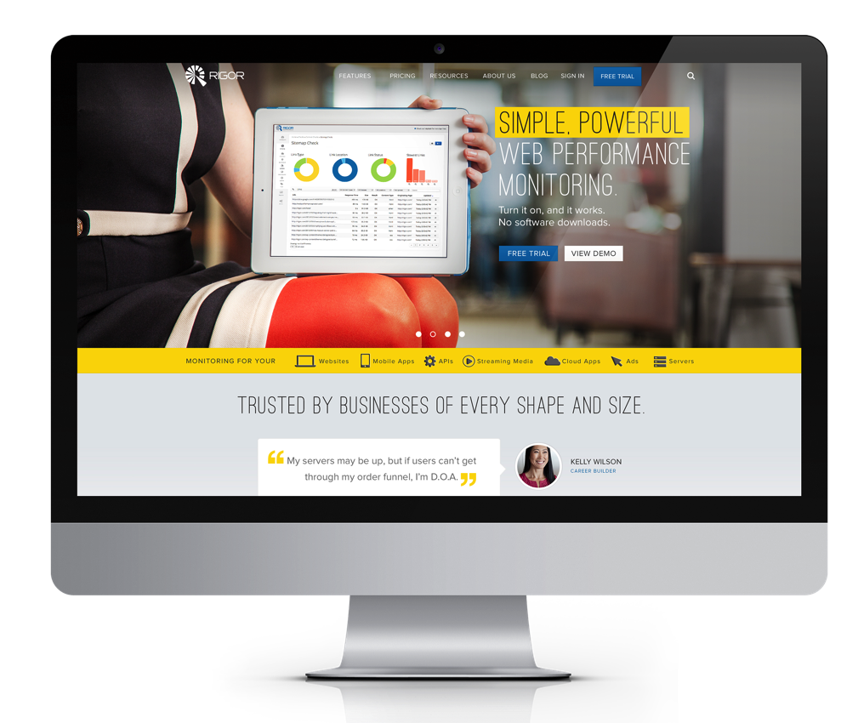
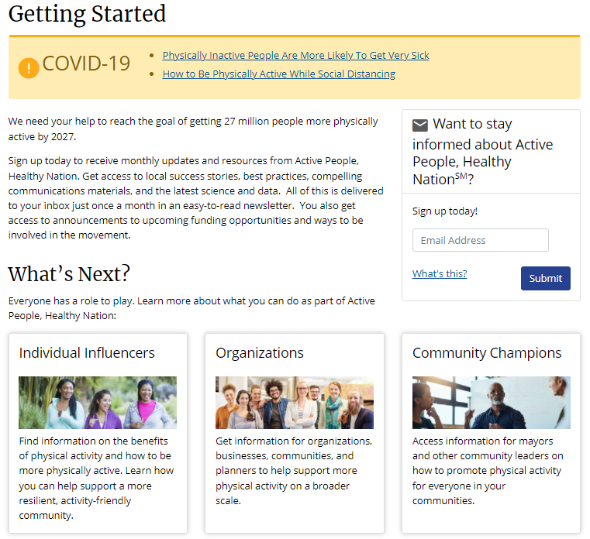
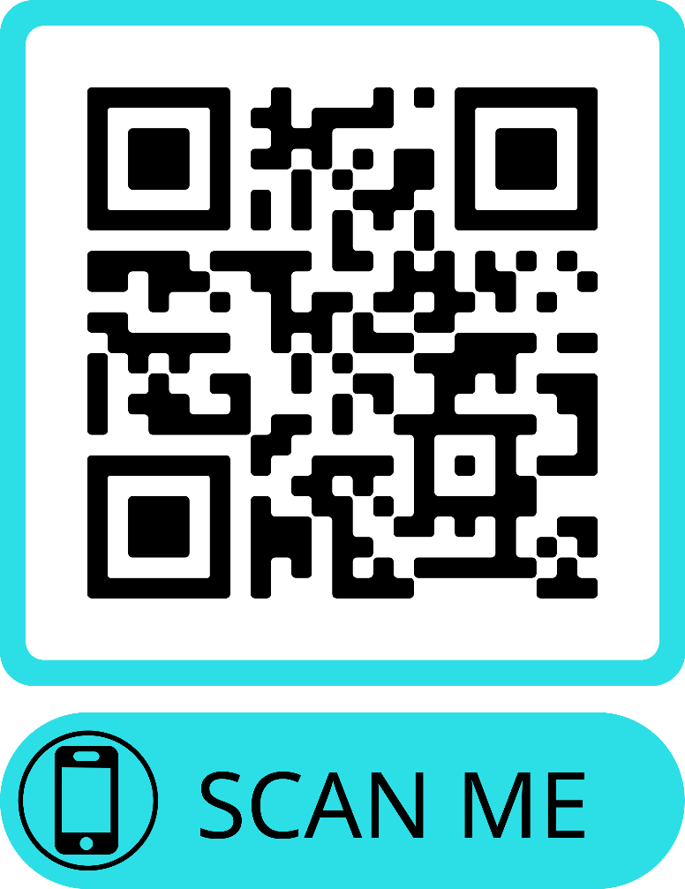
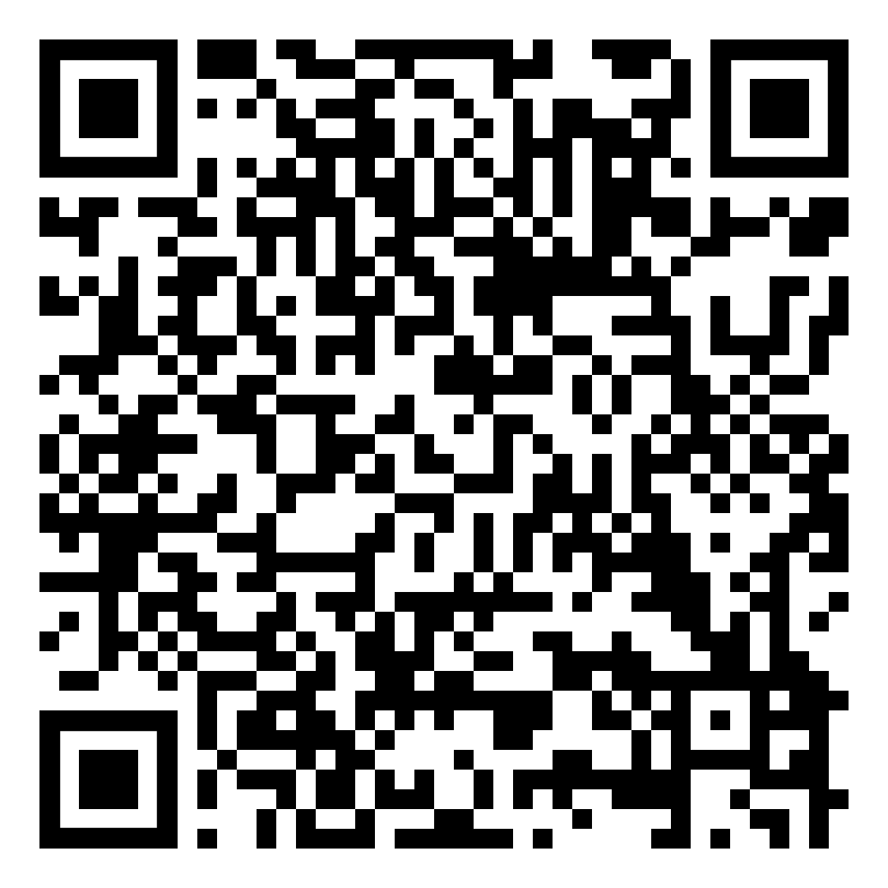
What Can You Do? Sign Up Today!
v
https://www.cdc.gov/physicalactivity/activepeoplehealthynation/getting-started/index.html

Slide 18




Let’s Stay Connected
Visit Active People, Healthy Nation online at:
www.cdc.gov/activepeople
Facebook.com/CDCEatWellBeActive
#ActivePeople
Twitter.com/@CDC_DNPAO
#ActivePeople
ActivePeople@cdc.gov
Notes:
[THIS INFORMATION SHOULD BE UPDATED TO INCLUDE PRESENTER’S CONTACT INFORMATION AS WELL.]

